Slide 1
LOCAL COMMUNITY
DISASTER
PREPAREDNESS
BECOME YOUR OWN
FIRST RESPONDER
Presented by Greg C. Johnston
Travis County Emergency Services District No. 10
This is an editable template WITH FULL PERMISSION

Slide 2
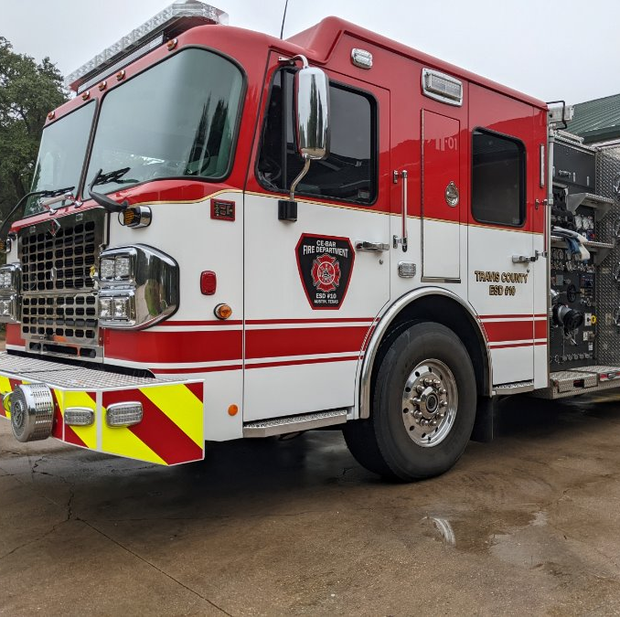
Who We Are
Travis County ESD #10
10 Square Miles
Service 8000 Residents
600 Calls / Year
Various Call Types
4.5 Minute
Response Time

Slide 3
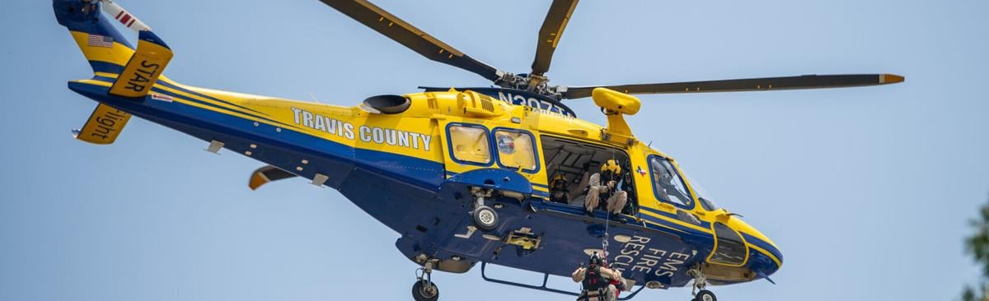
Travis County
Divided into 13 ESDs surrounding the City of Austin
Neighboring departments – Westlake (ESD 9), Lake Travis (ESD 6), Oak Hill (ESD 3), AFD
Auto-aid partnership and response (4-5 agencies for high priority incidents)
Box Alarm – 4 Engines, 2 Trucks, 2 Bat Chiefs
Brush Alarm– 4 Brush Trucks, 2 Engines, 1 Tender, 2 Bat Chiefs
WUI Task Force – 4 Engines, 1 Aerial

Slide 4

(Your)
Facility
Restrooms – Shoulda gone
Water – Shoulda brought it
Break – nah!
Questions/Discussion – Jot ‘em down
Emergency Evacuation – Hurry. Be nice.

Slide 5
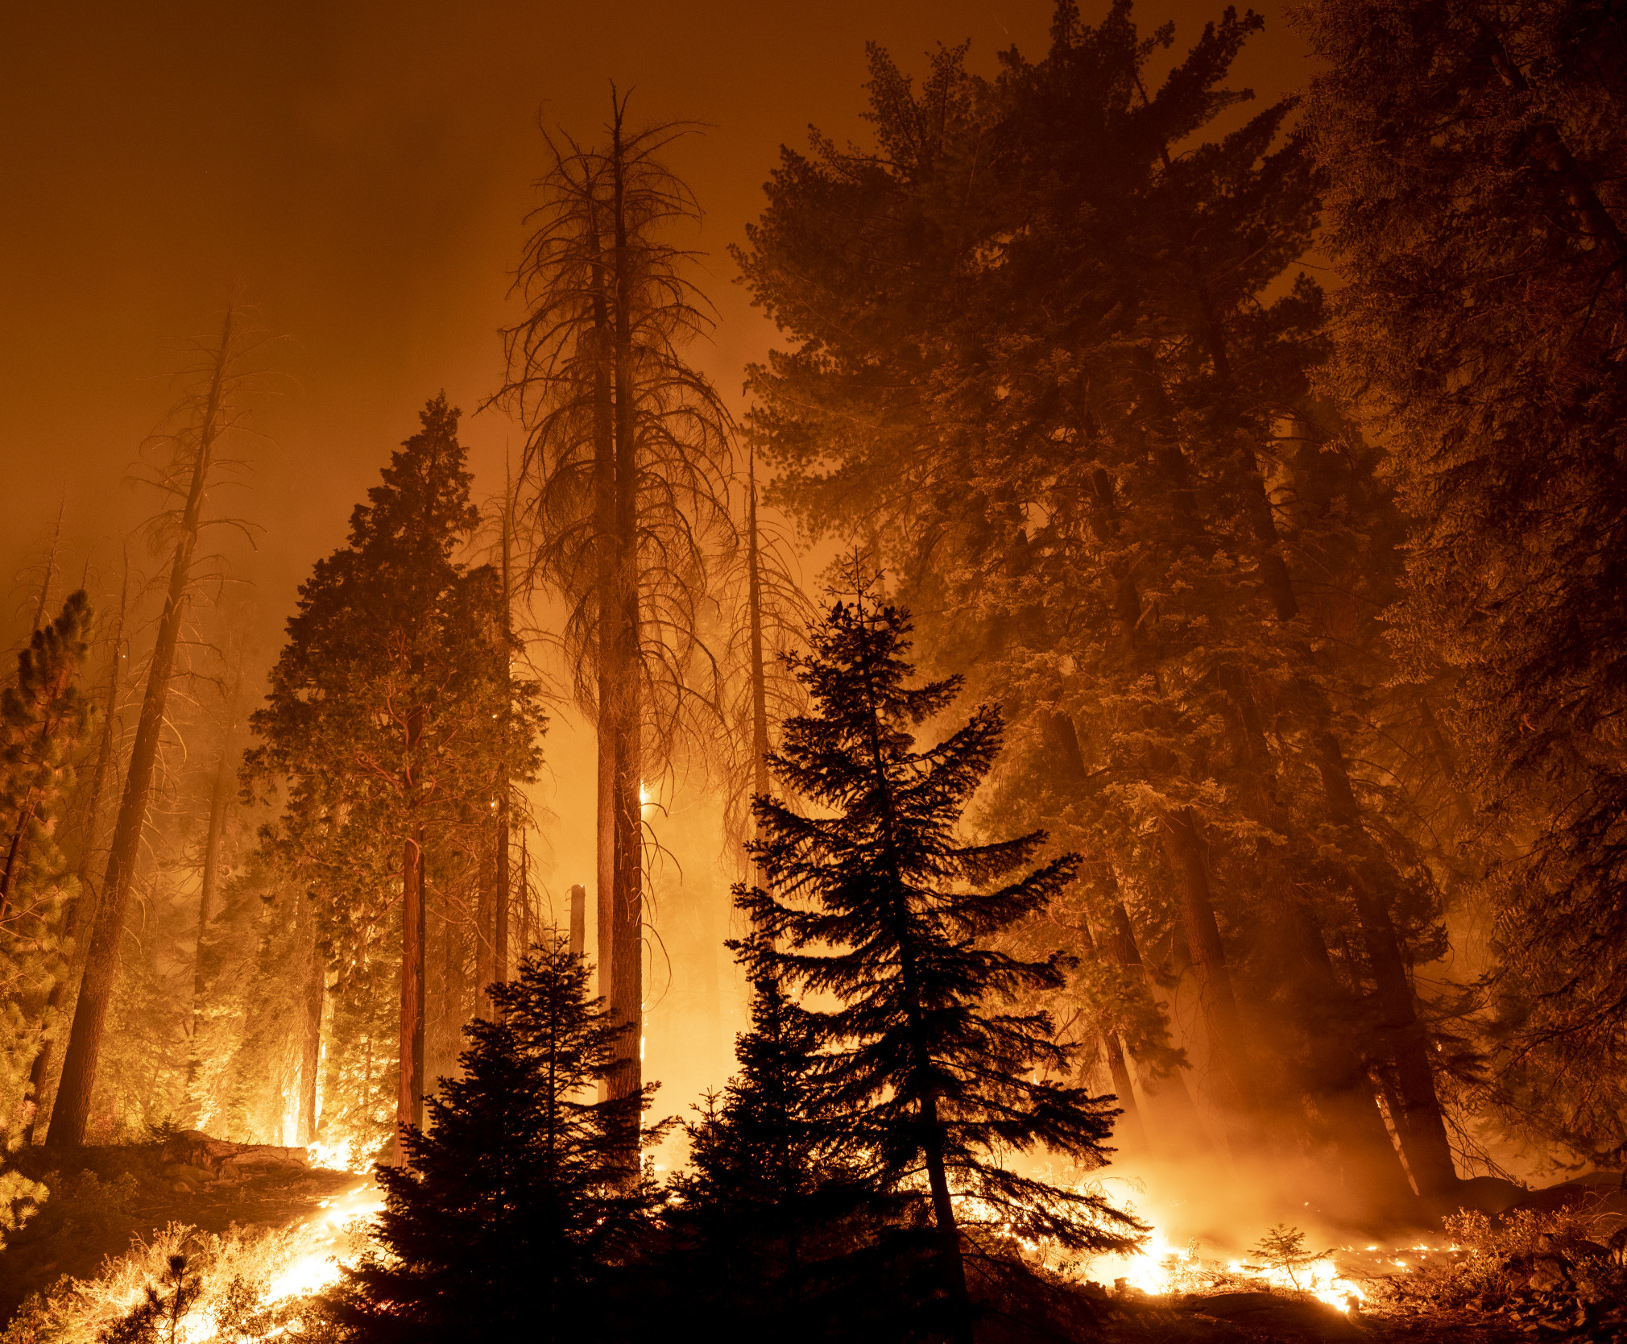
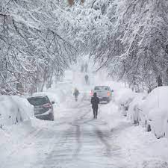
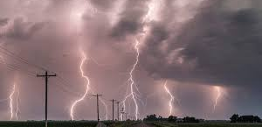
Why We’re Here
Urge YOU to be your own first responder.
Help you prepare for local disasters
Reduce impact on your community - physical, psychological & financial
Reduce reliance on emergency services when they are busy, in the fight
Faster, better outcome – measurable!
Prepare leaders!

Slide 6
Overview
Get Home Bag(s) – Very important; leads to…
Preparedness Mindset – Maybe more important; leads to…
Preparedness Lifestyle – Maybe most important
Recent disasters - Weakest Link(s)?
Preparedness - Neighbors, Friends, Everyone Age 10-90
Medical supplies - Airway & bleeding control
Q & A

Slide 7
Objectives
Understand local emergency service & limitations
Understand individual AND local community disaster preparedness
Understand how to prepare for disasters & reduce negative impacts immediately

Slide 8
          Get Home Bag

Slide 9
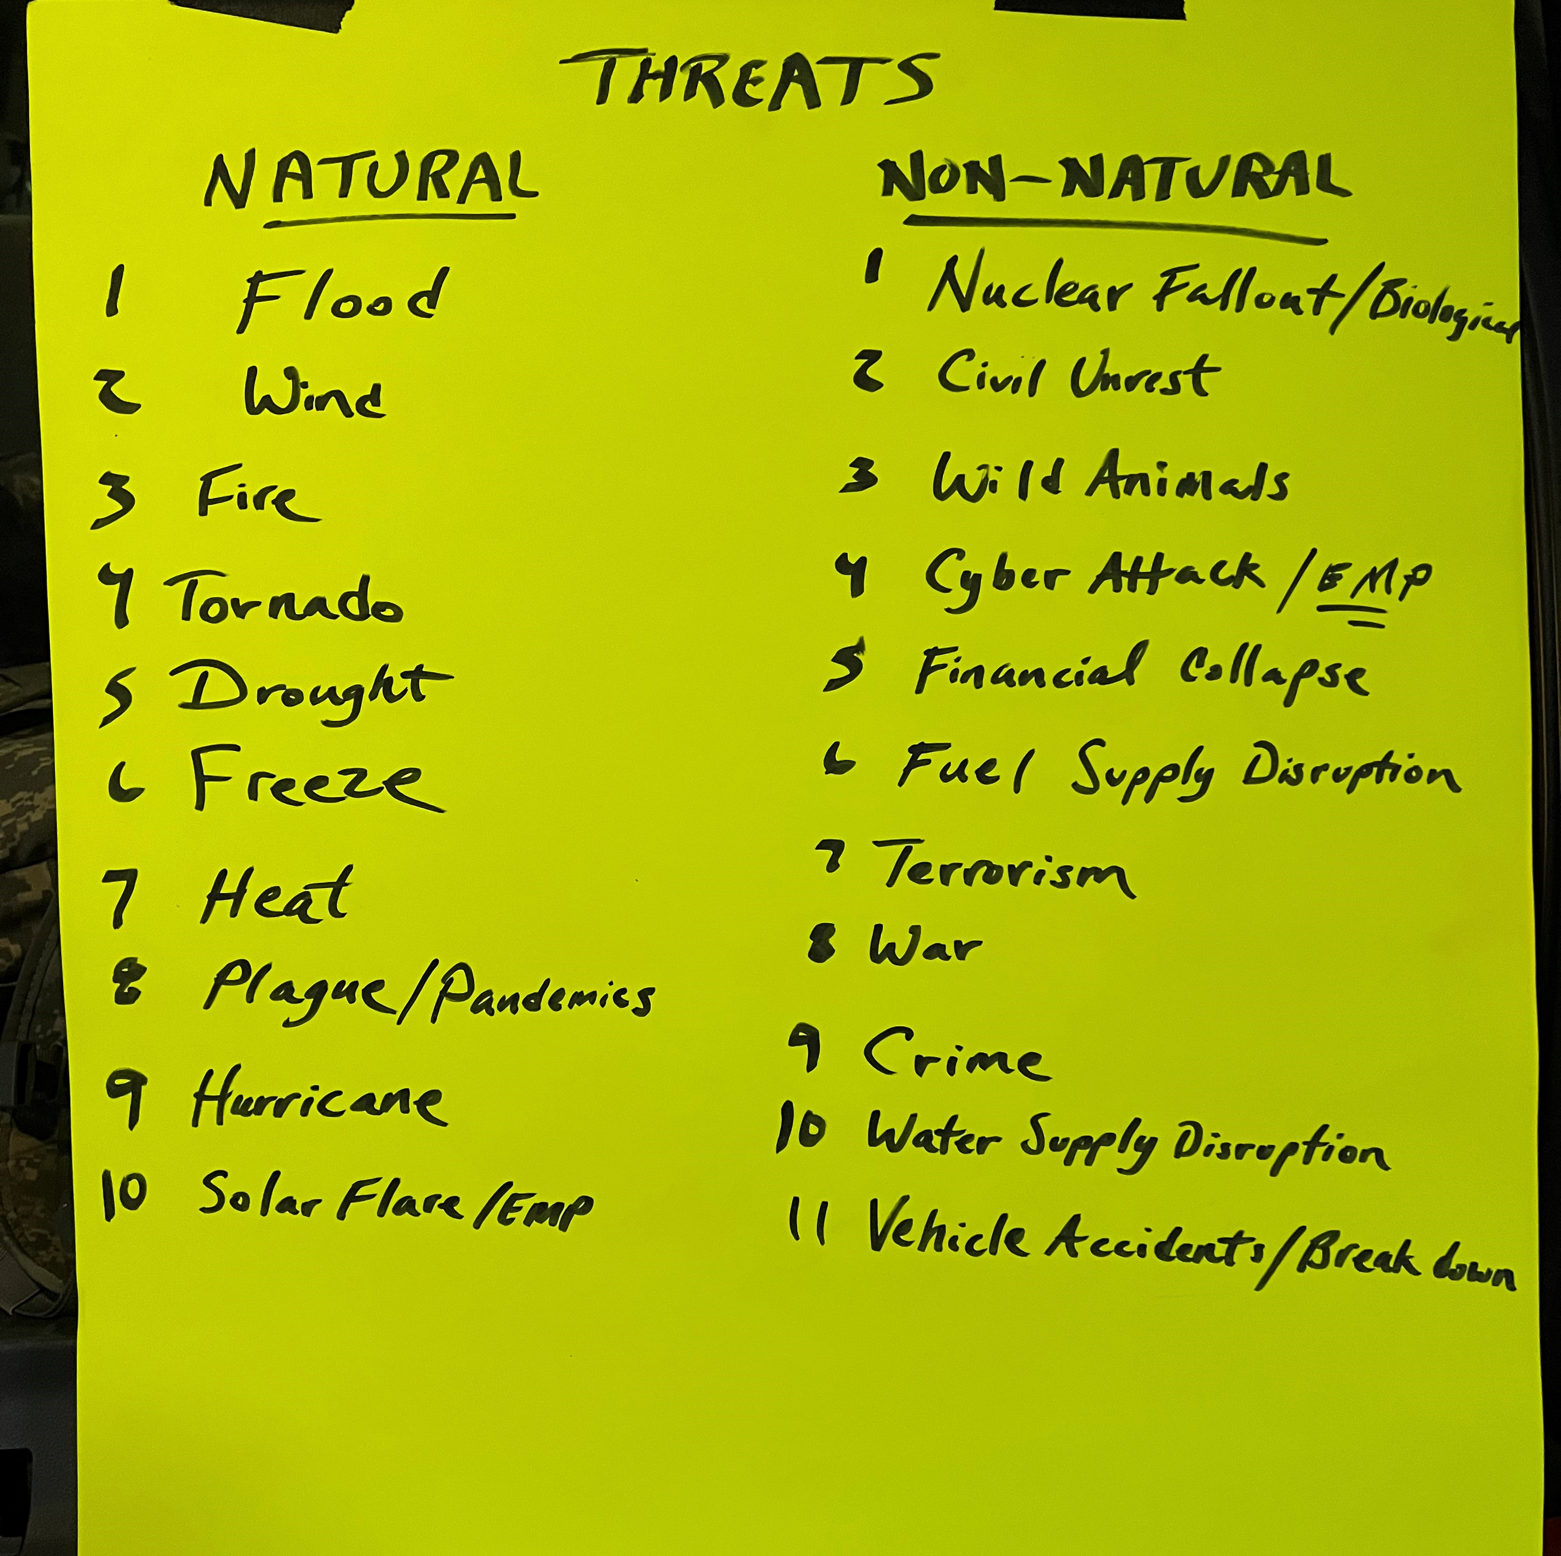
Preparedness Mindset
From NESA Eagle Scout Meeting

Slide 10
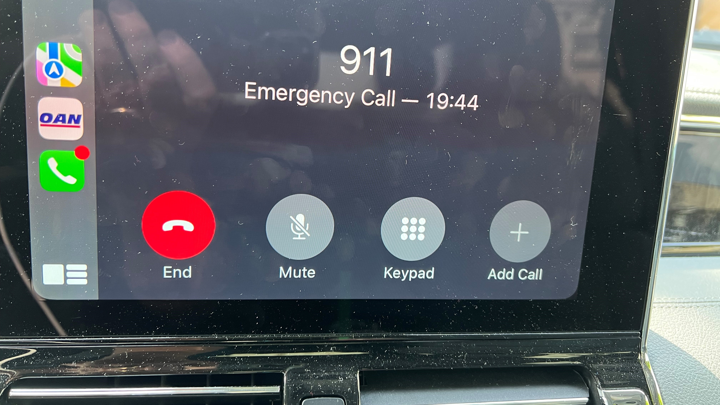

Slide 11
WATER is LIFE

Slide 12
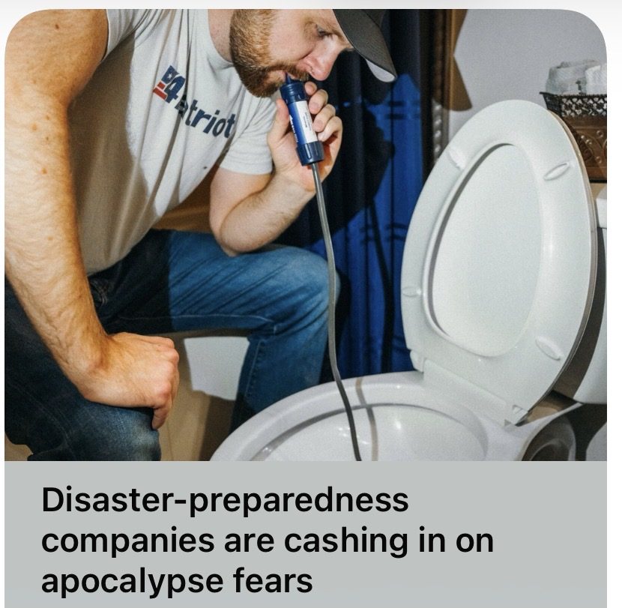

Slide 13
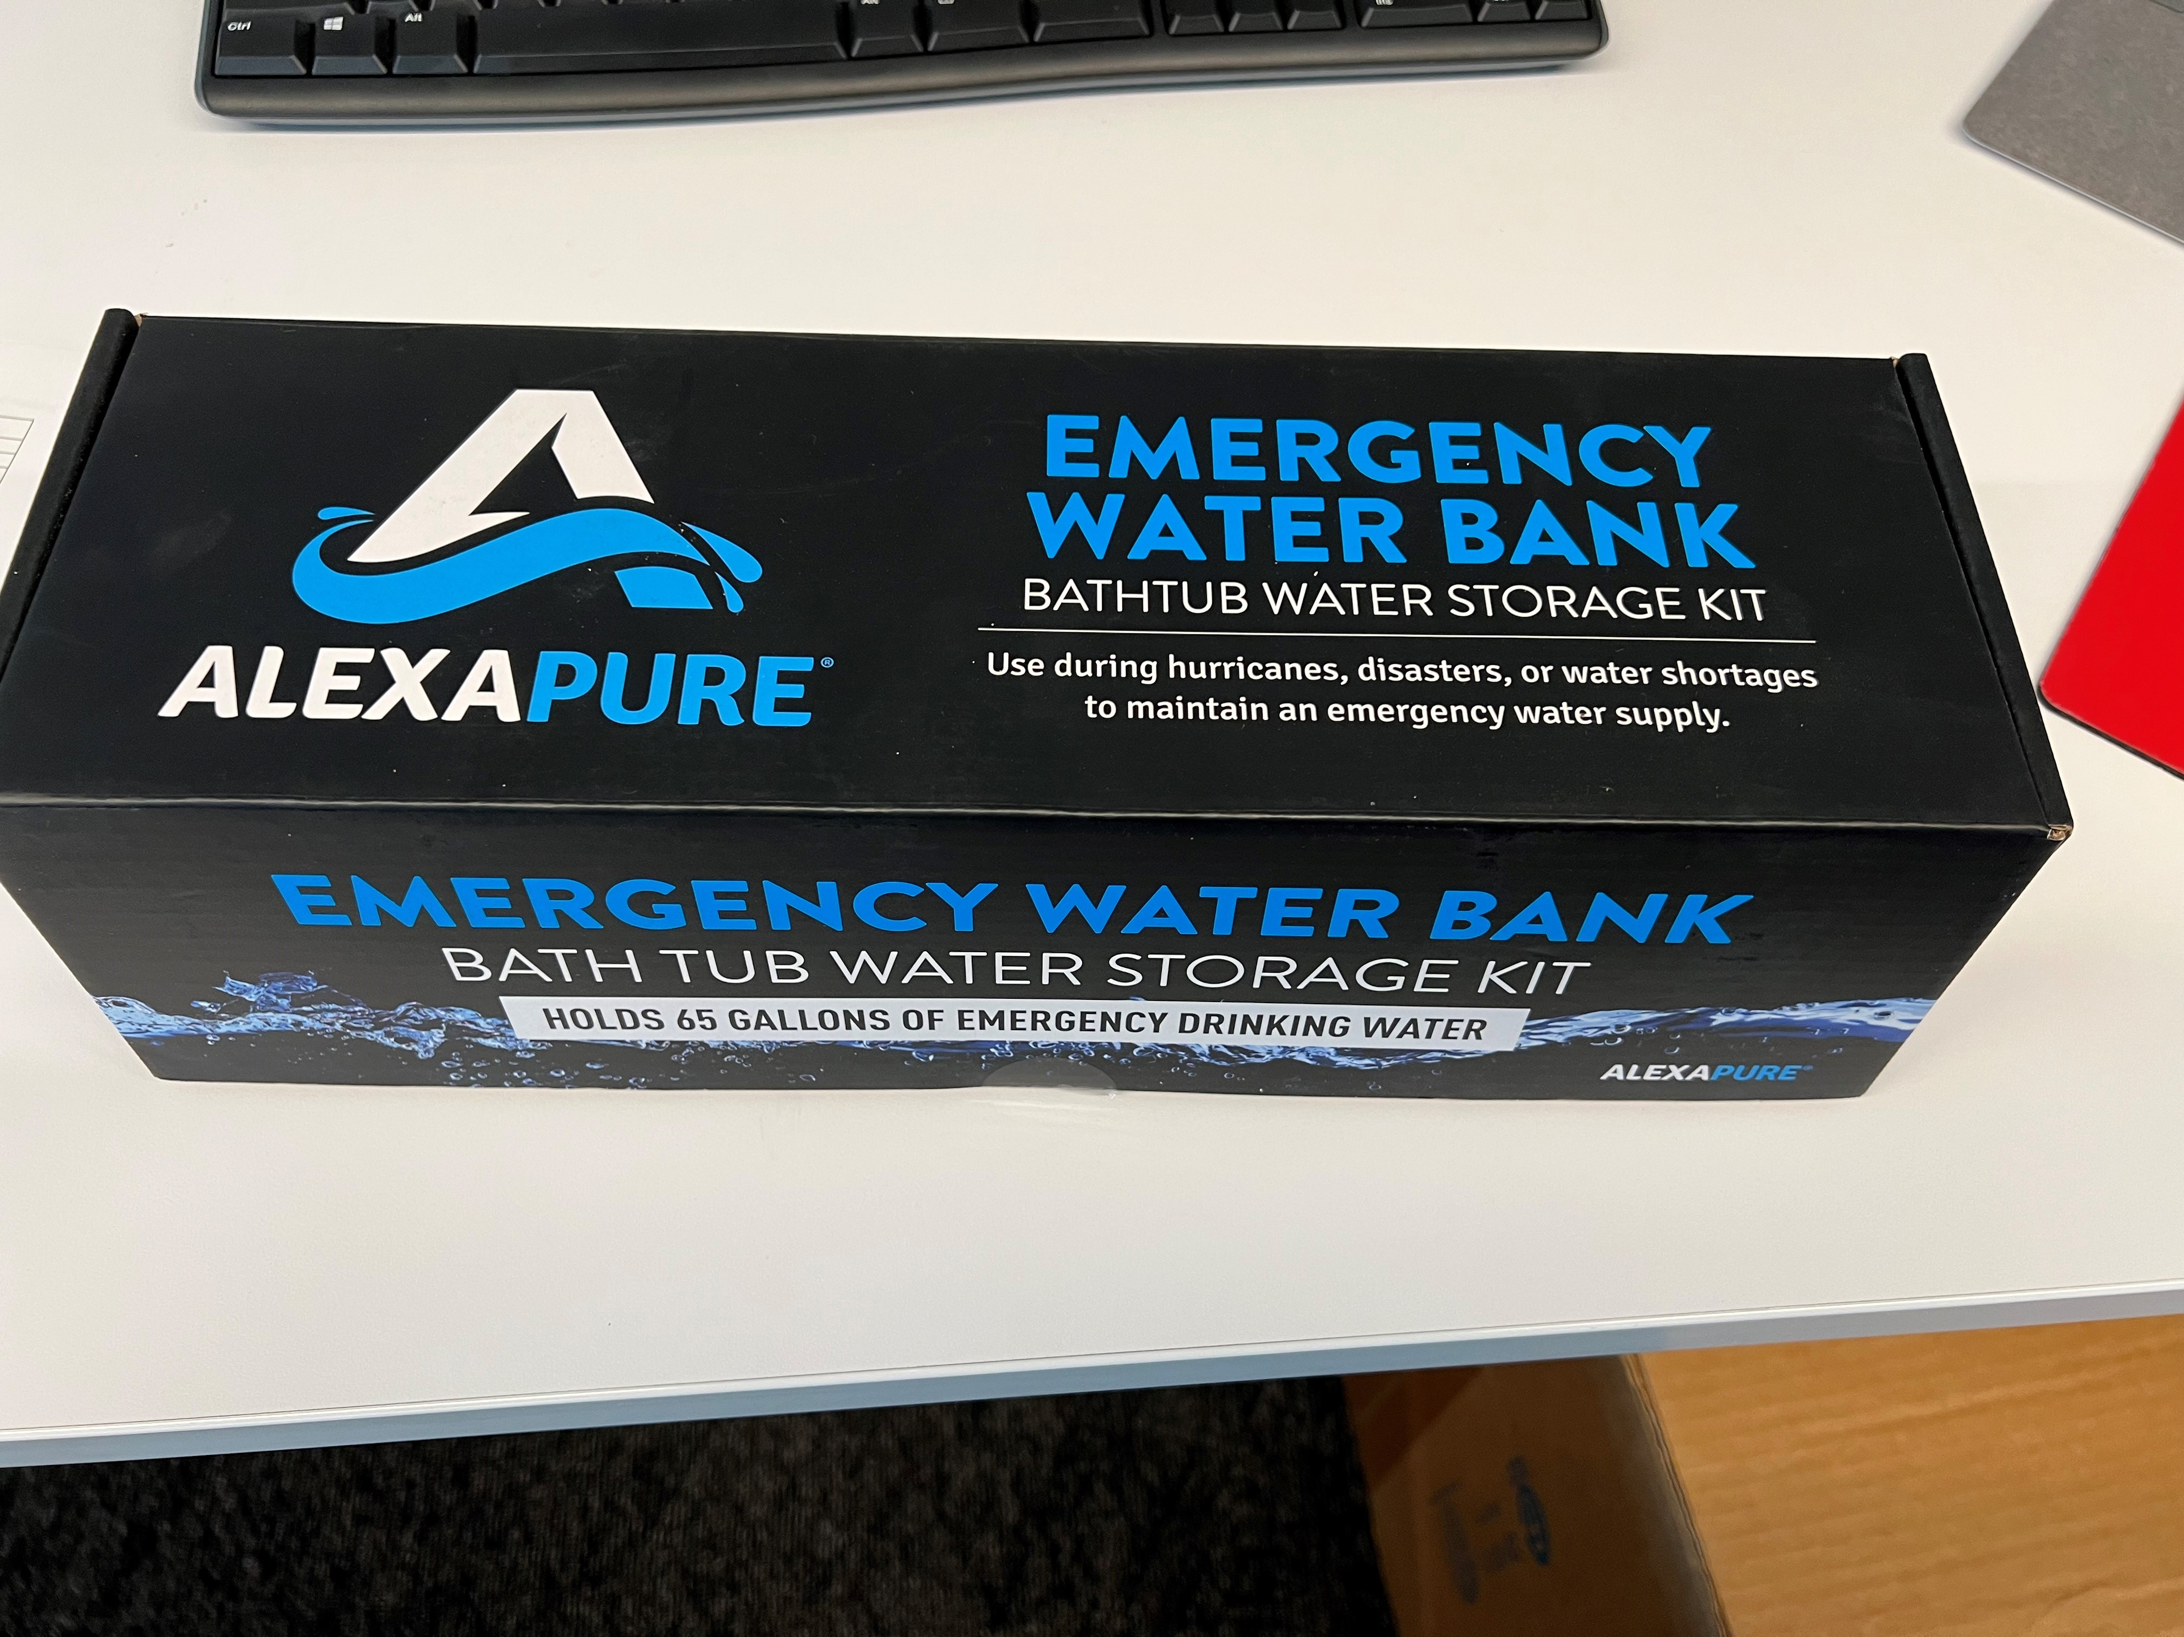

Slide 14
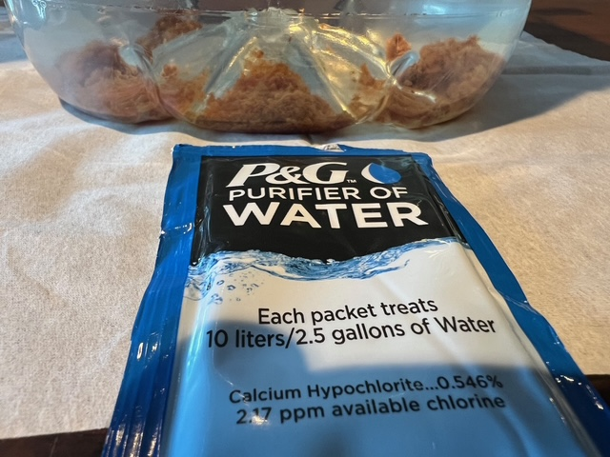

Slide 15
RECENT DISASTERS

Slide 16
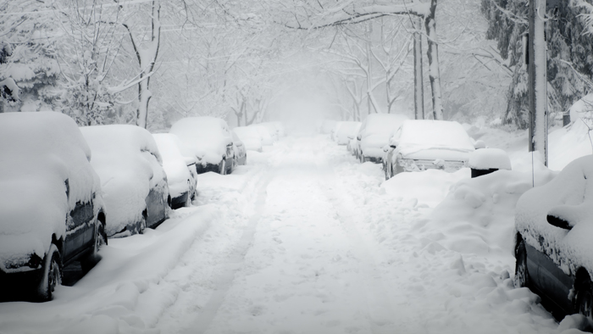
Winter Storms

Slide 17
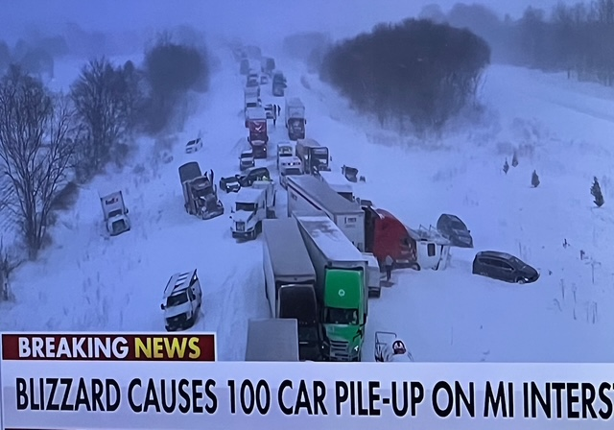

Slide 18
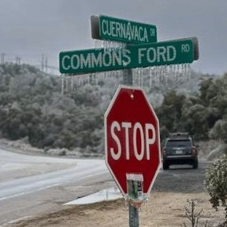
Winter Storms
Hazards
  Icy roads
  Loss of power
  Broken water pipes
  Frigid temps / hypothermia
  No emergency service access
  Lack of food, medical services
  Carbon monoxide poisoning
  Residential fires

Slide 19
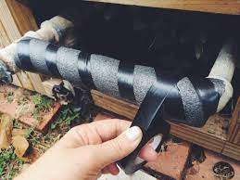
Winter Storms
Preparation
  Wrap pipes, drip faucets, shut off water
  Water shut off tool at the box!
  Maintain generator – serviced, fuel, proper cords, output; Kill A Watt
  Adequate blankets & clothing
  Stockpile firewood
  Indoor safe propane heater
  4” ‘port’ - through wall access
  Emergency kits
  Tire chains
  Salt / sand entrances

Slide 20
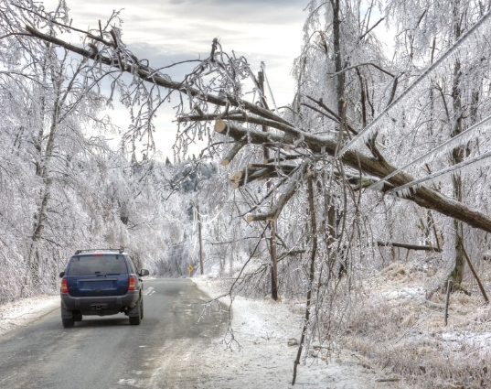
Winter Storms
During the Event
  Avoid driving if possible
  Travel during day. Have emergency kit in vehicle.
  Notify emergency contacts before departing
  Inventory emergency supplies
  Prevent carbon monoxide poisoning!
  Fire extinguishers

Slide 21
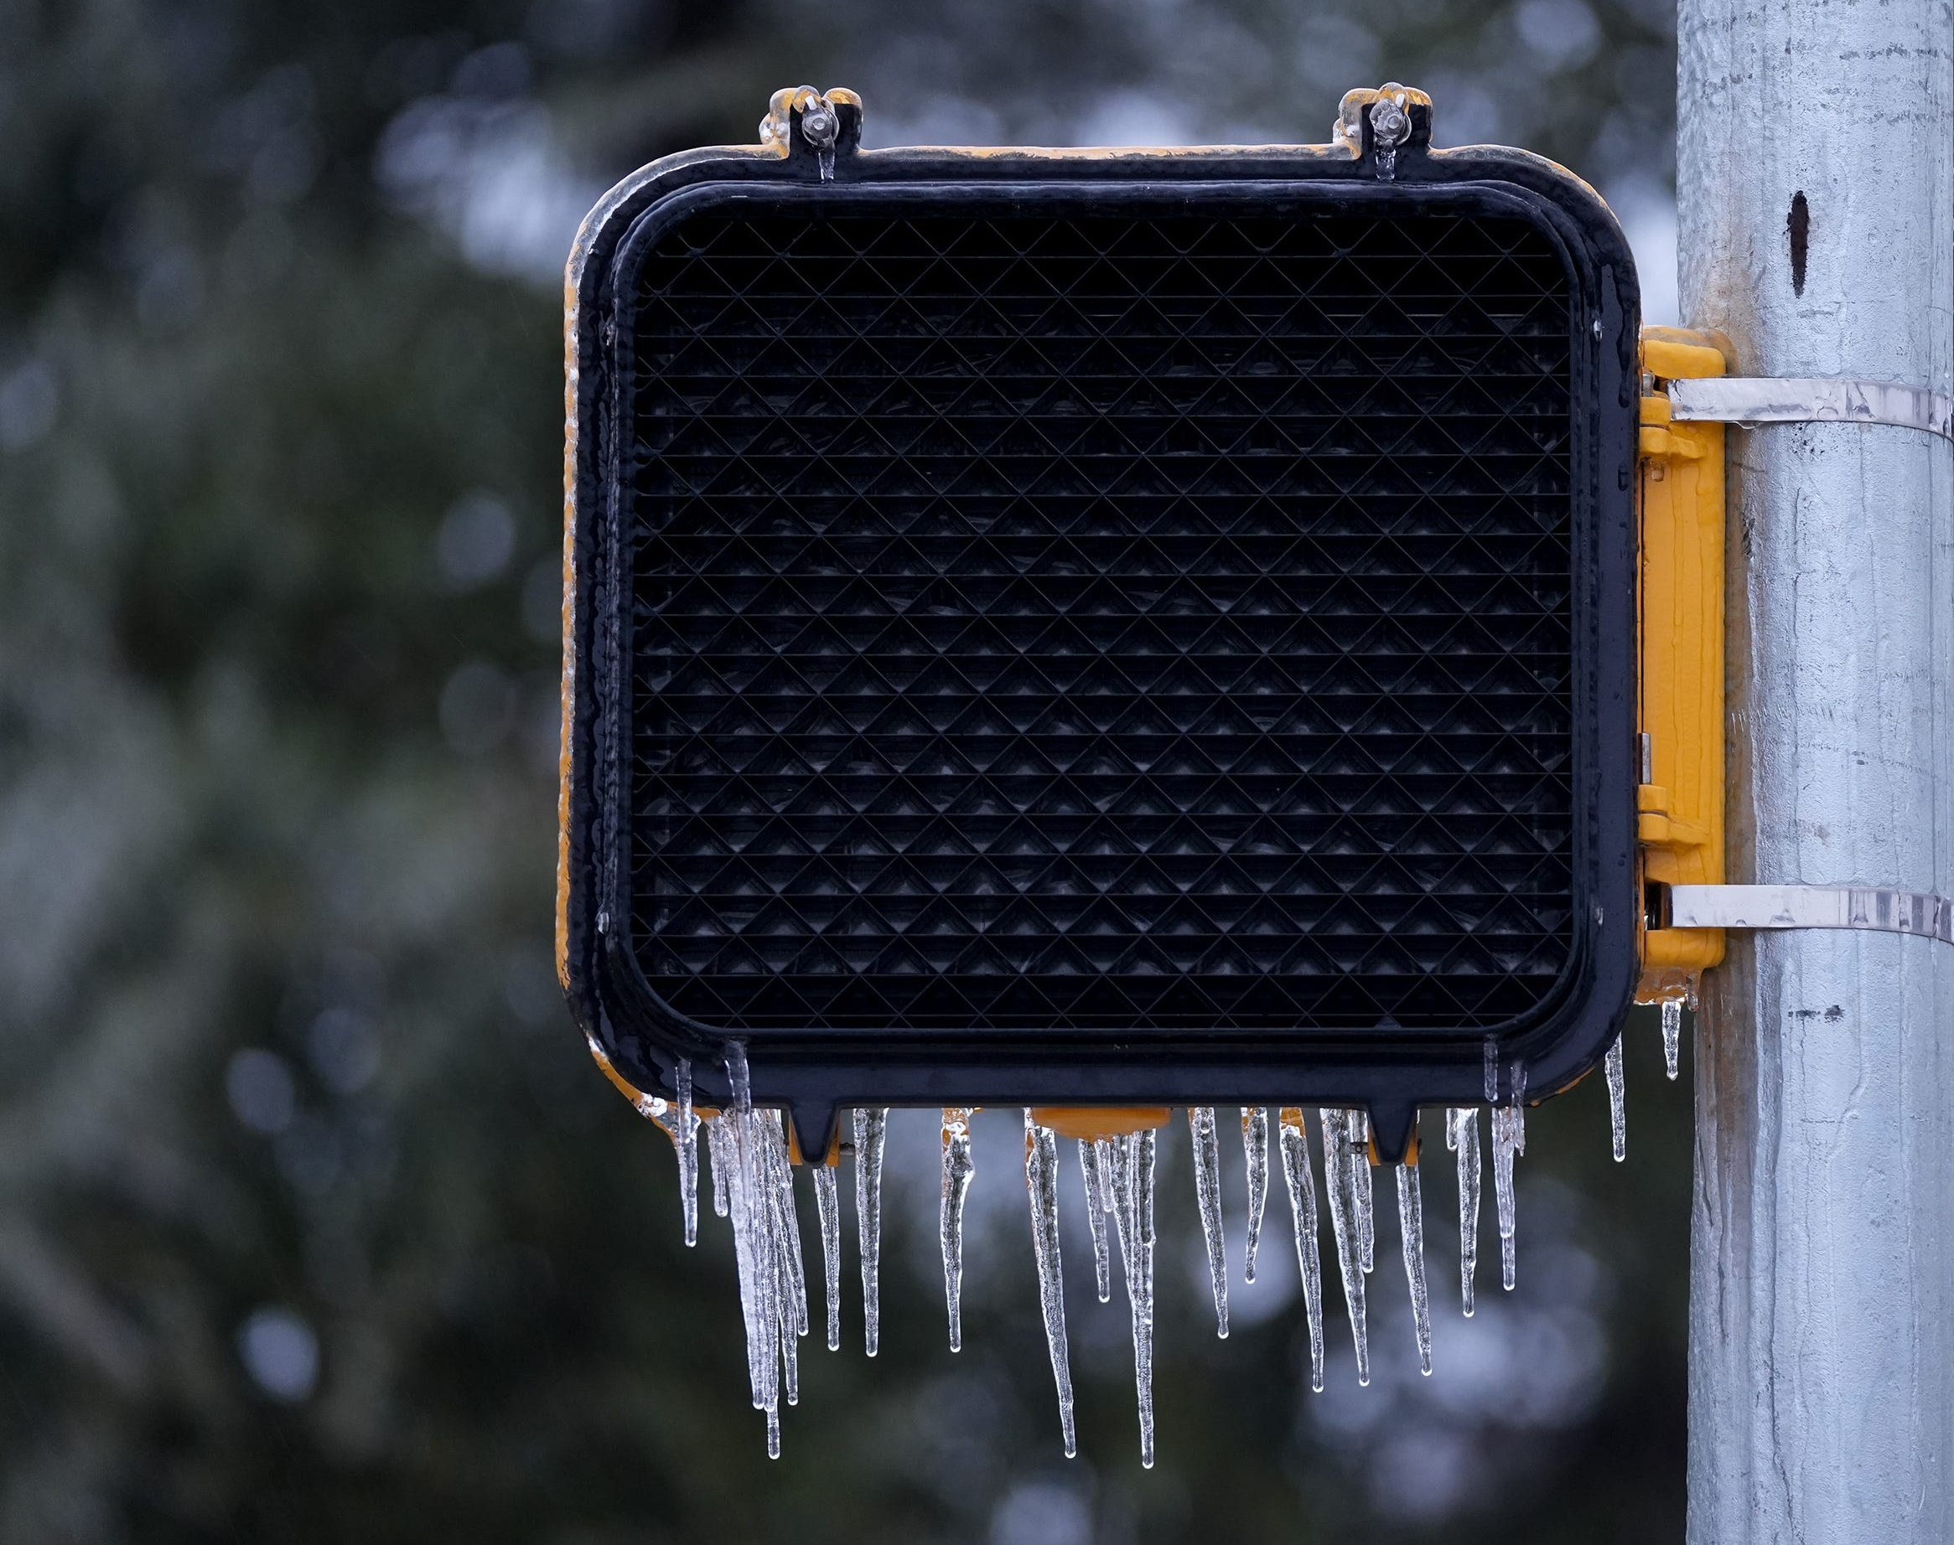
Power Outages

Slide 22
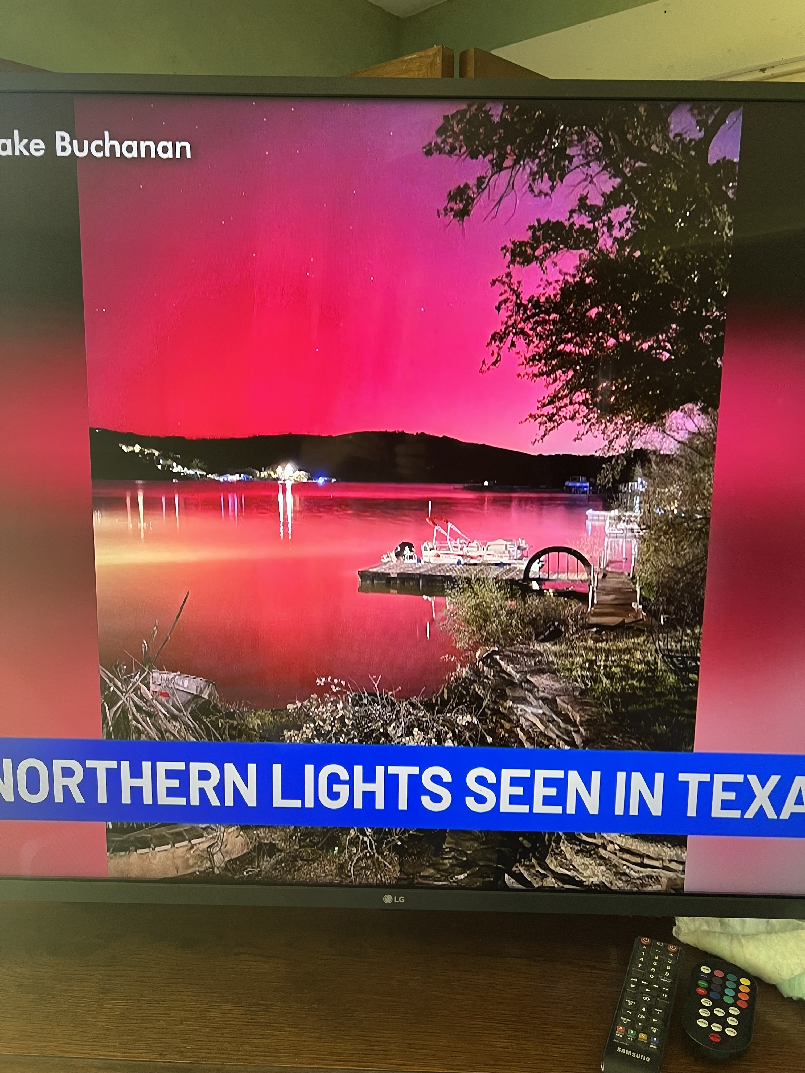
“So pretty!
” …WARNING

Slide 23
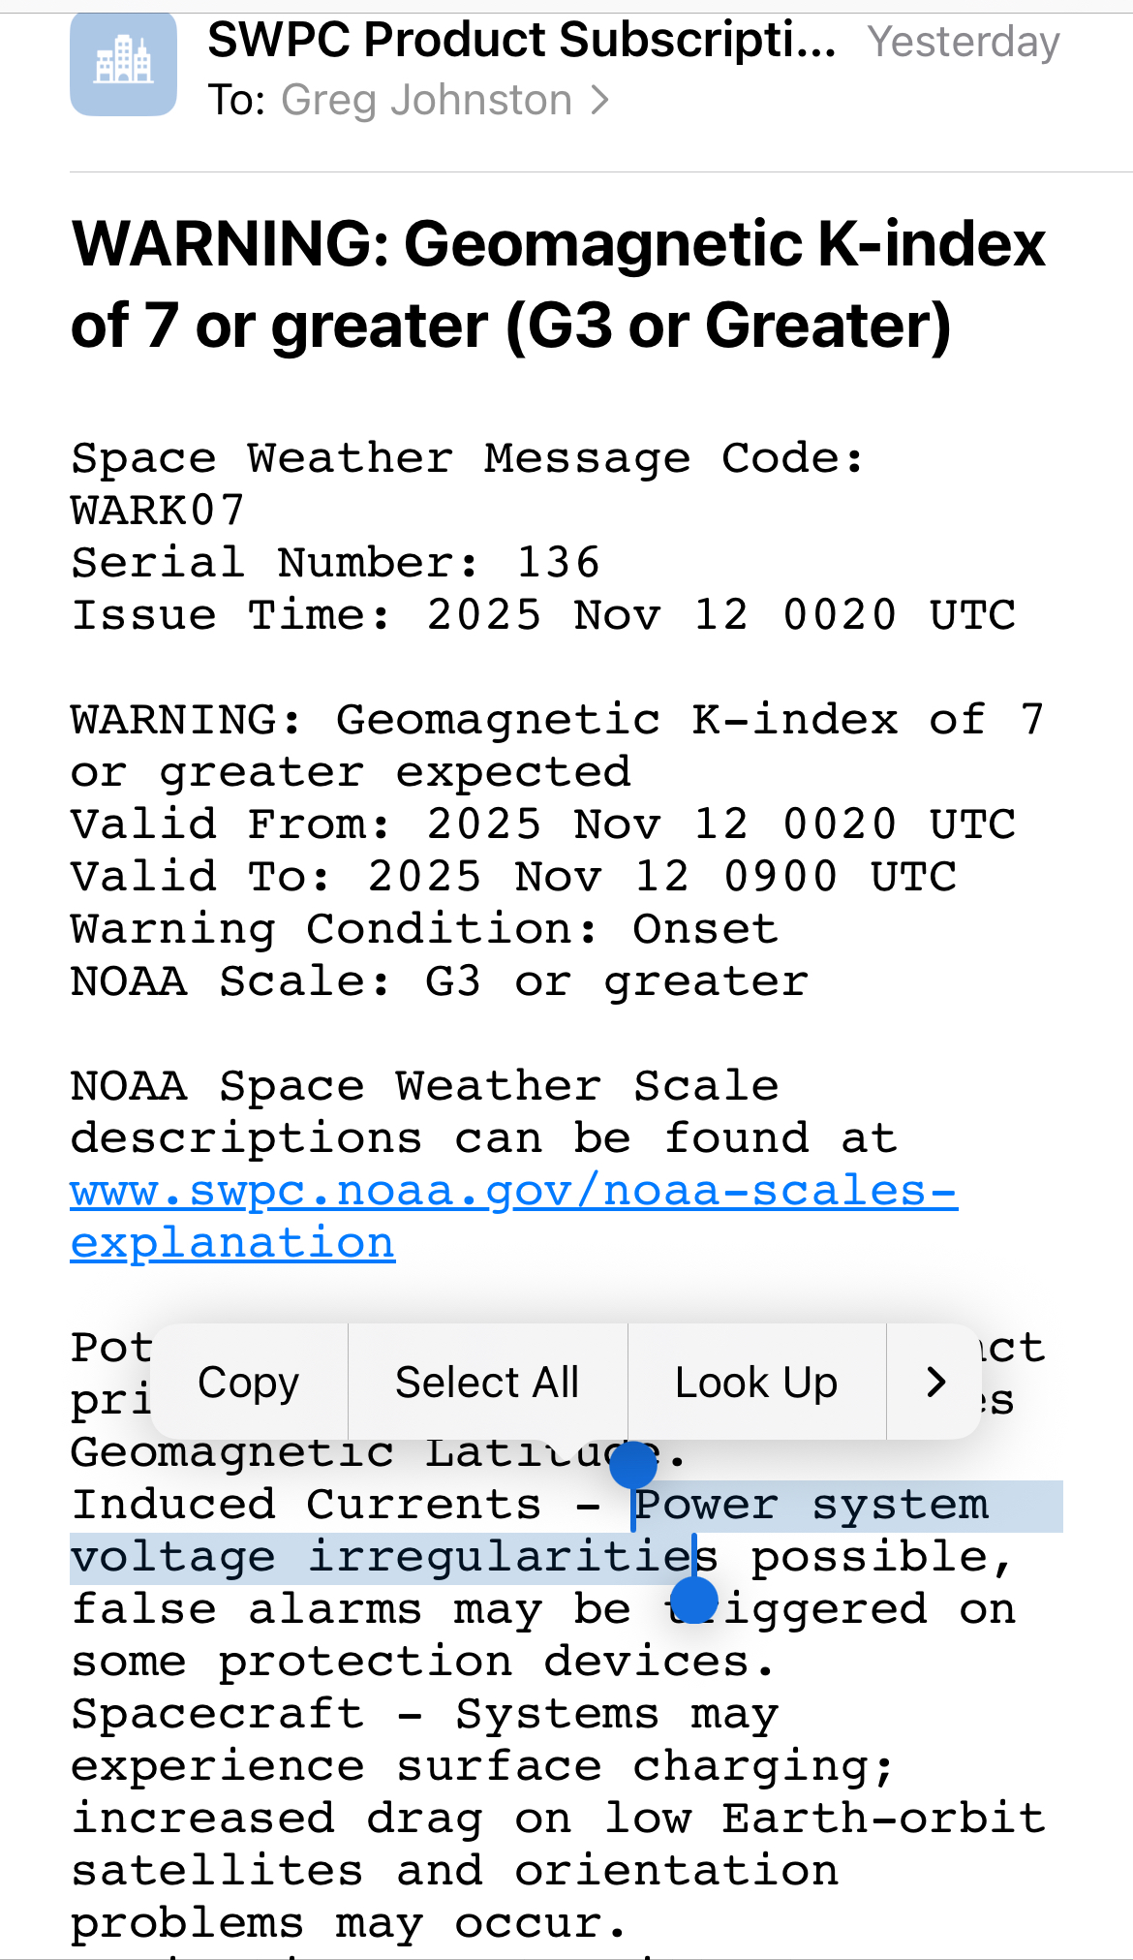
1st “Warning” I’ve seen in ~6 years…

Slide 24
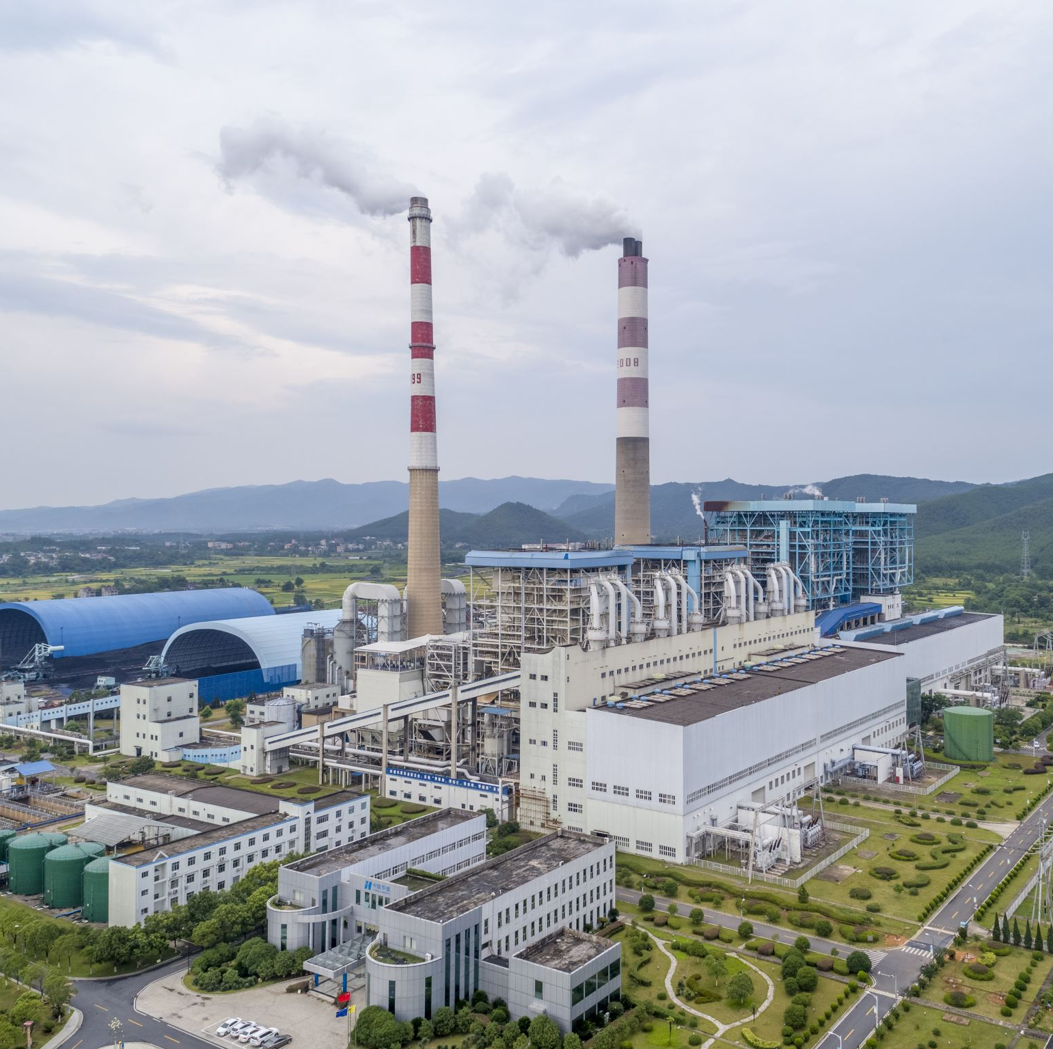
Power Outages
Hazards
  Extreme temperatures
  Lack of food, water, utilities, information
  Carbon monoxide poisoning
  Electrical fires when power turns back on
  Traffic hazards
  Chimney fires (winter)

Slide 25
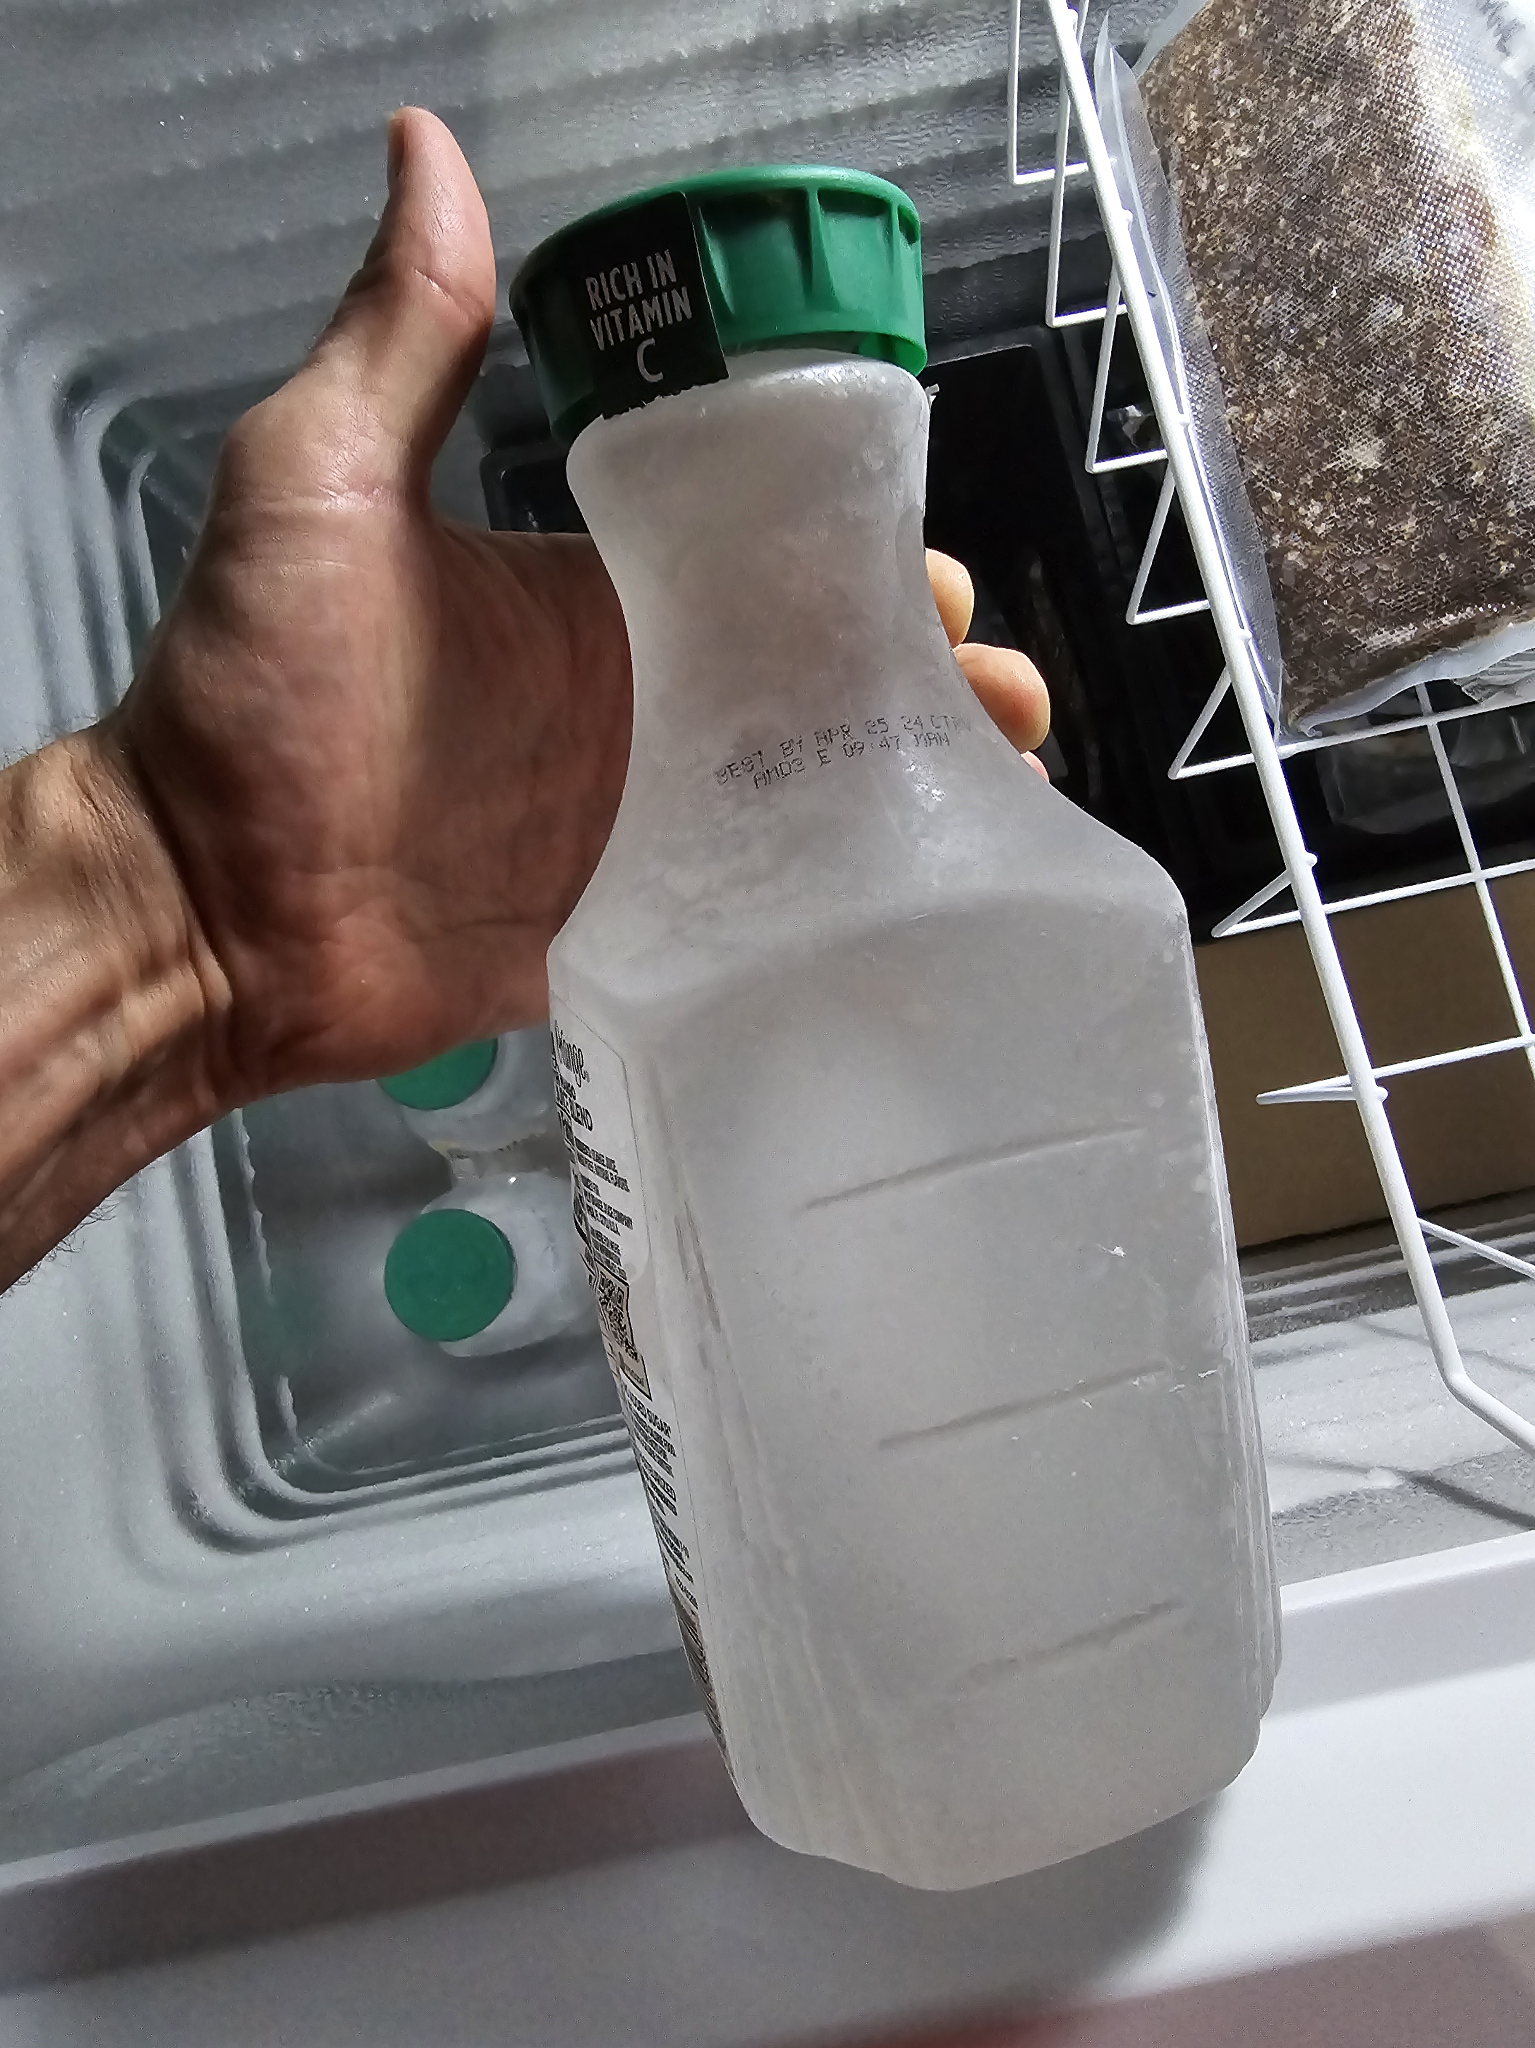
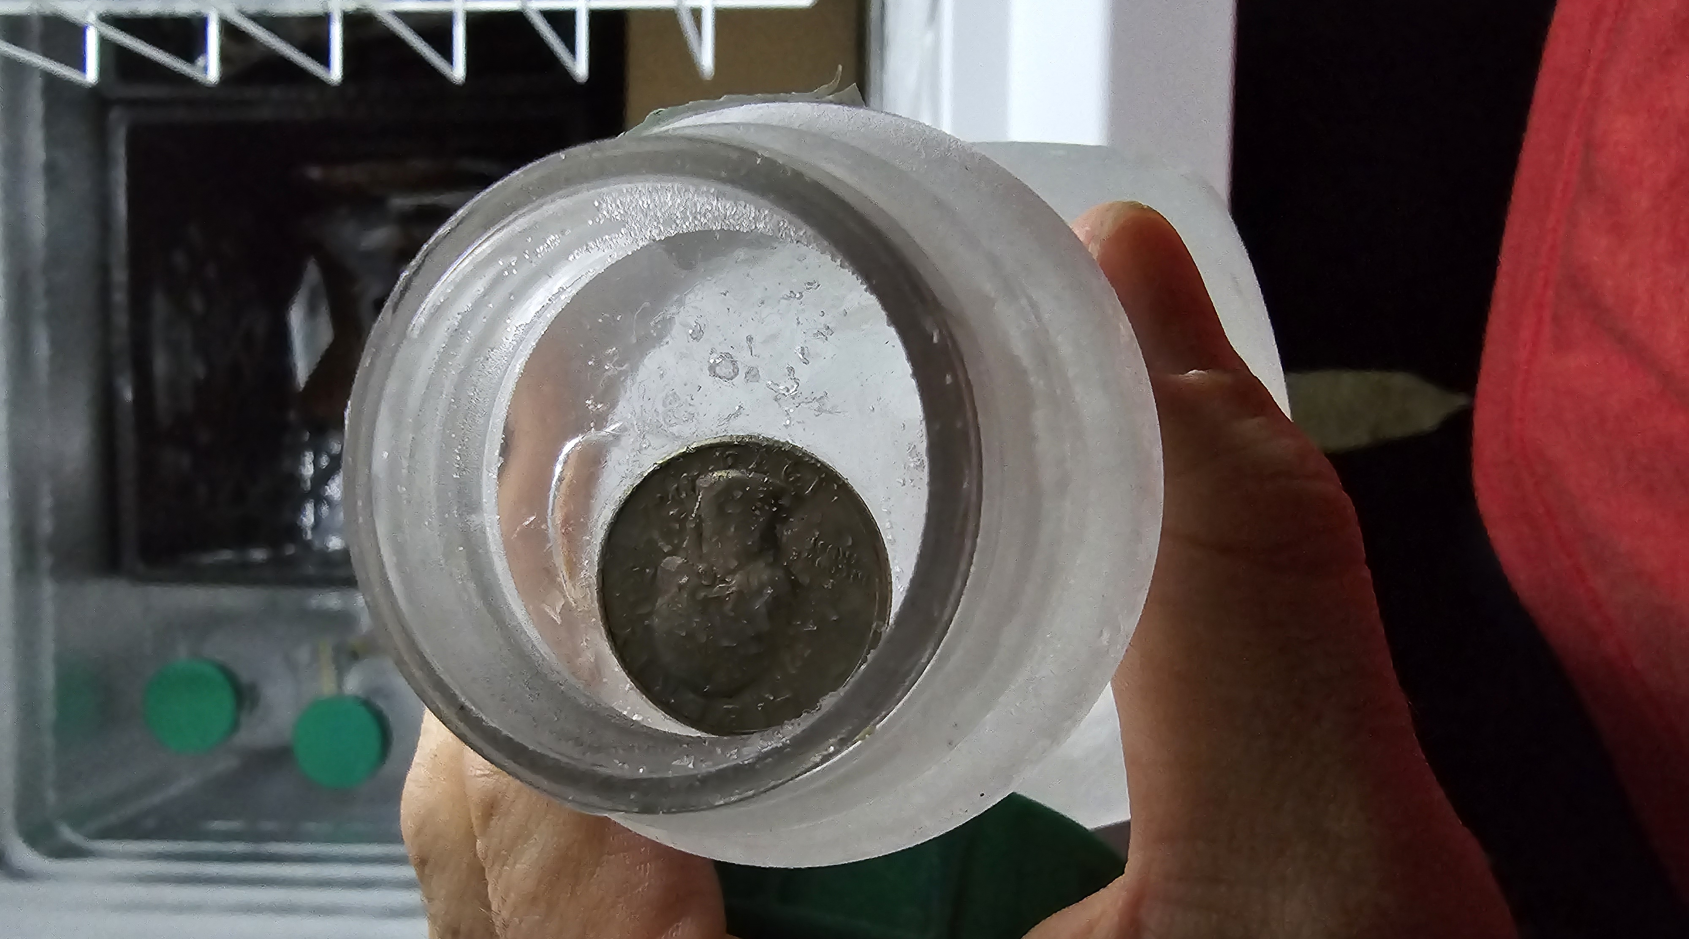
Power Outages
Preparation
  Emergency supplies kit
  Generator
    Transfer switch, Lockout vs. direct supply
    Maintenance
    Stabilized fuel
  Makeshift ice blocks ahead of time
  Season appropriate equipment
    Winter – blankets, firewood, indoor safe space heaters
    Summer – fans, portable a/c units
  Chimney serviced and cleaned
  Battery powered carbon monoxide detector

Slide 26
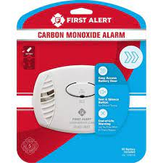
Power Outages
During the Event
  Extend food supplies
    Eat perishable food first
    Closed fridge – 4 hours, full freezer – 48 hours, deep freezer – 72+
    Rotating appliances (generator)
  Prevent carbon monoxide poisoning
    Use generators in well ventilated areas
    Place CO detector in common area near where generator is
  Decide when to stay and go based on safety, comfort, and health

Slide 27
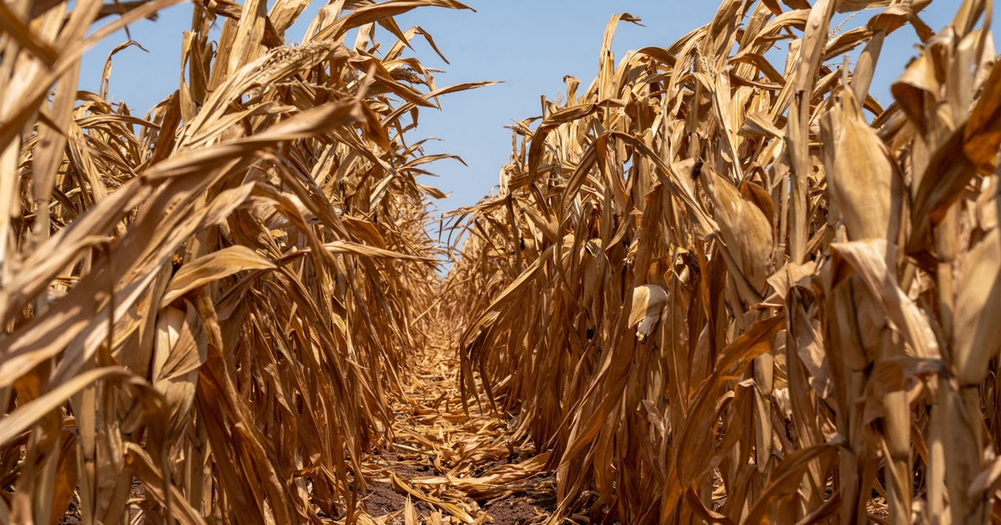
Extreme Heat

Slide 28
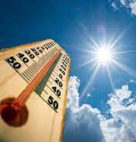
Extreme Heat
Hazards
  Dehydration, heat exhaustion, heat stroke
  Elderly and young populations at higher risk
  Children or pets left in vehicles
  Sunburn
  Wildfire

Slide 29
Extreme Heat
Preparation
  Individual
    Drink extra fluids (H2O) w/ electrolytes
    Wear moisture wicking garments
    Plan strenuous outdoor activities to avoid peak temperatures
    Take frequent breaks when working outside
    Know the signs of heat emergencies:
    Heat exhaustion – sweating, cramping, weakness, dizziness, nausea, vomiting, headache
    Heat stroke – high body temp, hot dry skin, headache, confusion
  Home
    Have A/C serviced before summer; clean/vacuum drain lines
    Box fans if you have a power source
    Screen material for open doors & windows

Slide 30
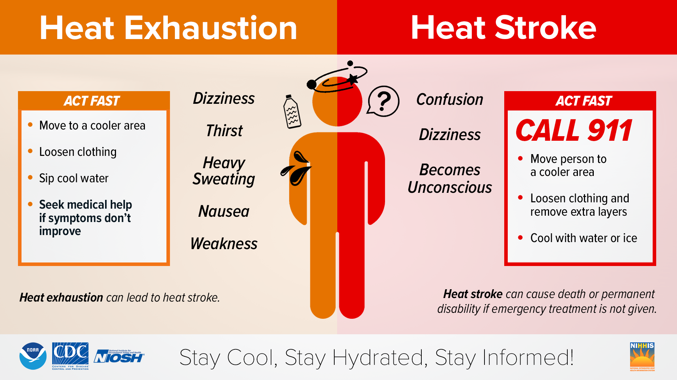
Extreme Heat
During the Event
Heat emergencies
  Call for emergency services
  Move person inside or to shaded area
  Remove clothes and cool as best as possible
  Cold water immersion is most effective treatment
Home
  Have a back-up plan if A/C malfunctions
  Never leave people or pets in a closed vehicle
  Cooling centers available

Slide 31
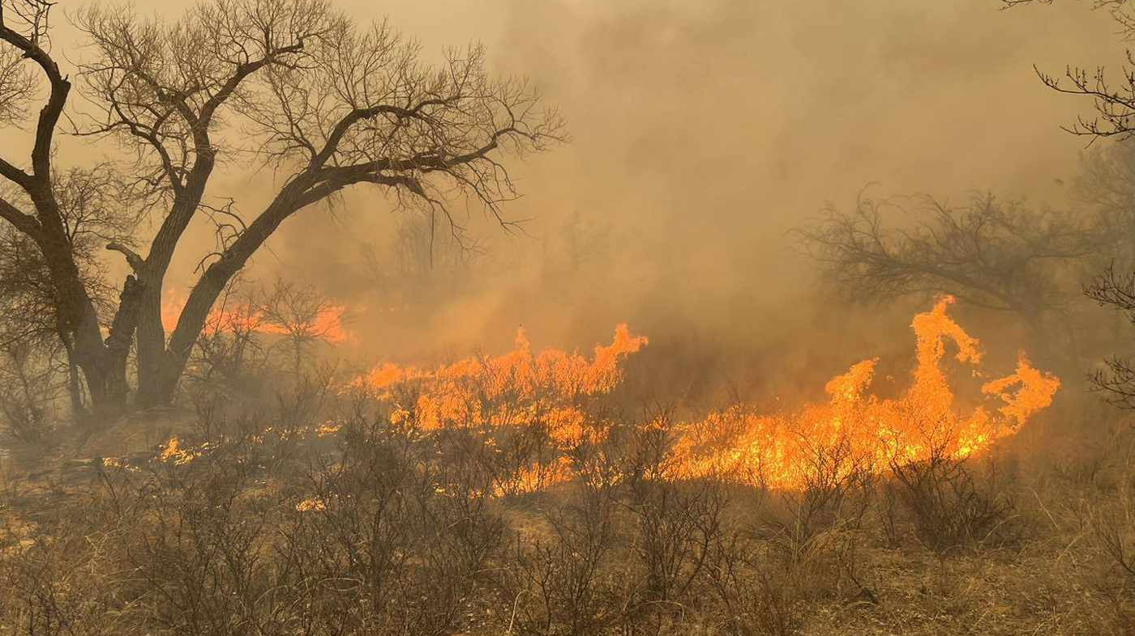
Wildfire

Slide 32
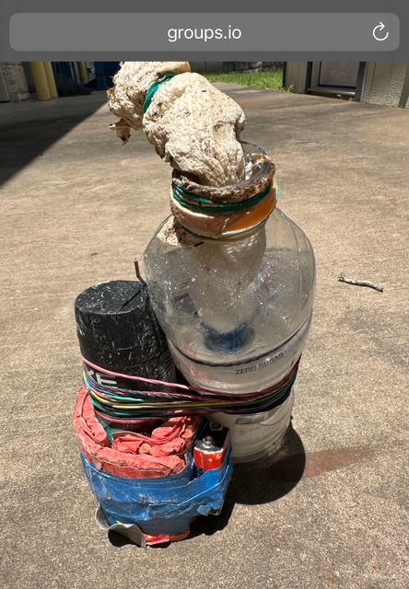

Slide 33
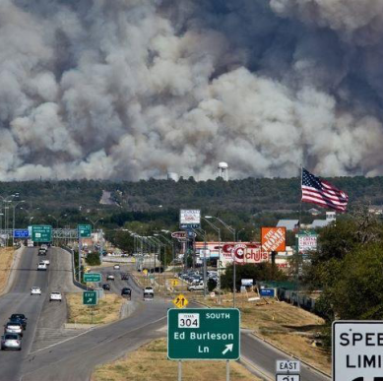
Wildfire “Bastrop”
Texas
  12,000 Wildfires
  650,000 Acres
Travis County
  6,700 Acres
  200 Homes Destroyed

Slide 34
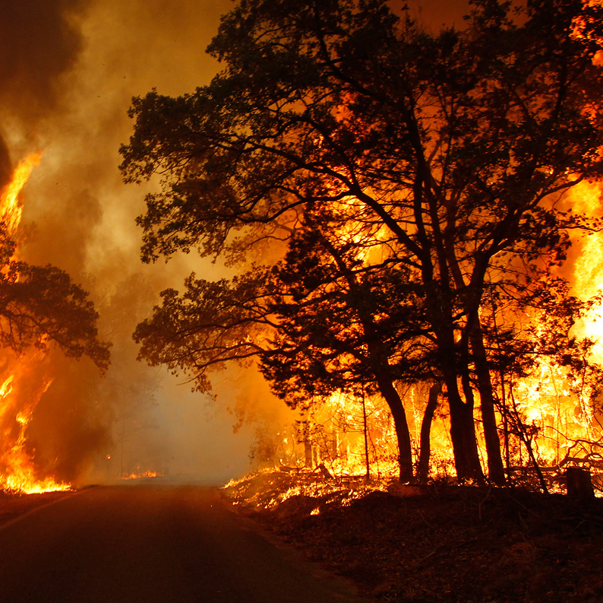
Wildfire
Preparation (individual)
  Video all personal property
  300+ photos; Cloud storage
  List impt things to take
  Prioritize it
  Emergency kit for your vehicle
  Create a family meet/comm plan
  Register with alert systems
  Know evacuation routes
  Evacuate; don’t delay
  Notify your emergency contact when leaving

Slide 35
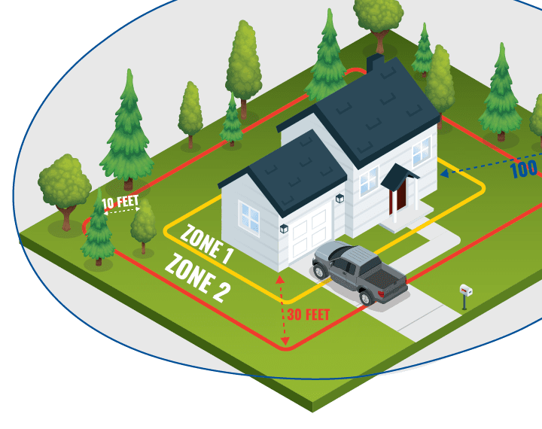
Wildfire
Preparation (home)
  Mitigation programs – ReadySetGo, Firewise, TexasWildFireRisk.com
  Watch Duty - wildfire tracking app
  How you prepare impacts FD ability to defend your home
  Defensible space, trees, roofs, gutters, building materials, propane tanks, access

Slide 36
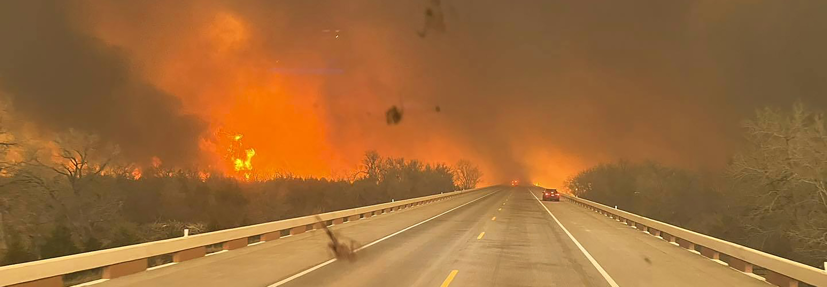
Wildfire
During the Event
  Monitor disaster updates
  Evacuate when directed – Let’s DISCUSS
  Notify your emergency contact that you are leaving
  Do not leave sprinkler systems running
  Anticipate evacuation problems

Slide 37
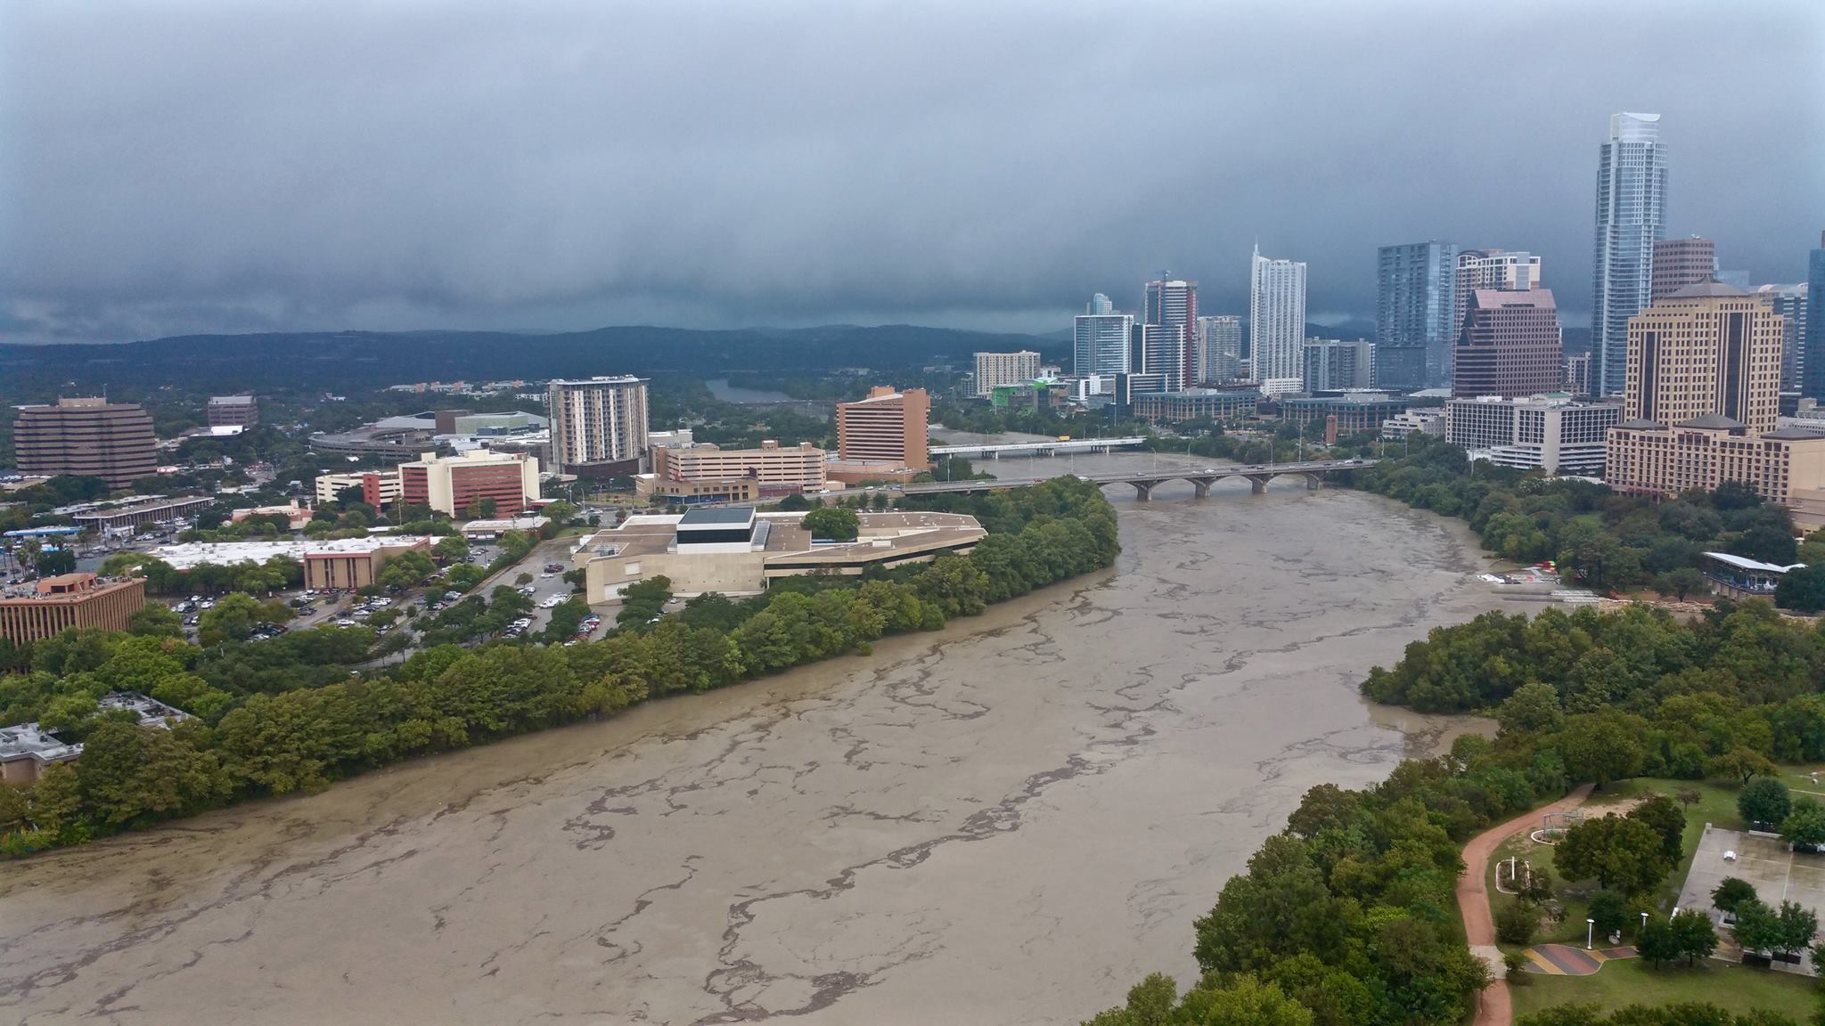
Severe Storms & Flooding

Slide 38
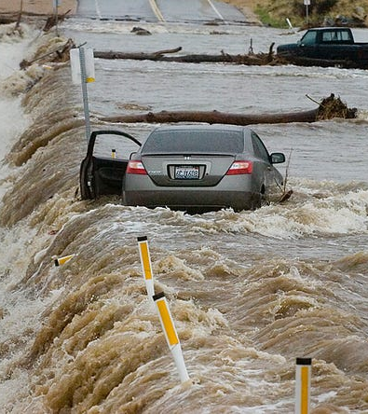
Severe Storms & Flooding
Hazards
  Often underestimated
  Flood water is fast & powerful!
  Camp Mystic, Guadalupe, July 4th
  High winds, down trees
  Blocked roadways
  Lighting strikes and residential fires

Slide 39
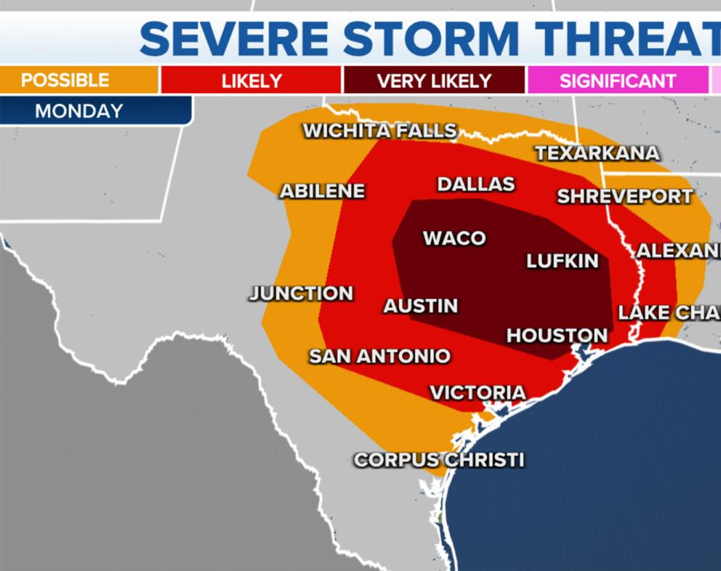
Severe Storms & Flooding
Preparation
  Maintain trees on property
  Clean gutters
  Generator maintained & top off fuel
  Install / check smoke detectors,10-year lifespan
  Emergency kit
  Know local flood areas
  Monitor weather forecasts

Slide 40
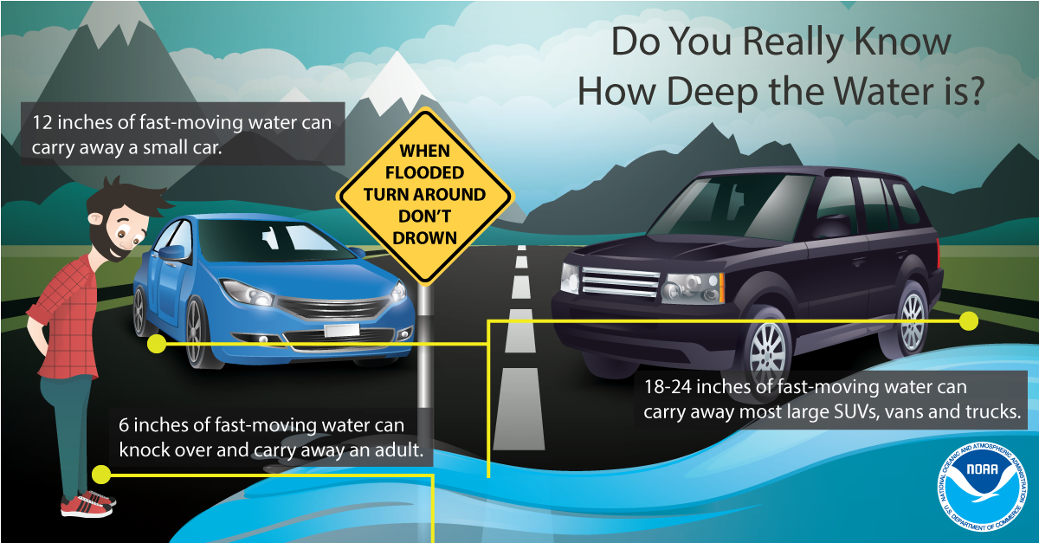
Severe Storms & Flooding
During the Event
  Stay indoors
  Avoid driving if possible
  Check ATXflood.com for flood map
  Do not cross flooded roads; Lasso!
  Do not drive over power lines

Slide 41
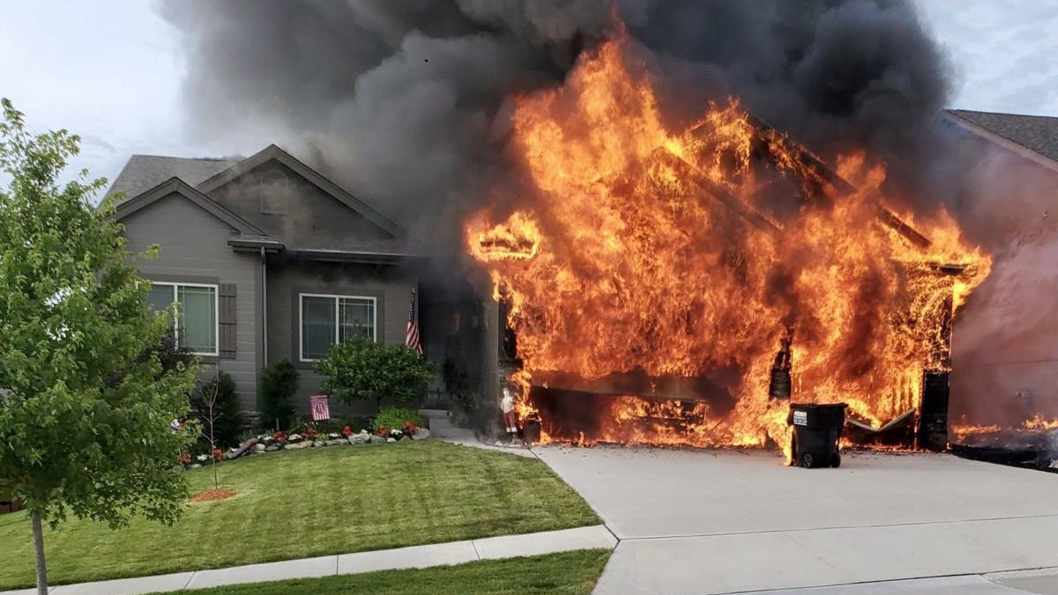
Residential Fires

Slide 42
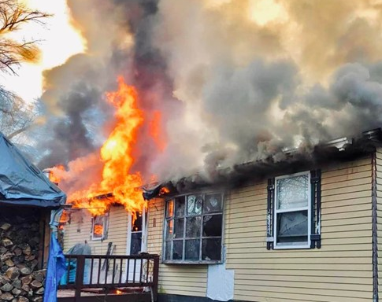
Residential Fires
National Statistics
  3,000 deaths
  10,000 injuries
  $10B in damage
  375,000 house fires = 1/90 seconds
  70% of deaths are in residential structures
  Leading cause = 47% cooking

Slide 43
Ignition to Flashover
Natural vs Synthetic Furnishings
https://youtu.be/87hAnxuh1g8

Slide 44
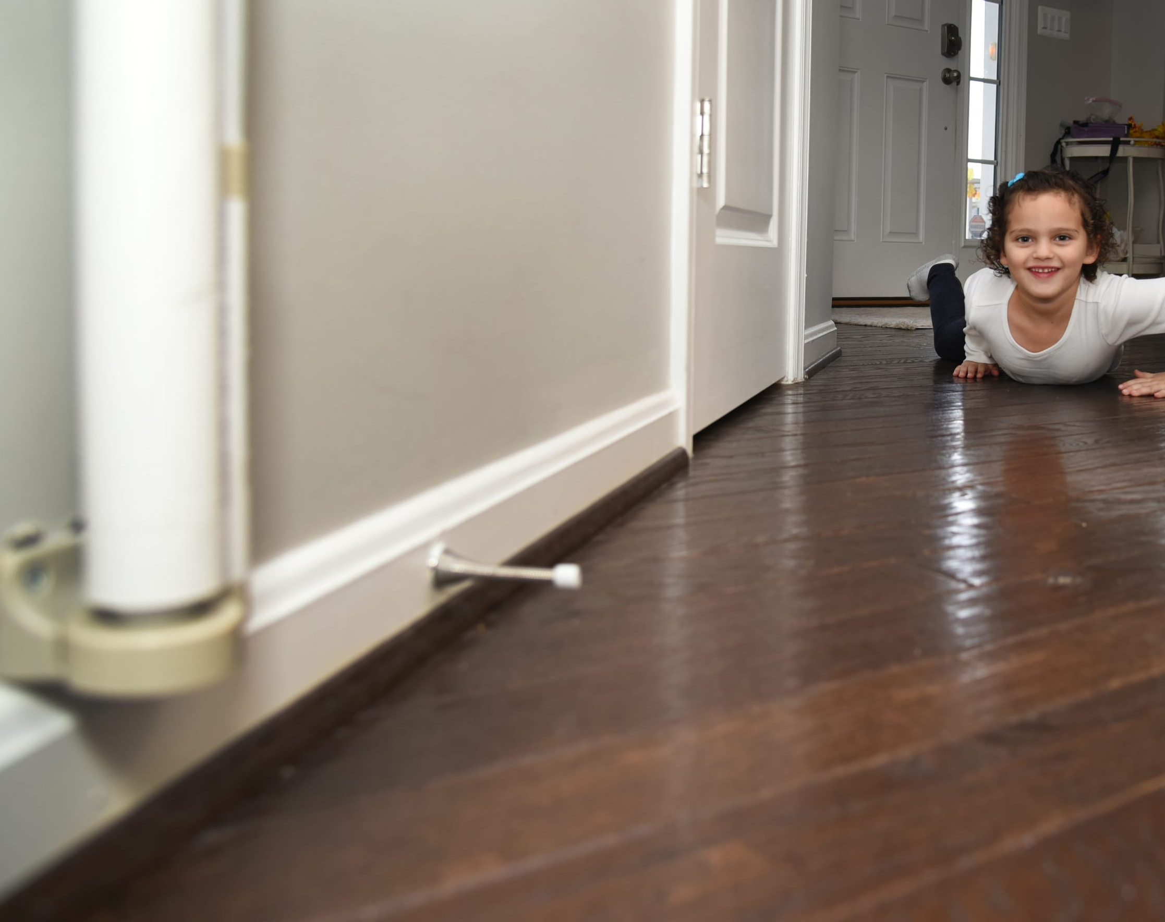
Residential Fires
Preparation
  Install detectors outside every living space on every floor, in attic & garage
  Change batteries in detectors every 6 months (time change)
  Avoid open flame candles
  Ensure children do not have access to matches / lighters
  Clean chimney. Anyone seen a chimney fire?
  Have extra fire extinguishers, mounted. Know how to use them.
  Develop a family fire safety plan & meeting place (mailbox?)
  Practice a fire drill. Get started!

Slide 45
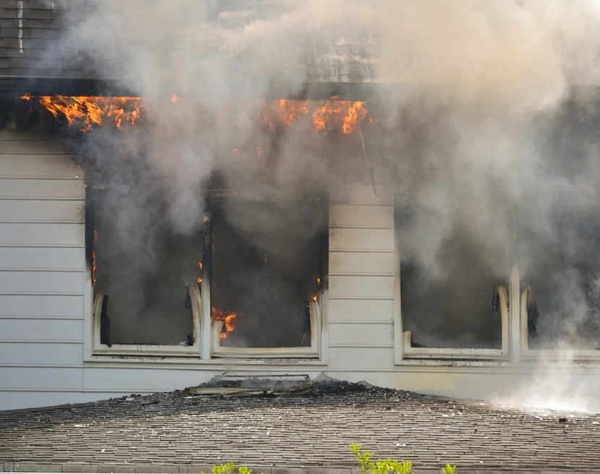
Residential Fires
During the event
  Call 9-1-1
  Use extinguishers for small fires only
  Do not use water on kitchen / grease fires
  When in doubt, get out
  Stay low and go
  If unable to get out, shut and seal door and move to the window
  Flagger by road
  Report accountability of occupants to FD immediately

Slide 46
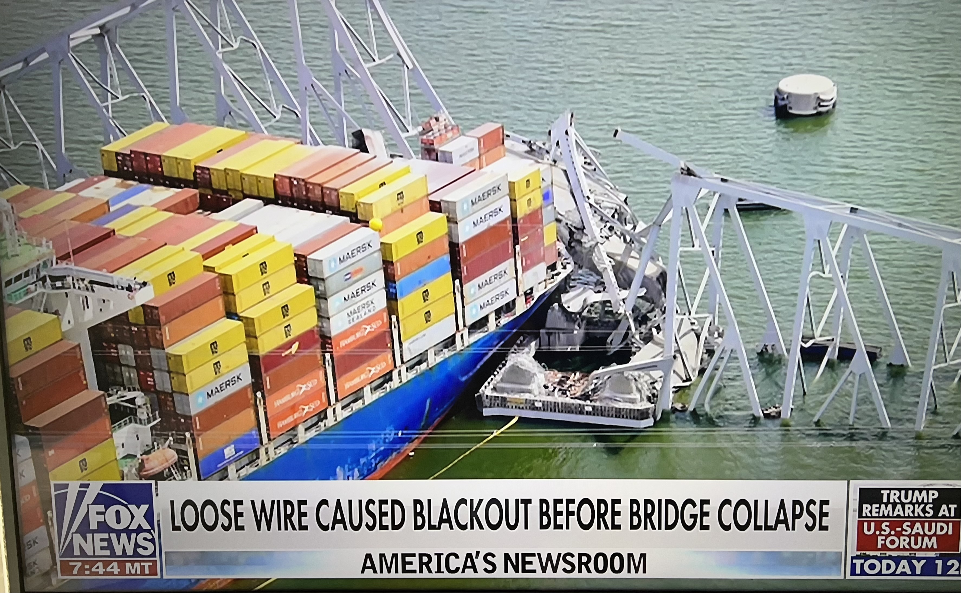
Massive Bridge Collapse

Slide 47
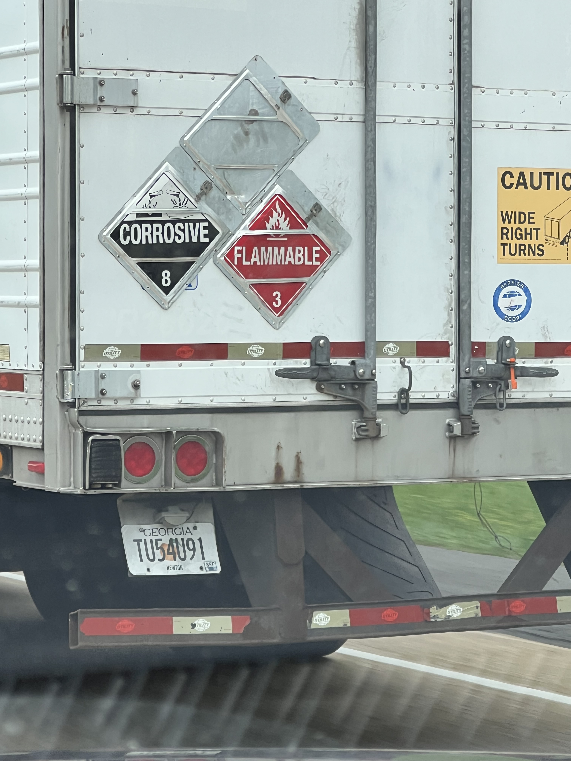
What’s in there?

Slide 48
PERSONAL & FAMILY PREPAREDNESS

Slide 49
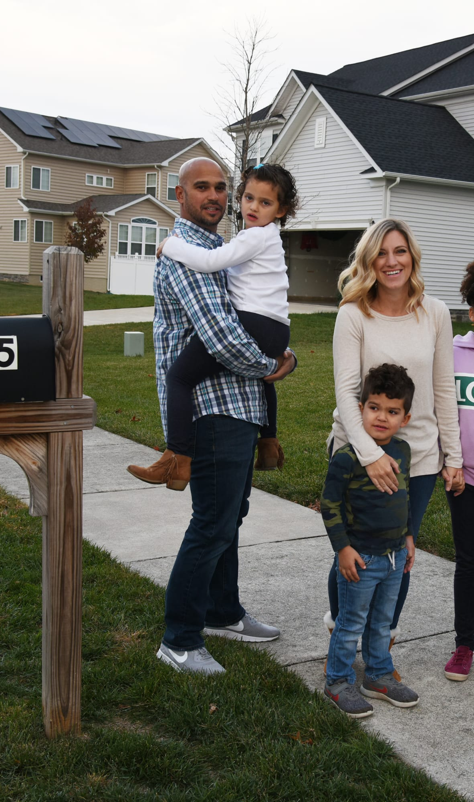
Make a Plan
Family Communications
  Family phone numbers, addresses, socials & medical info
  Emergency contacts in case of separation or loss of phone – local & out-of-town
  Important phone numbers – doctors, schools, employers, etc
  TWO Family code words:
    (a) I’m ok: “daytime” or “Christmas” or “I feel good”
    (b) I’m in distress: “nighttime” or “Halloween” or “I feel sick”
Meeting Place
  Select a meeting place for at home, local & out-of-town
  Establish meeting places in two directions
  Save locations to map ahead of time

Slide 50

Make a Plan
Evacuation / Shelter In Place
  Charge phones, fill fuel tank ahead of time, load gear
  Plan what situations you’ll stay and for how long
  Realistic expectations based on supplies and conditions – weather, utilities, comfort & health
  Risk vs Benefit – 911 may be strained
  Set triggers. Avoid indecision.
  Plan TWO ways out
  Leave early. Don’t delay.
  Share your evacuation plan with emergency contacts
  Follow instructions from emergency services - DISCUSS

Slide 51
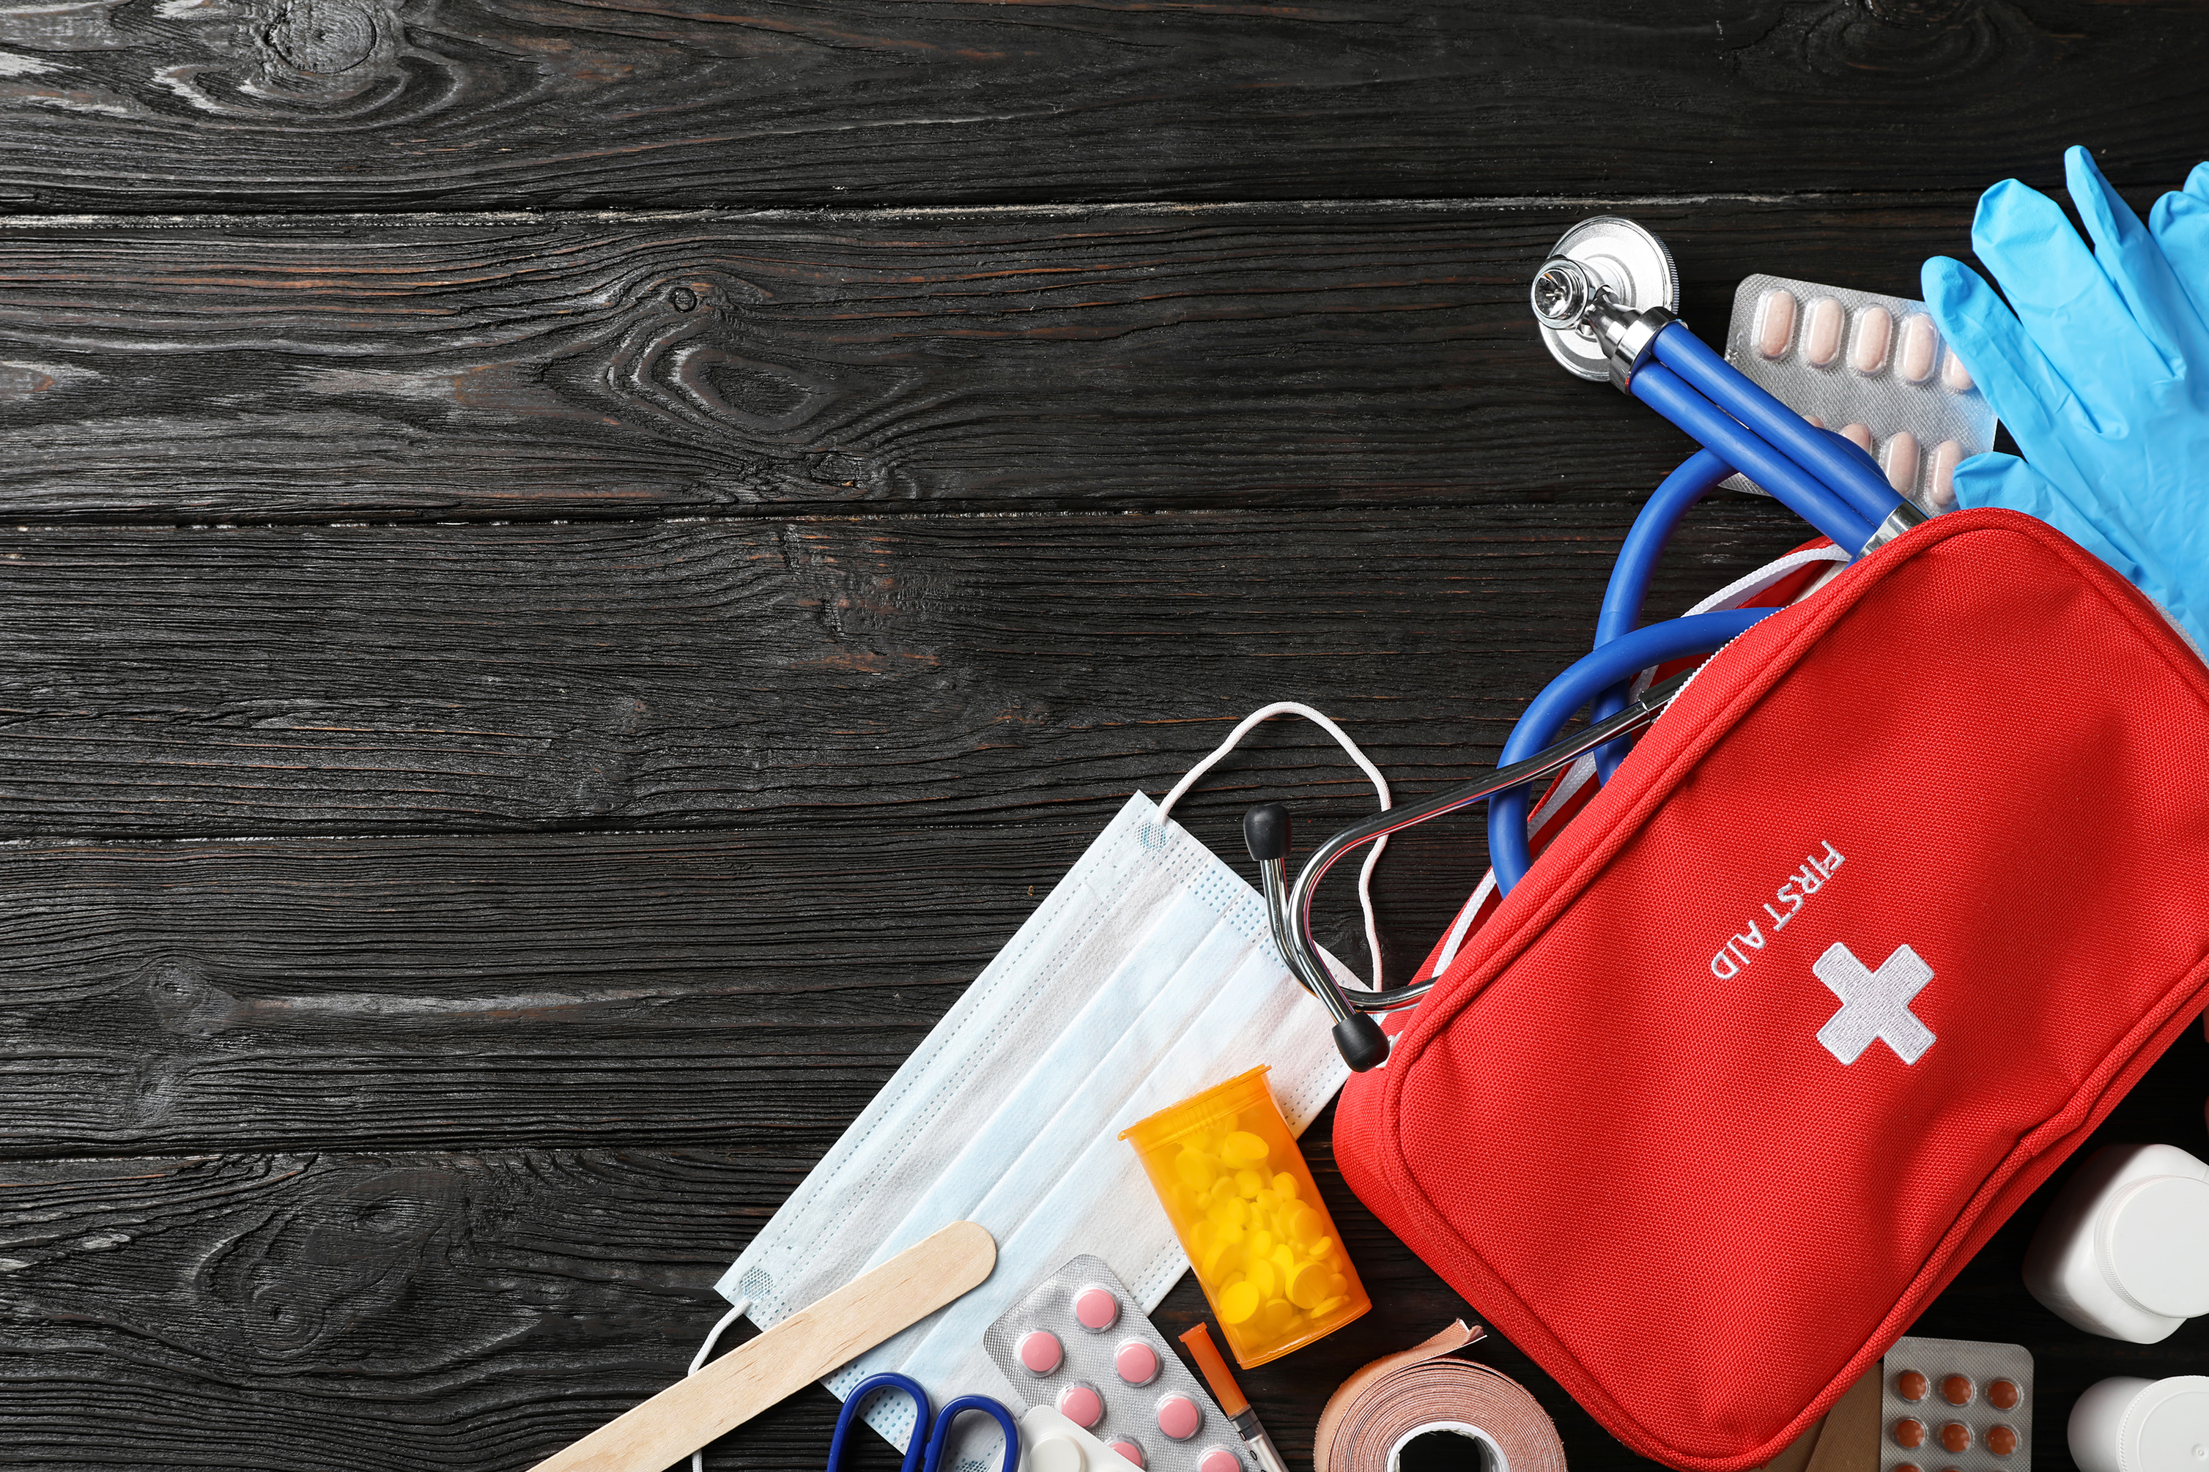
Build an Emergency Kit
Get home bag, Go bag, Bug out bag, etc.
Build kits before the season
Build kits for both sheltering and evacuating
Ensure kits are season appropriate
Have a pre-made list for quick packing during evacuations
Tailor to your family’s needs
Inspect kits every 6 months and replace items as needed

Slide 52
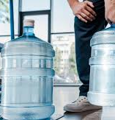
Build an Emergency Kit
Sheltering in Place (7 days supply)
  Water – 1 gallon per person per day
  Fill bathtub: WaterBob, Aquapod, Alexapure. Great Gifts!
  Nonperishable, canned, freeze-dried food
  Baby items – milk, formula, bottles, diapers, wipes, rash ointment
  Pet supplies – food, medications, leash
  First aid kit
  Rx medications
  Hearing or vision products
  Flashlights w/ extra batteries
  Battery powered or hand crank radio; AM/FM w earphones

Slide 53
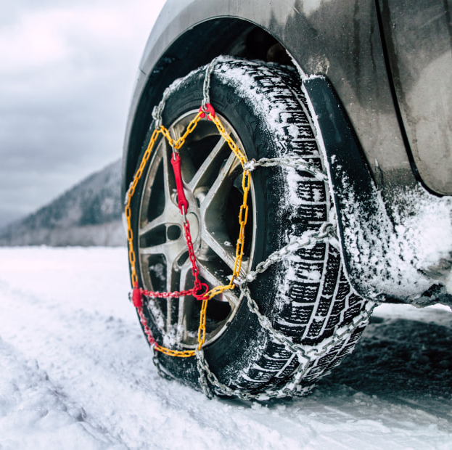
Build an Emergency Kit
Shelter in Place (continued)
  Hand sanitizer
  Plain bleach; check date
  P&G Purifier of Water packets
  Whistle
  ABC extinguisher
  Lighter or matches
  Cash; it’s free!
  Firewood & starters (winter)
  Sleeping bags or warm blankets (winter)
  Tire chains & cables (winter)

Slide 54
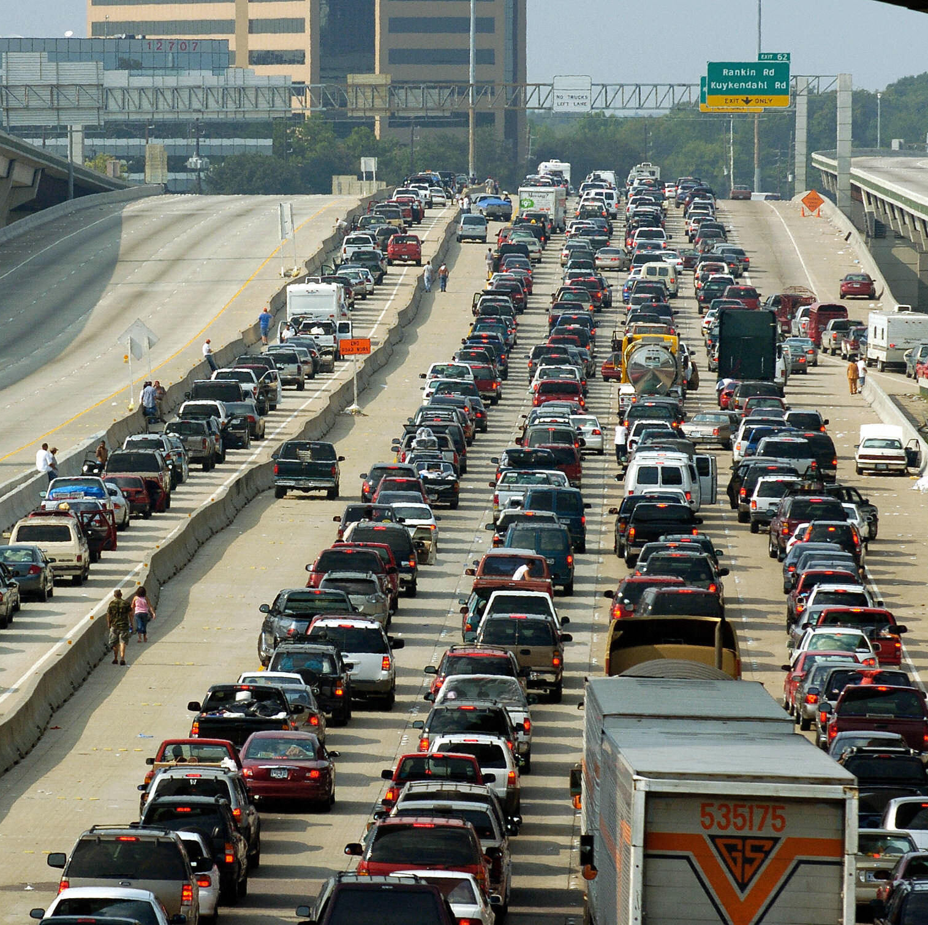
Build an Emergency Kit
Evacuating by Car
  Fuel tank FULL
  Water
  I need to potty! Pullups? Thank you!
  Nonperishable food; can opener
  Baby & Pet supplies
  First aid kit; Rx medications
  Phones & chargers
  Hearing or vision products
  Flashlights w/ extra batteries

Slide 55
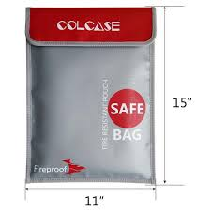
Build an Emergency Kit
Evacuating by Car (continued)
  Cash
  Whistle
  Road maps
  Spare clothes (season appropriate)
  Essential toiletries
  Documents – DL, passport, SSN, birth certificate, legal docs, family photos, insurance cards, prescriptions & dosages
  Blankets (winter)
  Roadside equipment – jumper cables, jack, spare tire

Slide 56
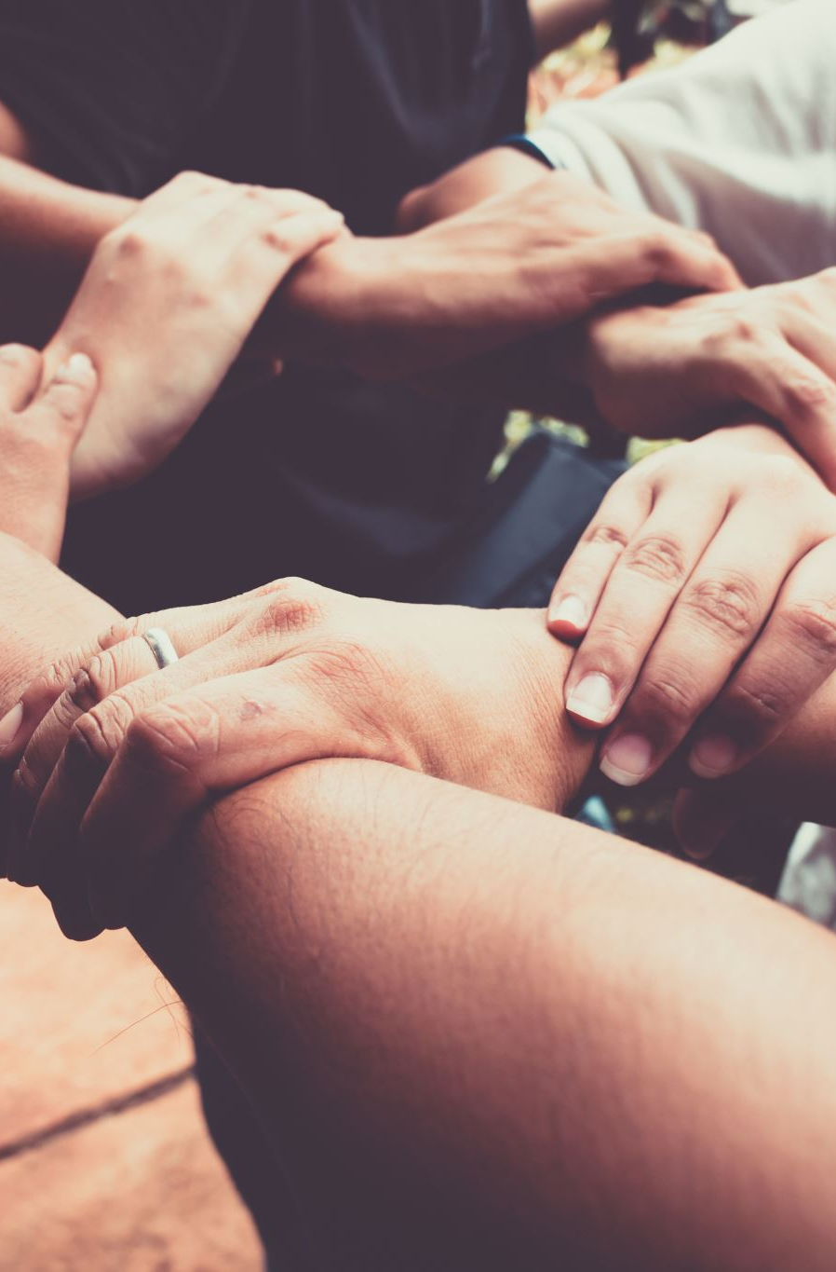
Know Your Neighbors
Identify at risk neighbors who may go unnoticed
Encourage others to prepare and seek help when needed
Reduces strain on emergency services
Bystander aid is often faster than responders
You are the first responder until help arrives!
Community ties, build a network & improve mental health

Slide 57
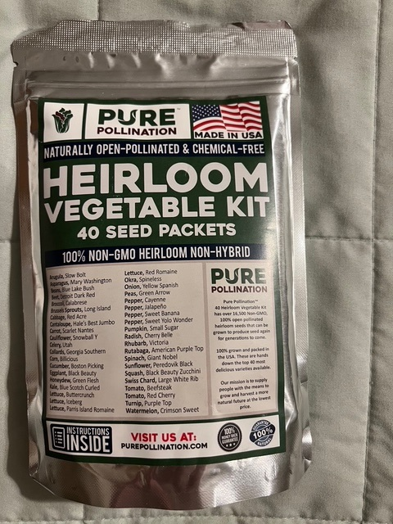

Slide 58
Stay Informed
Public Alerting Systems
WarnCentralTexas.org – must register
Accessible Hazard Alert System (AHAS) – deaf, blind, hard of hearing
KLBJ 590 AM / 99.7 FM Broadcast EAS
FEMA - Integrated Public Alert & Warning System (IPAWS)
Mobile Apps
FEMA
City of Austin: ReadyCentralTexas
STEAR – State of Texas Emergency Assistance Registry – must register
National: Ready.gov

Slide 59
Stay Informed
Media
Facebook.com/TravisCoEmergencyServices
211texas.org – emergency updates & health and human services
ATXfloods.com – flood map
tfswildfires.com – wildfire map
Drivetexas.org – road closure map
Watch Duty - wildfire tracking app

Slide 60
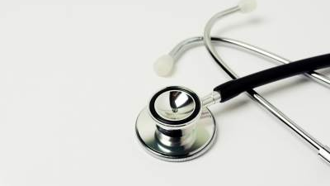
Medical Supplies
For Airway and Bleeding Control

Slide 61
Airway Overview
Foreign Body Airway Obstructions
Opioid OD; NARCAN

Slide 62
Airway Obstructions
Things to Know - Foreign Body Airway Obstruction
  Usually little kids, people that don’t fully chew food, those with swallowing difficulties
  Laughter while eating
  What to do if the person is STILL MOVING AIR?
  NO BLIND FINGER SWEEPS
  4-6 mins of no O2 before brain injuries occur
Treatments
  Call 911
  Life Vac
  Abdominal thrust/ Back Blows

Slide 63
Life Vac Home Kit: For Choking
Creates a Negative Pressure to “vacuum” a foreign object out of the air
Comes with an adult mask, adult practice mask, and pediatric mask
https://youtu.be/ENdY2j2xlbI

Slide 64

Directions
Connect Mask to device
Place on face with a good seal covering the mouth and nose
Push handle towards face
Pull handle towards the ceiling while maintaining a good mask seal

Slide 65

Opioid OD
(Fentanyl, Heroin, Pain Meds)
Josh Posey…
The patient will breath slowly or not at all
  If not breathing check for a pulse
  If no pulse start CPR
Opioid Triad
  Constricted pupils, unconscious, slow or absent breathing
Treatment
  Narcan
  Call 911

Slide 66

Bleeding Control Overview
Stop The Bleed
Sterile Gauze Rolls
Normal bleeding is stopped by 5 mins of direct pressure.
5 mins of pressure will not work when the bleeding is:
  Arterial – Bright RED and squirting
  Deep Venous Bleeds – requires more intense pressure or a hemostatic agent (QuikClot)

Slide 67



Bleeding Control Tools When More than Direct Pressure is needed
Tourniquet
Israeli Pressure Bandage
QuikClot

Slide 68

Tourniquet

Slide 69
Tourniquet
When to Use
Squirting blood – Don’t hesitate
Direct pressure is not working
An amputation
You are overwhelmed with the amount of blood
When NOT to use
When the bleeding is not on an extremity
When direct pressure is working

Slide 70
How To Apply
High and tight
Prior to tightening the windlass, only one finger should be allowed to fit between the tourniquet and the limb
Tighten the windlass until blood is no longer flowing, squirting, or limb is pulseless
Secure the windlass in the slot
Call 911
https://youtu.be/1izlp-v6WSk

Slide 71

Israeli Pressure Bandage
Uses
Stab wounds
Junctional wounds (near shoulders and groin)
Deep venous bleeds (dark, oozing blood) that do not need a tourniquet
To hold pressure while attending to other injuries
*Not interchangeable with tourniquet *

Slide 72

How To Use an Israeli Pressure Bandage

Slide 73
QuikClot
Advantages
  Accelerates clotting
  Controls bleeding faster
  Strengthens clot formation
Cautions
  Not used in place of tourniquet
  Not for internal use unless properly trained
How to use
  Wipe off blood on surface of bleeding area
  Place on bleed
  Hold pressure for 5 mins or wrap it with roller gauze or Israeli Bandage
  Call 911

Slide 74


Slide 75
Summary
YOU are your own First Responder
Preparedness mindset!
Preparedness lifestyle!
Get Home Bags
Discuss “What if…”
Personal & local community preparedness
DON’T DELAY

Slide 76

LOCAL COMMUNITY DISASTER
PREPAREDNESS
Presented by Greg Johnston
Travis County Emergency Services District #10
gjohnstonaustin@gmail.com

