Slide 1
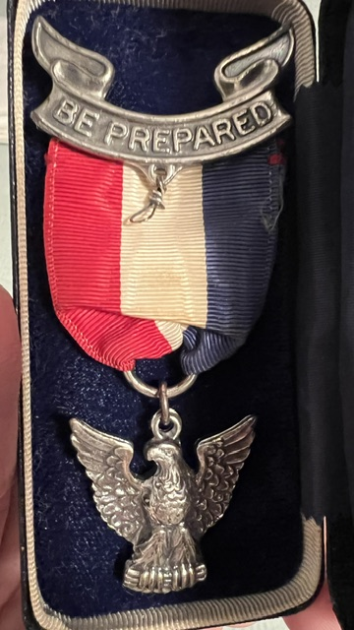
Dad’s Eagle Badge ~1948

Slide 2
Preparedness Mindset
Greg Johnston
ESD 10 Commissioner

Slide 3
“Rule of Threes”
3 Seconds – Driving Threats, Active Shooter, Fight, Scoundrels
3 Minutes – Airway, Choking, Major Bleed
3 Hours – Shelter in extreme weather
3 Days – Water is LIFE
3 Weeks – Food (3 week or 3 month supply?)

Slide 4
Preparedness Mindset
NOBODY that calls 911 thinks they will 2 minutes prior. Right?
Preparedness IS NOT about FEAR or Zombies or Apocalypse
Preparedness IS about Duty, Citizenship, Safety, Effectiveness, Insurance, Investment & Resiliency
YOU are your own first responder!
BE PREPARED. Get Started. Don’t Delay.
You ARE your own first responder!

Slide 6
DISASTER PREPAREDNESS
BECOMING YOUR OWN
FIRST RESPONDER
Presented by [YOUR] Fire Department / Entity
Travis County Emergency Services District #10

Slide 7
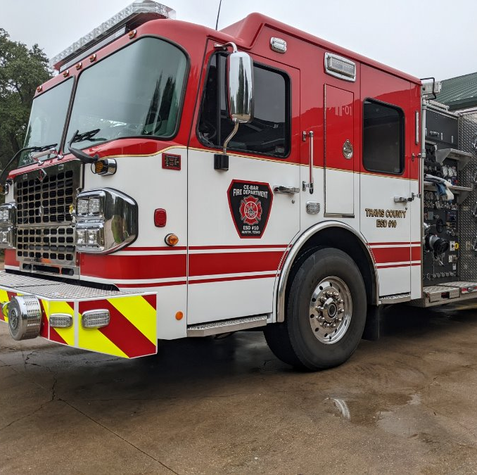
Who We Are
Travis County ESD #10
10 Square Miles
Service 8000 Residents
600 Calls / Year
Various Call Types
4.5 Minute
Response Time

Slide 8
Travis County
Divided into 13 ESDs surrounding the City of Austin
Neighboring departments – Westlake (ESD 9), Lake Travis (ESD 6), Oak Hill (ESD 3), AFD
Auto-aid partnership and response (4-5 agencies for high priority incidents)
Box Alarm – 4 Engines, 2 Trucks, 2 Bat Chiefs
Brush Alarm– 4 Brush Trucks, 2 Engines, 1 Tender, 2 Bat Chiefs
WUI Task Force – 4 Engines, 1 Aerial

Slide 9
Your Meeting Facility
Restrooms
Water
Breaks
Questions
Emergency Evacuation
Incident Action Plan

Slide 10
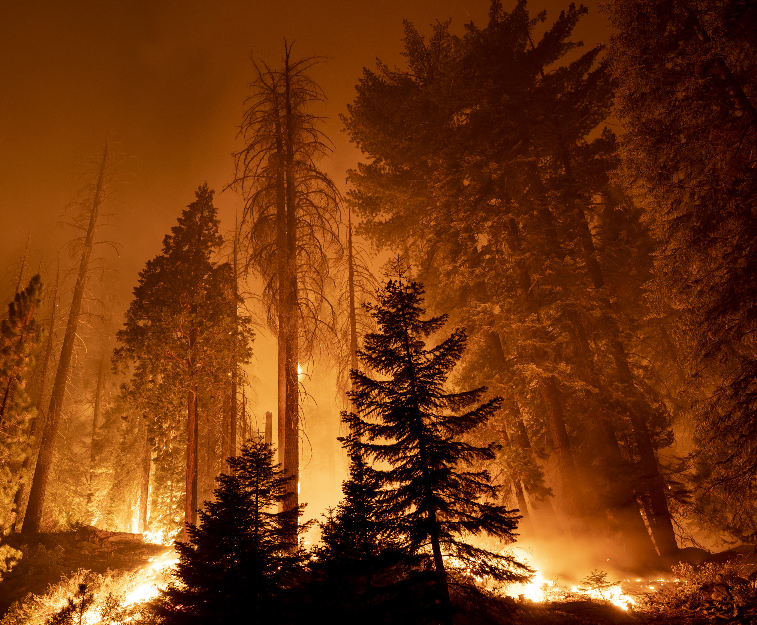
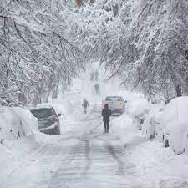
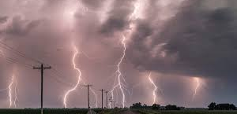
Why We’re Here
Promote and educate the community how to, plan and prepare for local disaster situations
They ARE their own first responders
Reduce the physical, psychological & financial impact of a disaster on your family and your community
Reduce reliance on emergency services when resources are diminished
Reduce the strain on the emergency response system

Slide 11
Overview
Recent disasters and consideration specific to each
Individual and family preparedness
Medical supplies for airway & bleeding control
Preparedness Mindset
Get Home Bags
Topic tables for questions & answers

Slide 12
Objectives
Attendees will understand of their local emergency service providers and their services
Attendees understand the importance of disaster preparation at the individual level, and the benefits of promoting preparedness throughout their communities
Attendees have a basic understanding of how to effectively plan and prepare for various types of disasters, mitigating the negative impact on our communities

Slide 13
RECENT DISASTERS

Slide 14
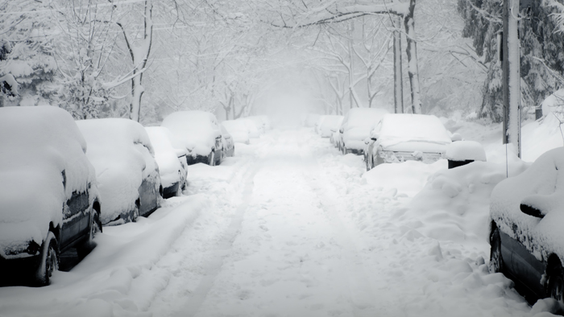
Winter Storms

Slide 15
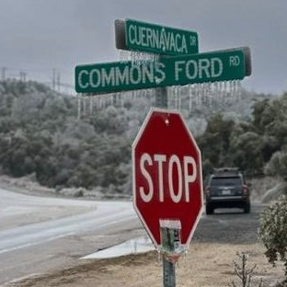
Winter Storms
Hazards
Icy roads
Loss of power
Broken water pipes; MINE!
Frigid temps / hypothermia
Lack of emergency services / access
Lack of retail / food services
Carbon monoxide poisoning
Residential fires

Slide 16
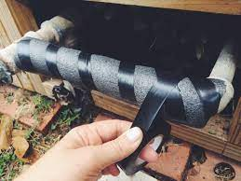
Winter Storms
Preparation
Wrap pipes, drip faucets, shut off water
Maintain generator – service, fuel, output
Adequate blankets & clothing
Stockpile firewood
Emergency kits
Tire chains
Salt / sand entrances

Slide 17
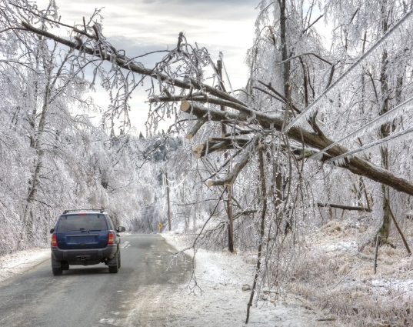
Winter Storms
During the Event
Avoid driving if possible
Travel during day and have emergency kit in vehicle
Notify emergency contacts before departing
Frequently inventory emergency supplies
Prevent carbon monoxide poisoning

Slide 18
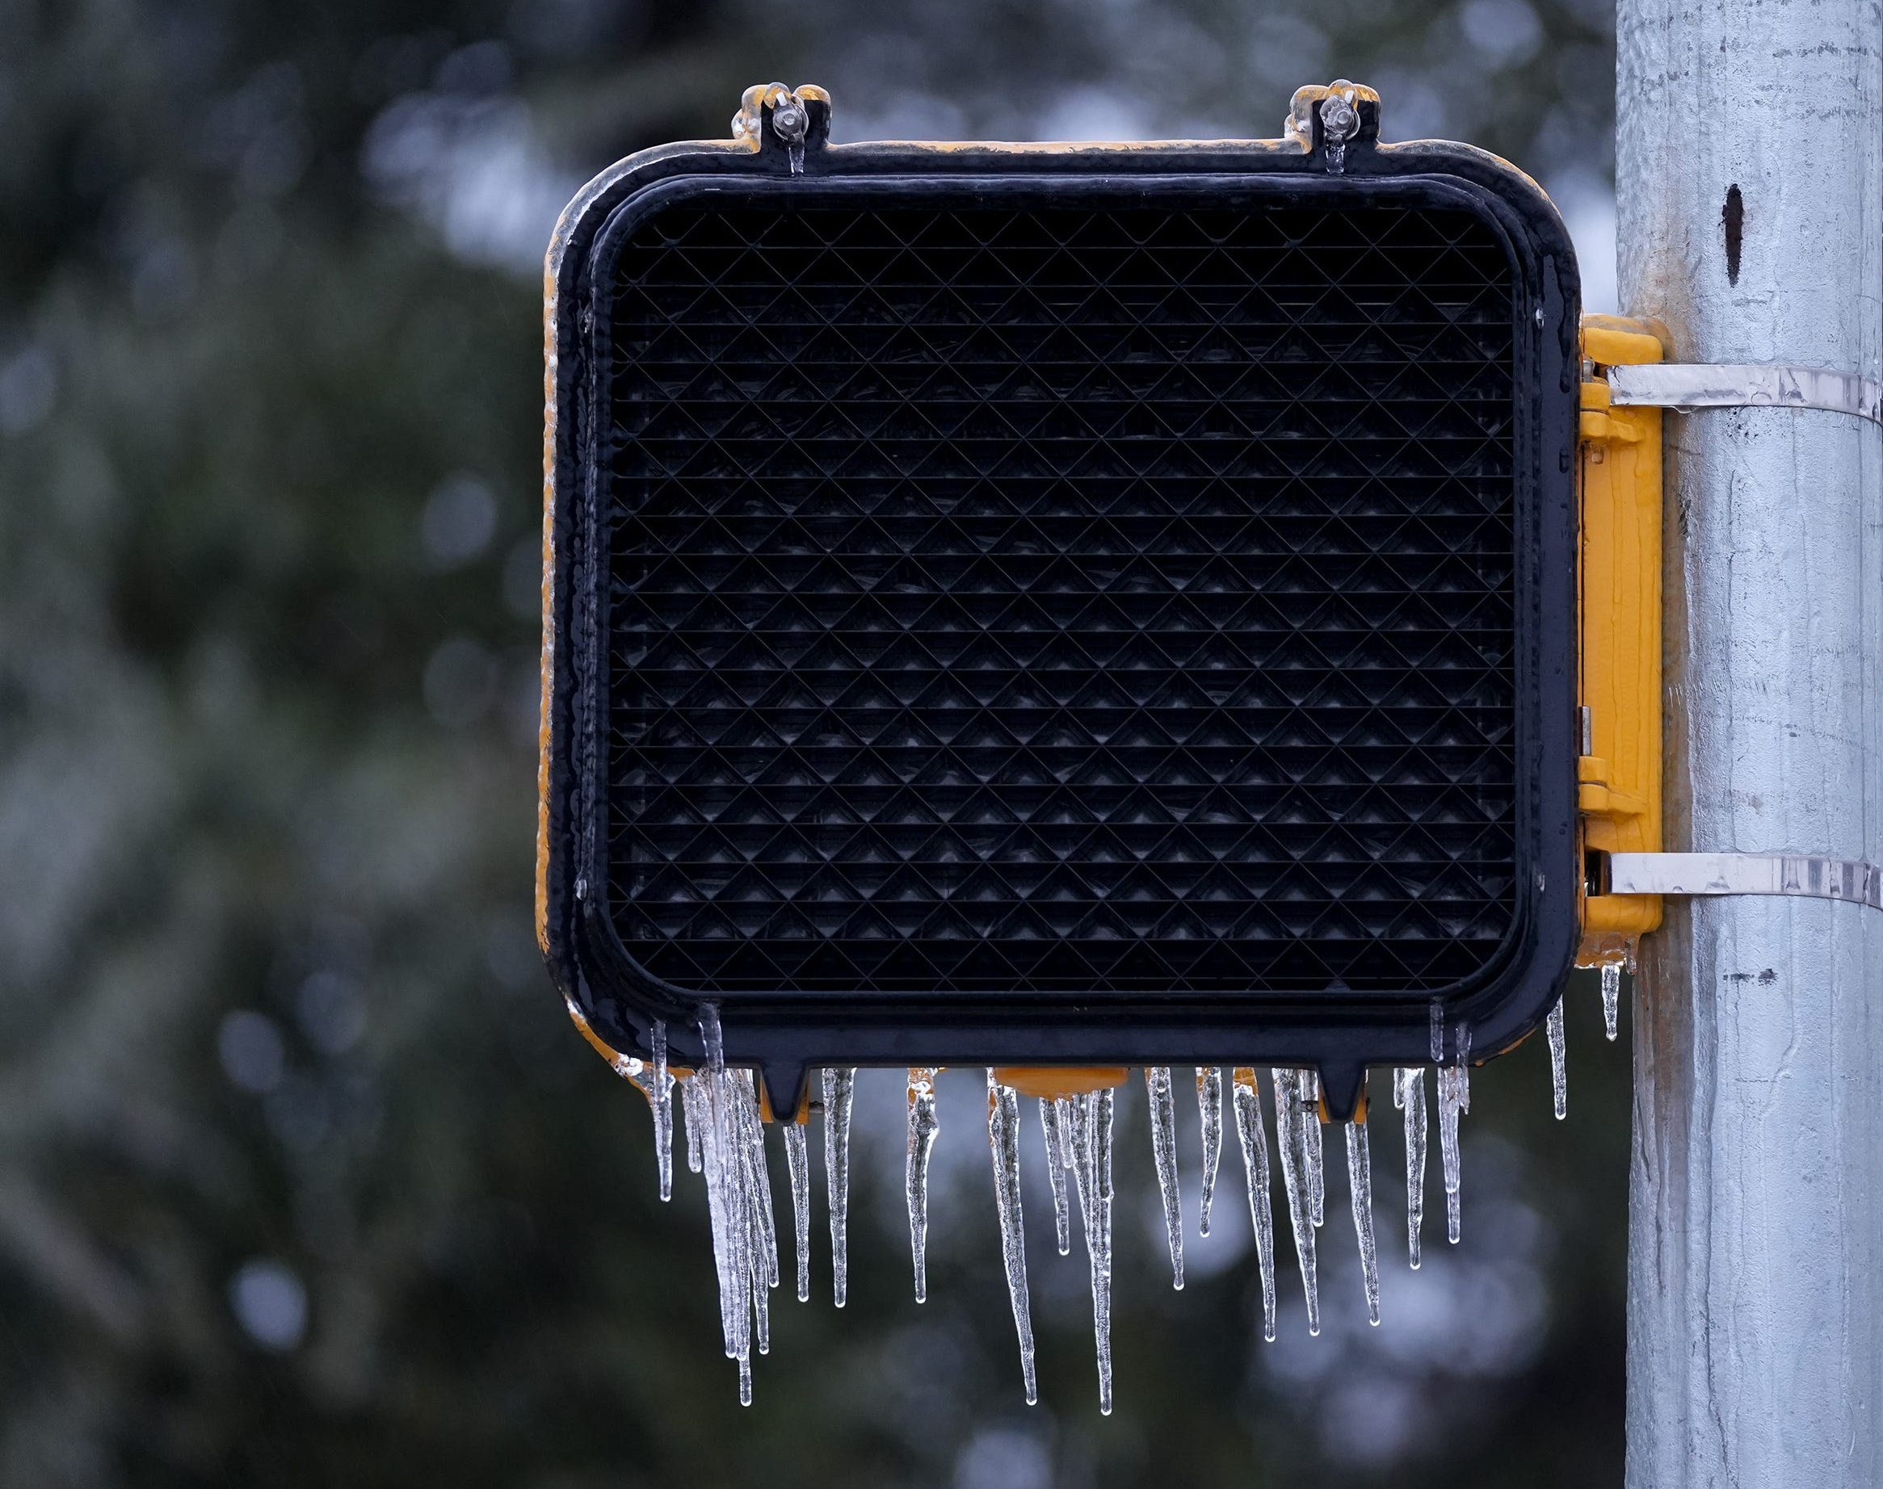
Power Outages

Slide 19
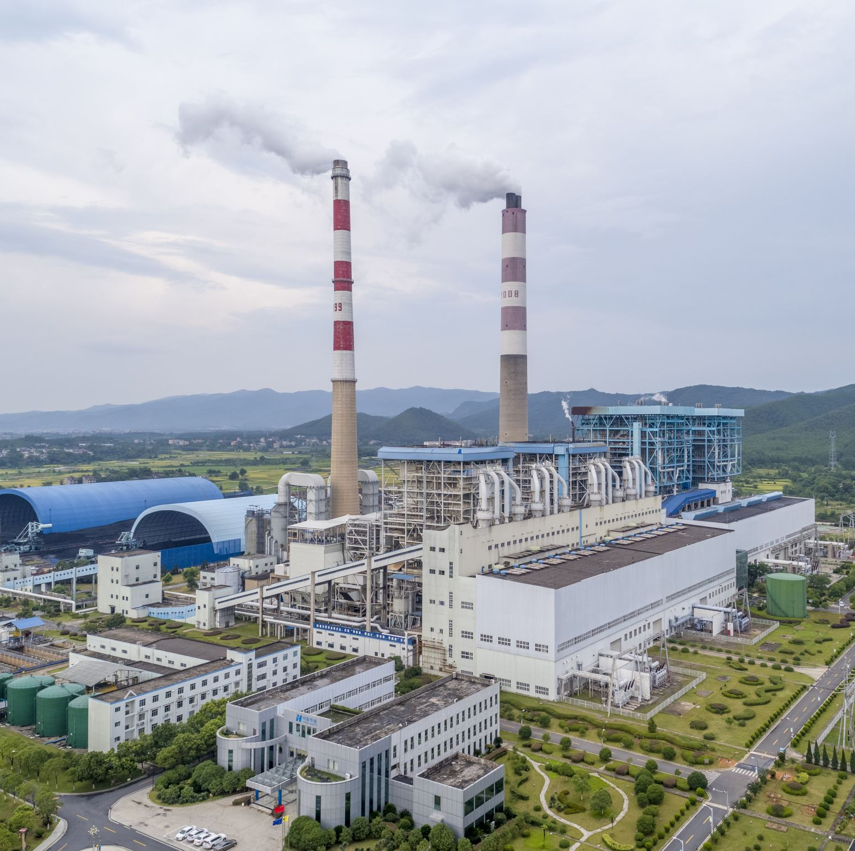
Power Outages
Hazards
Extreme temperatures
Lack of food, water, utilities, information
Carbon monoxide poisoning
Electrical fires when power turns back on
Traffic hazards
Chimney fires (winter)

Slide 20
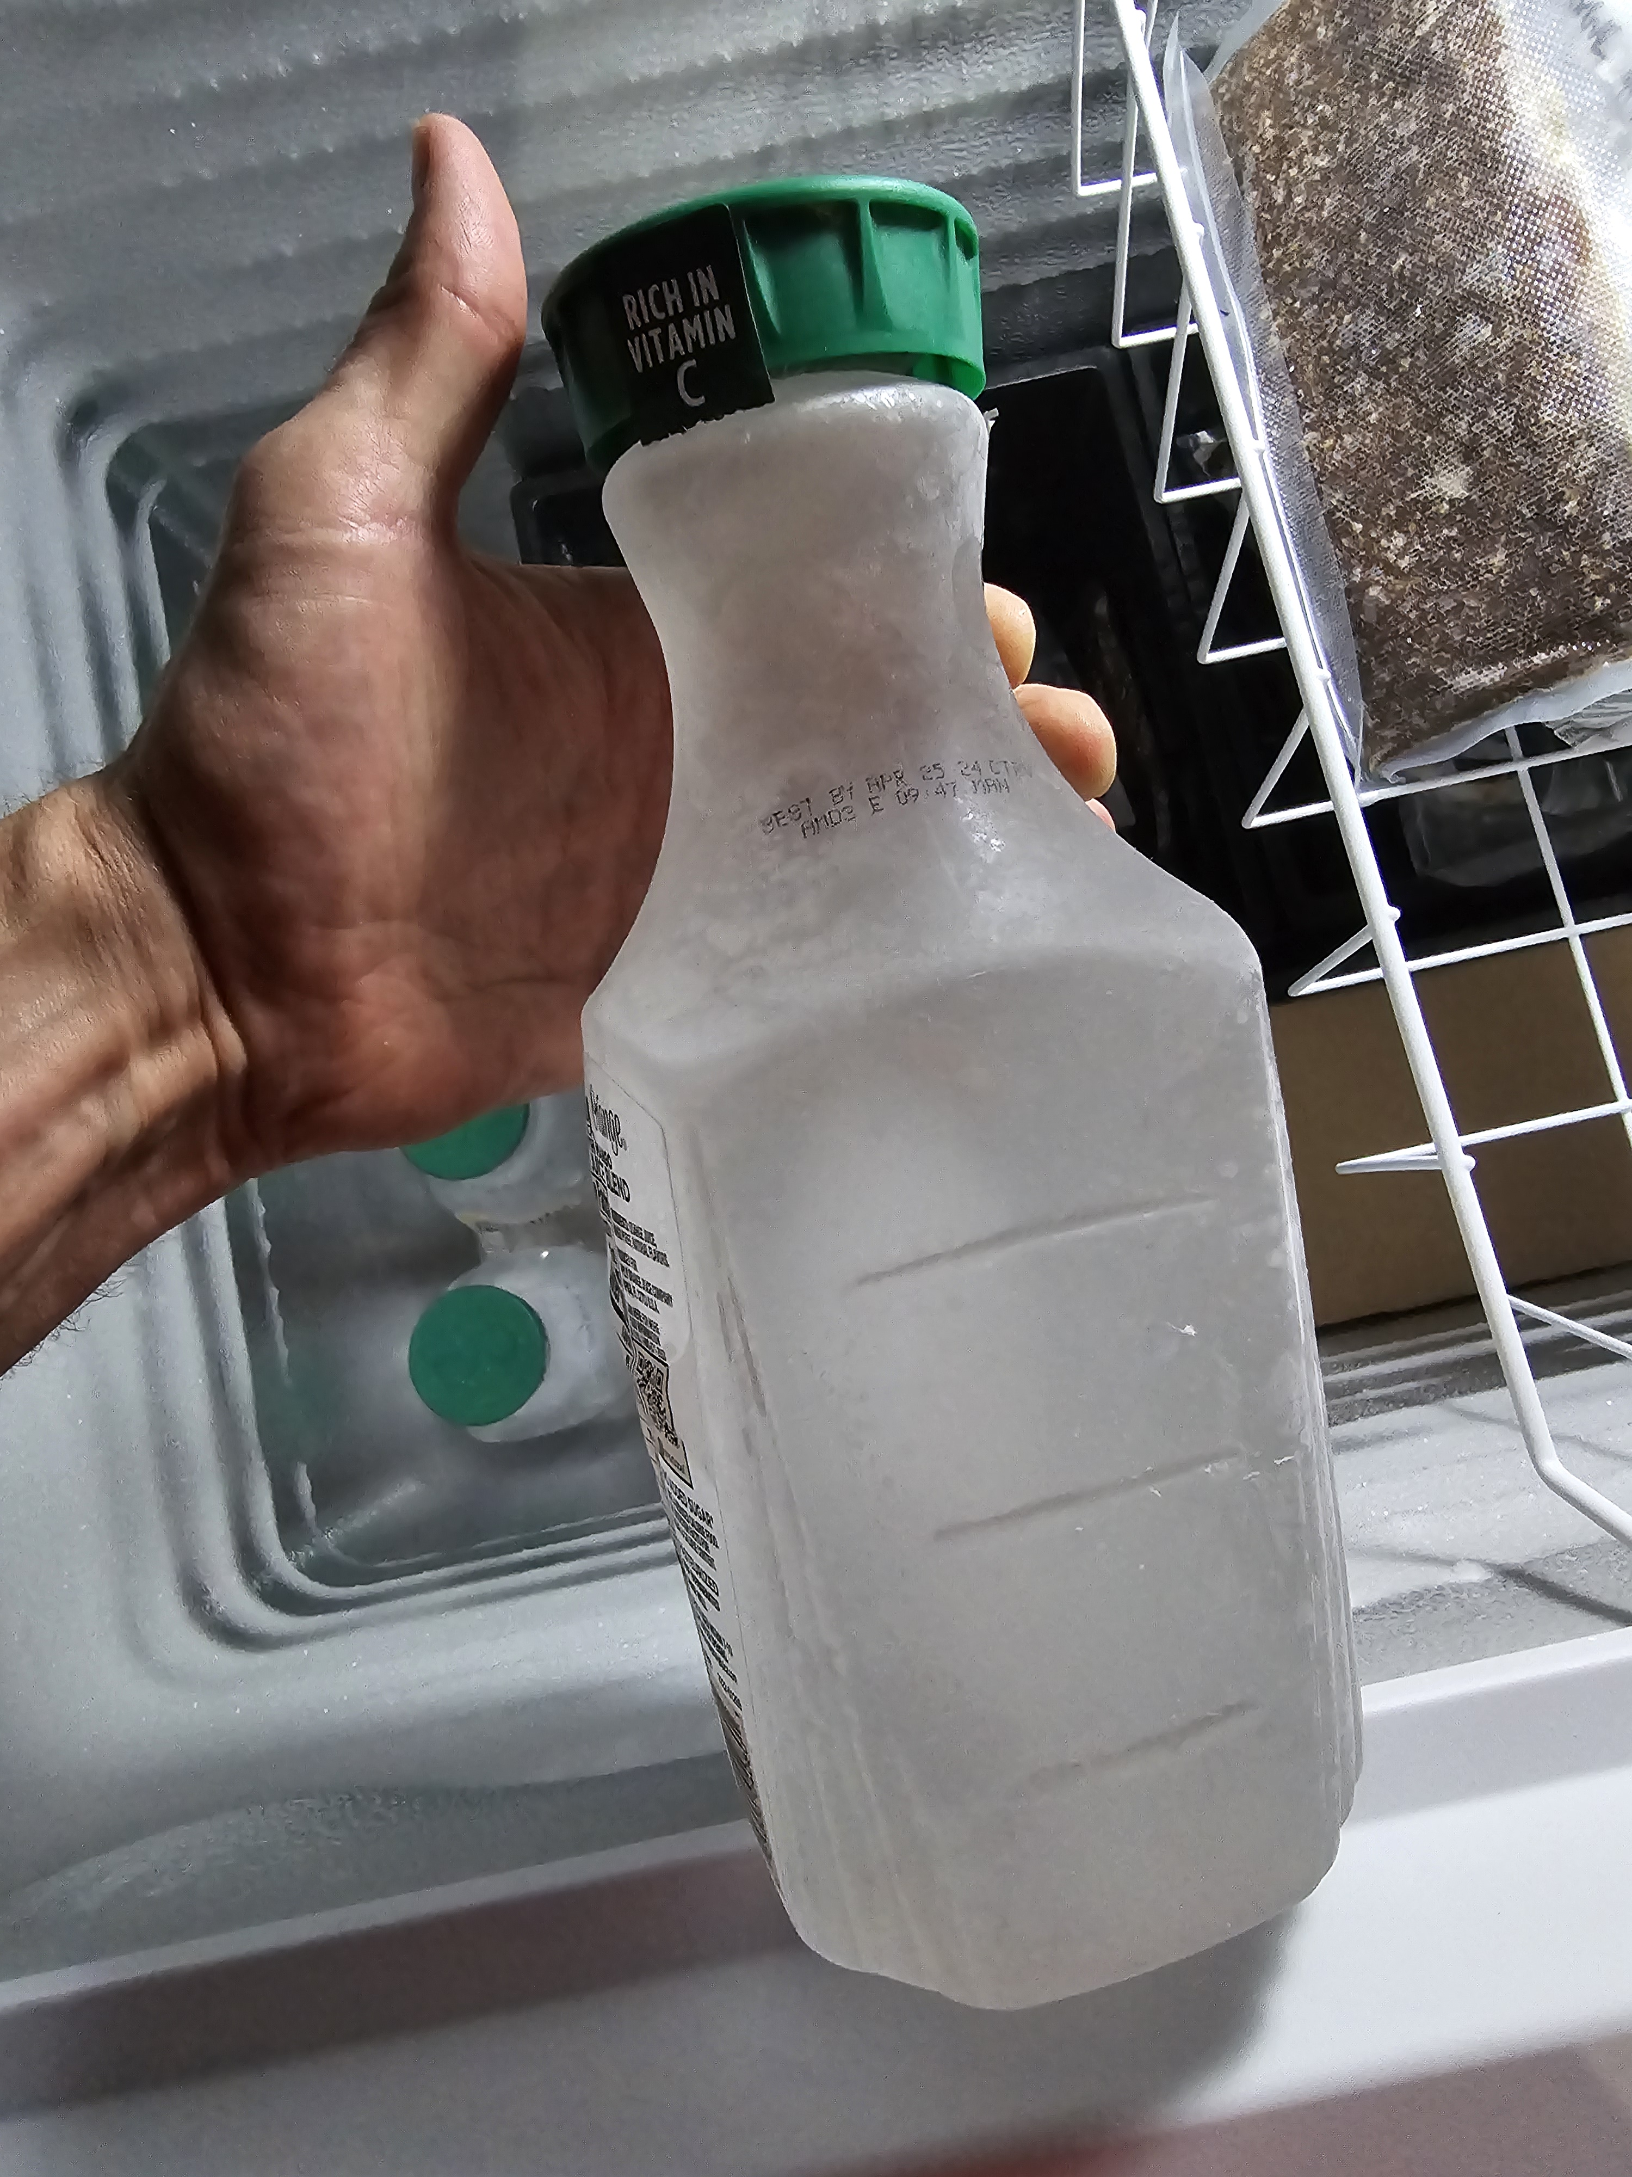
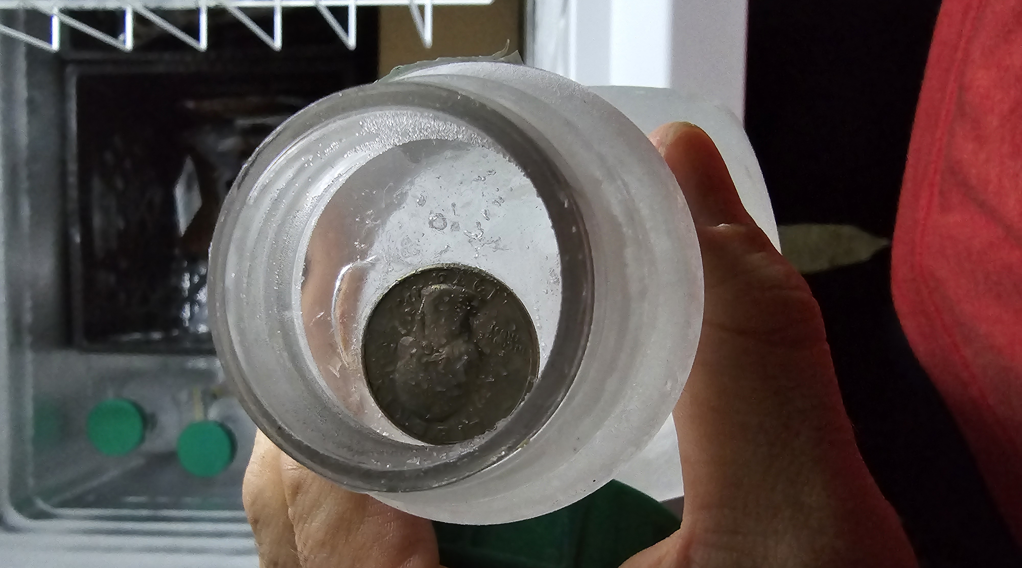
Power Outages
Preparation
Emergency supplies kit
Generator
Transfer switch vs. direct supply
Maintenance
Stabilized fuel
Makeshift ice blocks
Season appropriate equipment
Winter – blankets, firewood, indoor space heaters
Summer – fans, portable a/c units
Have chimney serviced and cleaned
Battery powered carbon monoxide detector

Slide 21
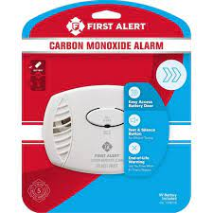
Power Outages
During the Event
Extend food supplies
Eat perishable foods first
Closed fridge – 4 hours, full freezer – 48 hours, deep freezer – 72+
Rotating appliances (generator)
Prevent carbon monoxide poisoning
Use generators in well ventilated areas
Place CO detector in common area near where generator is
Decide when to stay and go based on safety, comfort, and health

Slide 22
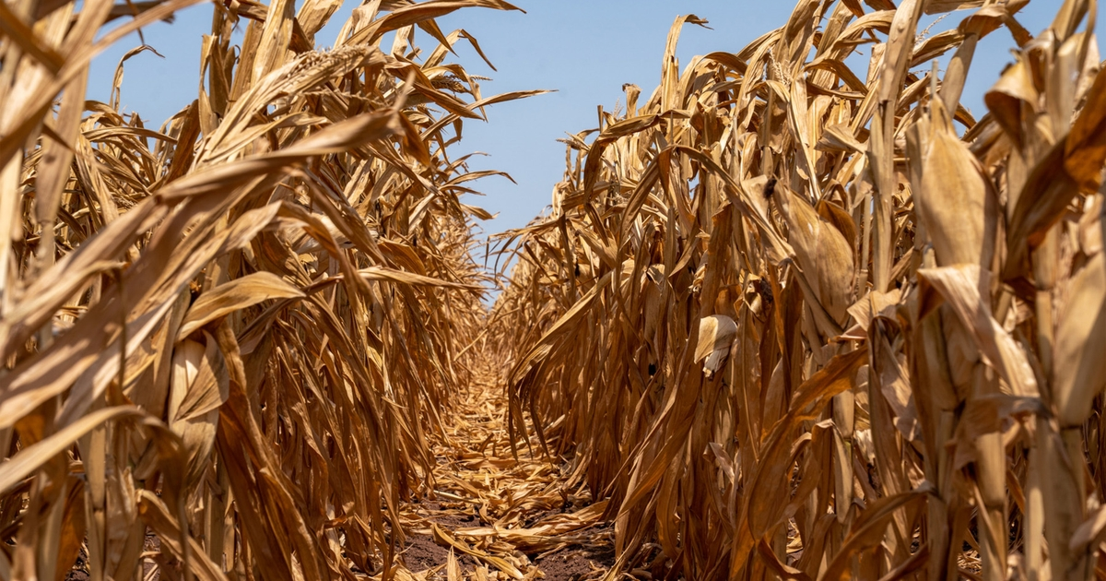
Extreme Heat

Slide 23
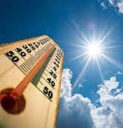
Extreme Heat
Hazards
Dehydration, heat exhaustion, heat stroke
Elderly and young populations at higher risk
Children or pets left in vehicles
Sunburn
Wildfire

Slide 24
Extreme Heat
Preparation
Individual
Drink extra fluids (H2O) w/ electrolytes
Wear moisture wicking garments
Plan strenuous outdoor activities to avoid peak temperatures
Take frequent breaks when working outside
Know the signs of heat emergencies
Heat exhaustion – sweating, cramping, weakness, dizziness, nausea, vomiting, headache
Heat stroke – high body temp, hot dry skin, headache, confusion
Home
Have A/C serviced before summer; clean drain lines
Consider purchasing extra fans if you have a power source

Slide 25
Extreme Heat
During the Event
Heat emergencies
Call for emergency services
Move the person inside or to shaded location
Remove clothes and cool as best as possible
Cold water immersion is most effective treatment
Home
Have a back-up plan if A/C malfunctions
Never leave people or pets in a closed vehicle
Cooling centers available

Slide 26
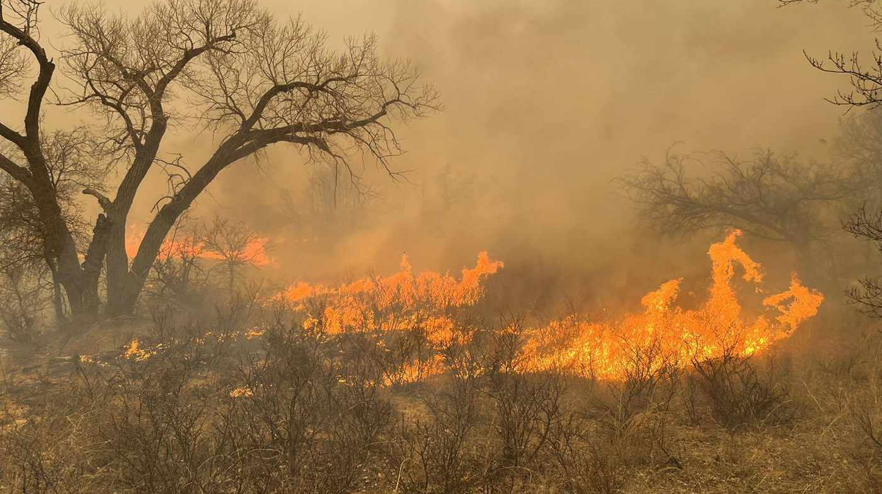
Wildfire

Slide 27
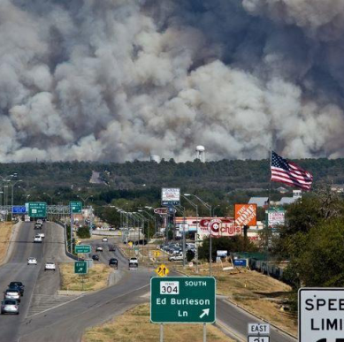
Wildfire
Texas 2024
12,411 Wildfires
650,712 Acres
Travis County 2024
6,725 Acres
202 Homes destroyed

Slide 28
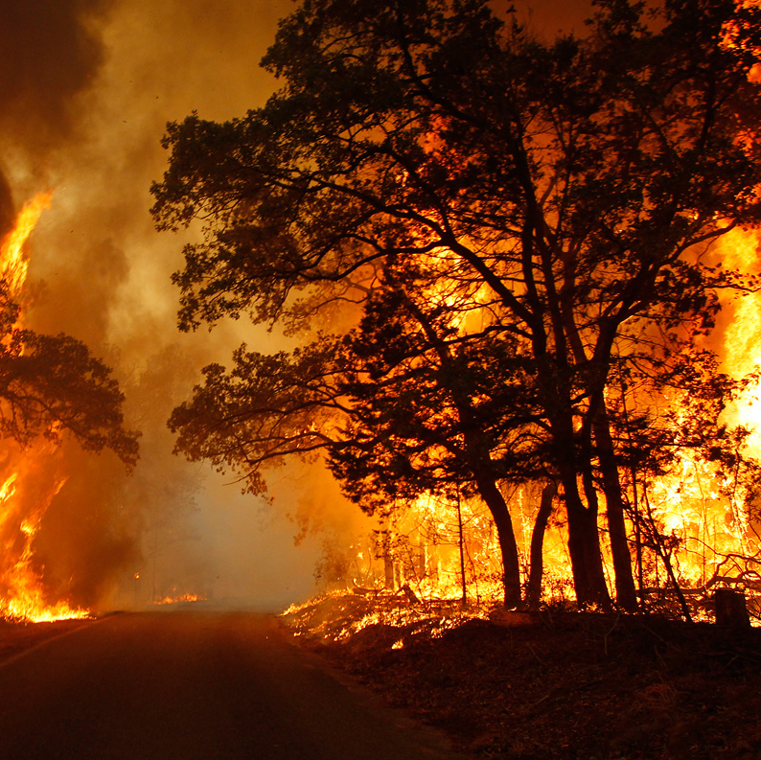
Wildfire
Preparation (individual)
Register with alerting systems
Create a family plan
Know evacuation routes
Take 300+ photos
List what you’ll take; Prioritize
Emergency kit ready
Walk out the door
Evacuate early
Tell emergency contact you left

Slide 29
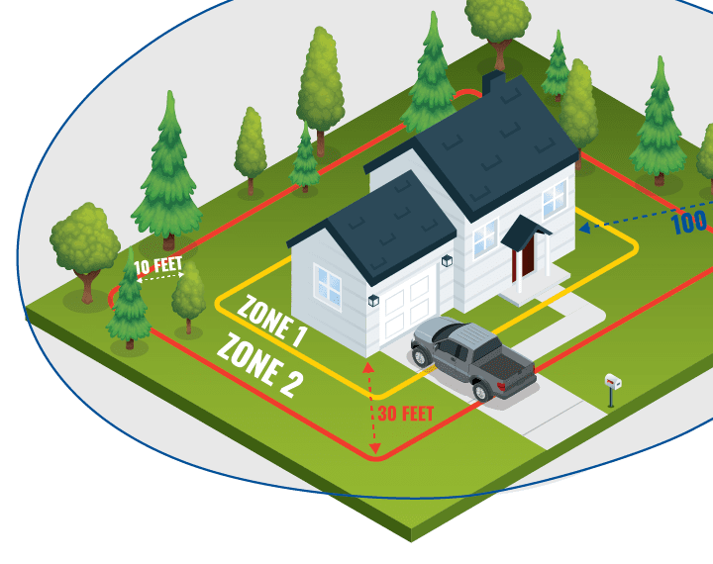
Wildfire
Preparation (home)
Mitigation programs – ReadySetGo, Firewise, TexasWildFireRisk.com
What you invest in prep directly impacts FD effort to defend your home
Defensible space, trees, roofs, gutters, building materials, propane tanks, access

Slide 30
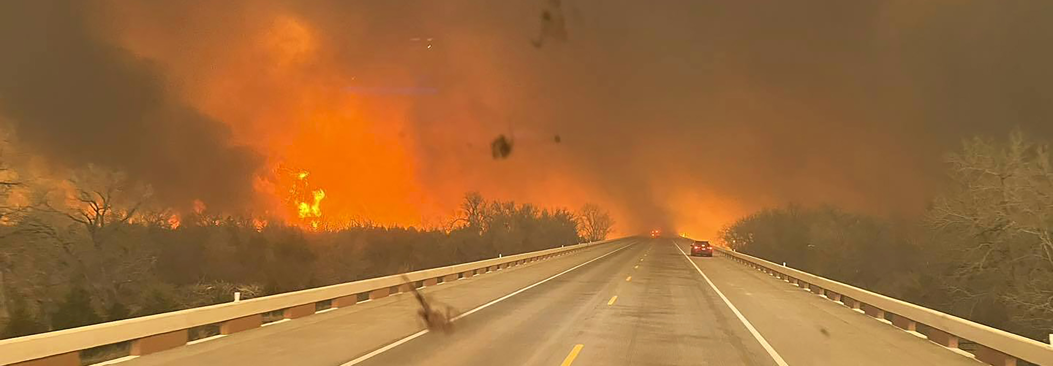
Wildfire
During the Event
Continuously monitor disaster updates
Evacuate early and when directed to by emergency personnel
Notify your emergency contact that you are leaving
Do not leave sprinkler systems running
Anticipate evacuation problems

Slide 31
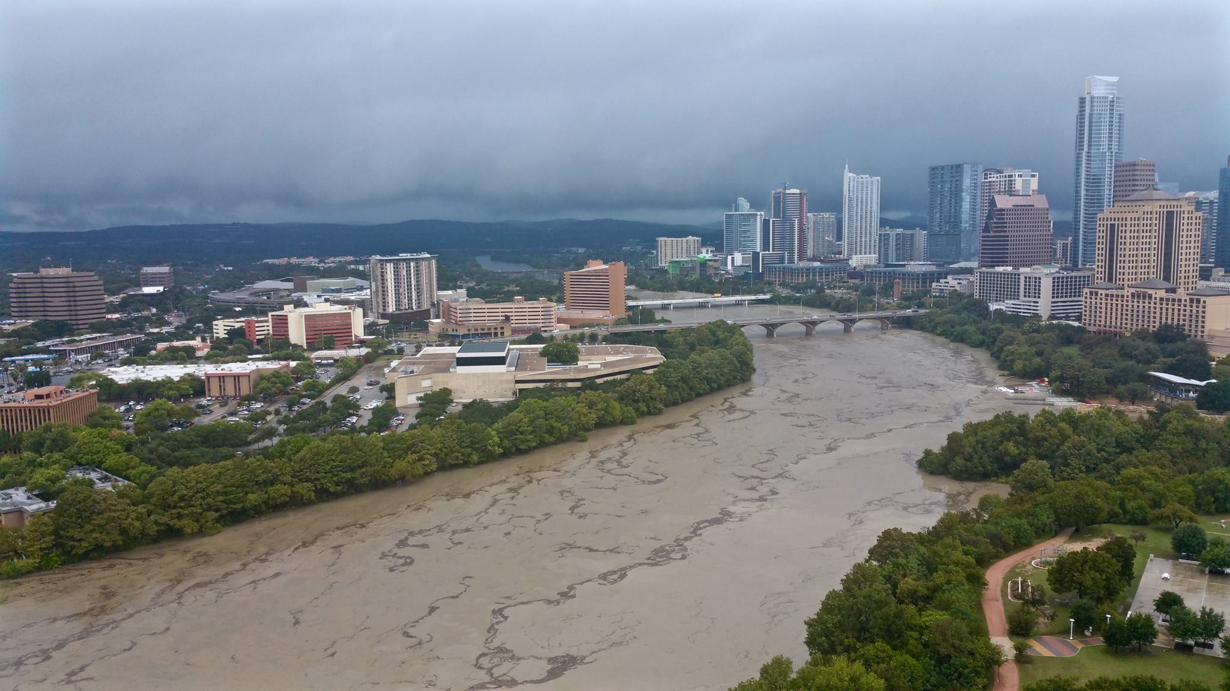
Severe Storms & Flooding

Slide 32
Severe Storms & Flooding
Hazards
Often underestimated
Flood water moves fast and is powerful!
High winds often lead to down trees
Blocked roadways
Lighting strikes and residential fires

Slide 33
Severe Storms & Flooding
Preparation
Maintain trees on property
Clean drains and gutters
PM your generator and top off fuel
Install / inspect smoke detectors,10-year lifespan
Have an emergency kit
Know your neighborhood flood areas
Monitor weather forecasts

Slide 34
Severe Storms & Flooding
During the Event
Stay indoors
Avoid driving if possible
Check ATXflood.com for flood map
Do not cross any roads with water over it
Do not drive over or handle any down lines

Slide 35
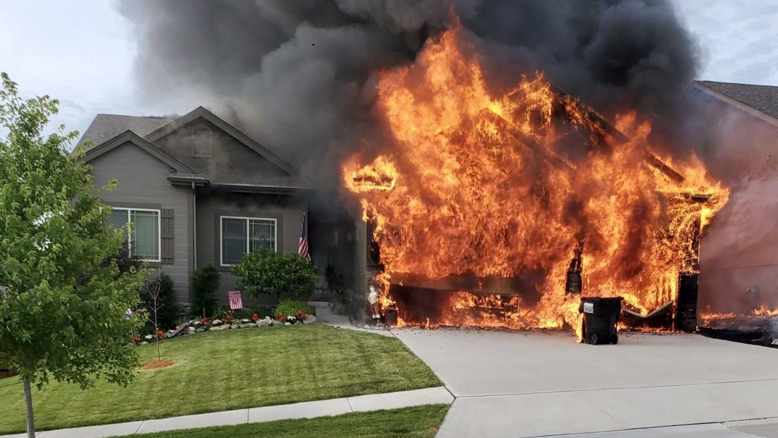
Residential Fires

Slide 36
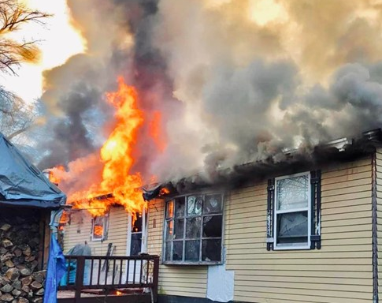
Residential Fires
2024 National Statistics
2,720 deaths
10,250 injuries
$10 billion in damage
374,300 house fires = 1 fire every 90 seconds
70% of all fire deaths occur in residential structures
Leading cause = 47% cooking

Slide 37
Ignition to Flashover UL Demo side by side Natural vs Synthetics 5 min vs 30 min to Flashover!
https://youtu.be/87hAnxuh1g8

Slide 38
Residential Fires
Preparation
Install smoke detectors outside every living space on every floor and in attic
Change batteries in detectors every 6 months (time change)
Avoid using open flame candles
Ensure children do not have access to matches / lighters
Clean chimney at least every 10 years
Have multiple fire extinguishers available. Know how to use them.
Develop a family fire safety plan & Meeting Location (Mailbox? Neighbor?)
Practice fire drills regularly

Slide 39
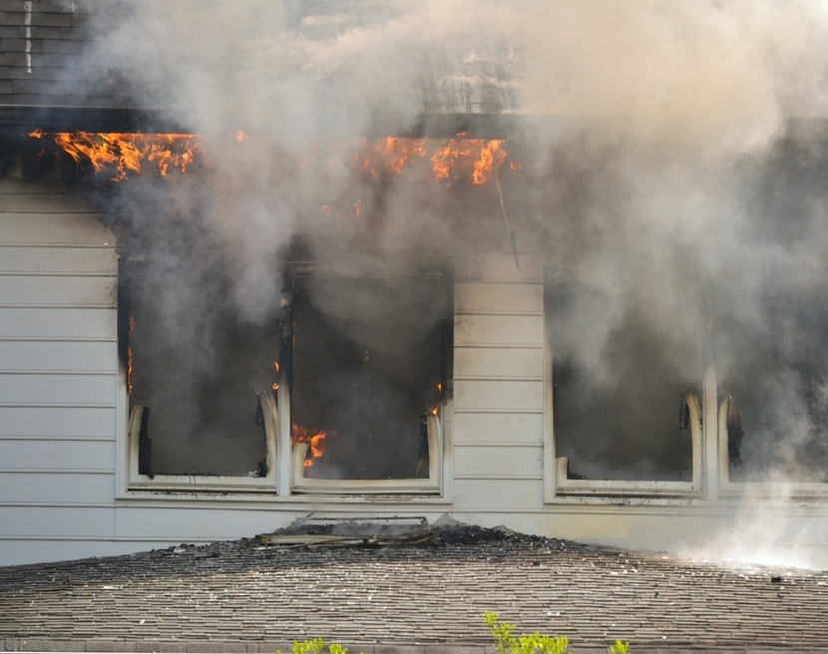
Residential Fires
During the event
Call 9-1-1 immediately
Use extinguishers for small fires only
Do not use water on kitchen / grease fires
When in doubt, get out
Stay low and go
If unable to get out, shut and seal door and move to the window
Report accountability of family members / tenants to FD immediately

Slide 40
PERSONAL & FAMILY PREPAREDNESS

Slide 41
Make a Plan
Family Communications
All family phone numbers, addresses, socials, & medical info
Emergency contacts in case of separation or loss of phone – local & out-of-town
Important phone numbers – doctor’s office, schools, employers, etc
Meeting Place
Have a rehearsed meeting place for at home, local, and out-of-town
Establish meeting places in multiple directions
Save locations to map ahead of time

Slide 42
Make a Plan
Evacuation / Shelter In Place
Plan what situations you’ll stay and for how long
Have realistic expectations based on supplies and conditions – weather, utilities, comfort, & health
Risk vs Benefit – 911 may be strained
Set triggers to avoid indecisiveness
Fill fuel tanks & Charge phones ahead of time
Have at least 2 planned ways out
Leave early when possible
Share your evacuation plan with emergency contacts
Always follow instructions from emergency services

Slide 43
Water IS LIFE!

Slide 47
Build an Emergency Kit
Build kits before the season
Build kits for both sheltering and evacuating
Ensure kits are season appropriate
Have a pre-made list for quick packing during evacuations
Tailor your kit to your family’s needs
Inspect kits every 6 months and replace items as needed

Slide 48
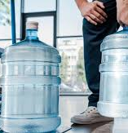
Build an Emergency Kit
Sheltering in Place (7 days supply)
Water – 1 gallon per person per day
Nonperishable food w/ can opener
Baby items – milk, formula, bottles, diapers, wipes, rash ointment
Pet supplies – food, medications, leash
First aid kit
Rx medications
Hearing or vision products
Flashlights w/ extra batteries
Battery powered or hand crank radio

Slide 49
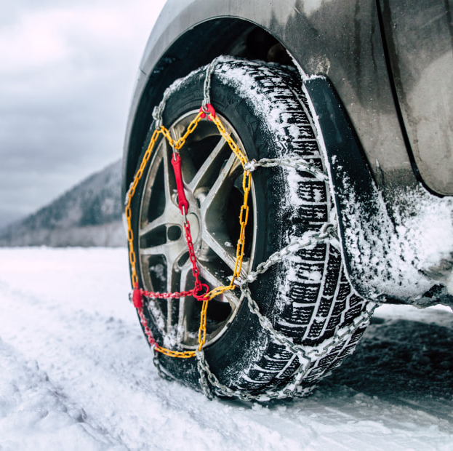
Build an Emergency Kit
Shelter in Place (continued)
Hand sanitizer
Bleach – 1/8 tsp per gallon let stand for 30 min; follow EPA Guidelines
Whistle
ABC extinguisher
Lighter or matches
At least $200 cash; its FREE
Firewood & starters (winter)
Sleeping bags or warm blankets (winter)
Tire chains/ cables (winter)

Slide 50
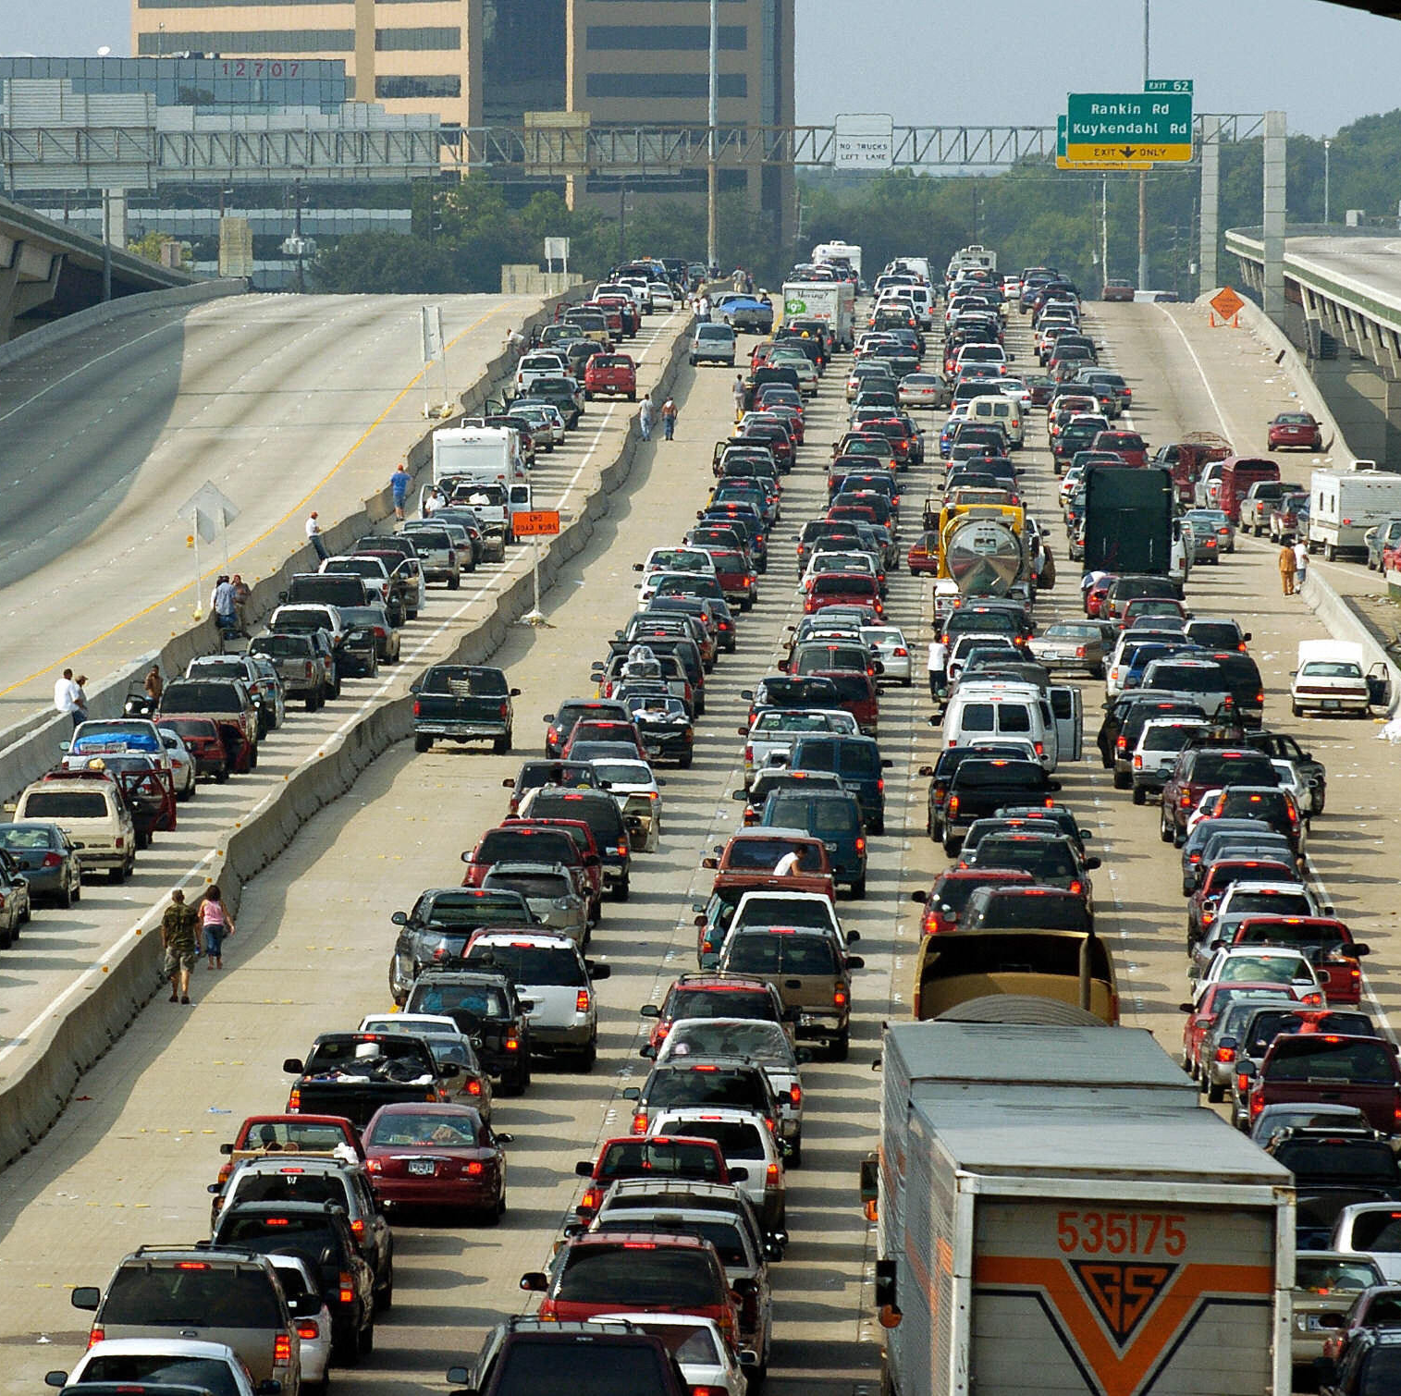
Build an Emergency Kit
Evacuating by Car
Water & options
Nonperishable food & can opener
Baby supplies – milk, formula, bottles, diapers, wipes, rash ointment
Adult diapers. Think about it!
Pet supplies – food, meds, leash
First aid kit
Rx medications
Phones & chargers
Hearing & vision products
Flashlights w/ extra batteries

Slide 51
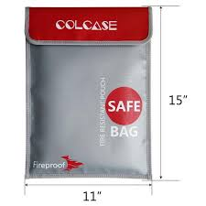
Build an Emergency Kit
Evacuating by Car (continued)
At least $200 cash
Whistle
Road maps
Spare clothes (season appropriate)
Essential toiletries
Documents bag – DL, passport, SSN, birth certificate, legal docs, pictures of family, insurance cards, prescriptions & dosages
Blankets (winter)
Roadside equipment – jumper cables, jack, spare tire

Slide 52
Get Home Bag…Get Started!
Check out the Get Home Bag List
Start with BASICS
Food, Water, First Aid, Shelter, Security
Great GIFTS for your loved ones

Slide 53
Know Your Neighbors
Identify at risk population
Encourage others to prepare and seek help when needed
Reduce strain on emergency services
Bystander aid is often faster than professional responders
You are the first responder until help arrives!
Community builds a network and improves mental health

Slide 54
Stay Informed
Public Alerting Systems
WarnCentralTexas.org – must register
Accessible Hazard Alert System (AHAS) – deaf, blind, hard of hearing
KLBJ 590 AM / 99.7 FM Broadcast EAS
FEMA - Integrated Public Alert & Warning System (IPAWS)
Mobile Apps
FEMA
ReadyCentralTexas
STEAR – must register

Slide 55
Stay Informed
Media
Facebook.com/TravisCoEmergencyServices
211texas.org – emergency updates & health and human services
ATXfloods.com – flood map
tfswildfires.com – wildfire map
Drivetexas.org – road closure map

Slide 56
Medical Supplies
For Airway and Bleeding Control
Lt. Erik Schleinkofer I Field Medical Officer

Slide 58
Airway Overview
Foreign Body Airway Obstructions
Opioid OD

Slide 59
Airway Obstructions
Things to know for a foreign body airway obstruction
Usually little kids, people that don’t fully chew their food or those with swallowing difficulties
OBSERVE table laughter.
What to do if the person is STILL MOVING AIR?
NO BLIND FINGER SWEEPS
4-6 mins of no O2 before brain injuries occur
Treatments
Abdominal thrust/ Back Blows
Life Vac
Call 911

Slide 60
Life Vac Home Kit: For Choking
Creates a Negative Pressure to “vacuum” a foreign object out of the air
Comes with an adult mask, adult practice mask, and pediatric mask
https://youtu.be/ENdY2j2xlbI

Slide 61
Directions
Connect Mask to device
Place on face with a good seal covering the mouth and nose
Push handle towards face
Pull handle towards the ceiling while maintaining a good mask seal

Slide 62
Opioid OD (Fentanyl, Heroin, Pain Meds) Dedicated to Josh Posey…
The patient will be breathing slowly or not at all
If not breathing check for a pulse, if no pulse start CPR
Opioid Triad
Constricted pupils, unconscious, slow or absent breathing
Treatment
Narcan
Call 911

Slide 63
Bleeding Control Overview
Normal bleeding is stopped by 5 mins of direct pressure.
5 mins of pressure will not work when the bleeding is:
Arterial – Bright RED and squirting
Deep Venous Bleeds – requires more intense pressure or a hemostatic agent (QuikClot)

Slide 64
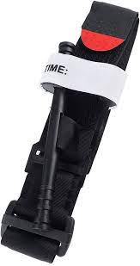
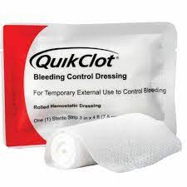
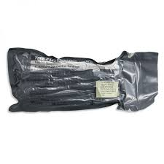
Bleeding Control Tools When More than Direct Pressure is needed
Tourniquet
Israeli Pressure Bandage
QuikClot

Slide 65
Tourniquet

Slide 66
Tourniquet
When to Use
Squirting blood – Don’t hesitate
Direct pressure is not working
An amputation
You are overwhelmed with the amount of blood
When NOT to use
When the bleeding is not on an extremity
When direct pressure is working

Slide 67
How To Apply
High and tight
Prior to tightening the windlass, only one finger should be allowed to fit between the tourniquet and the limb
Tighten the windlass until blood is no longer flowing, squirting, or limb is pulseless
Secure the windlass in the slot
Call 911
https://youtu.be/1izlp-v6WSk

Slide 68
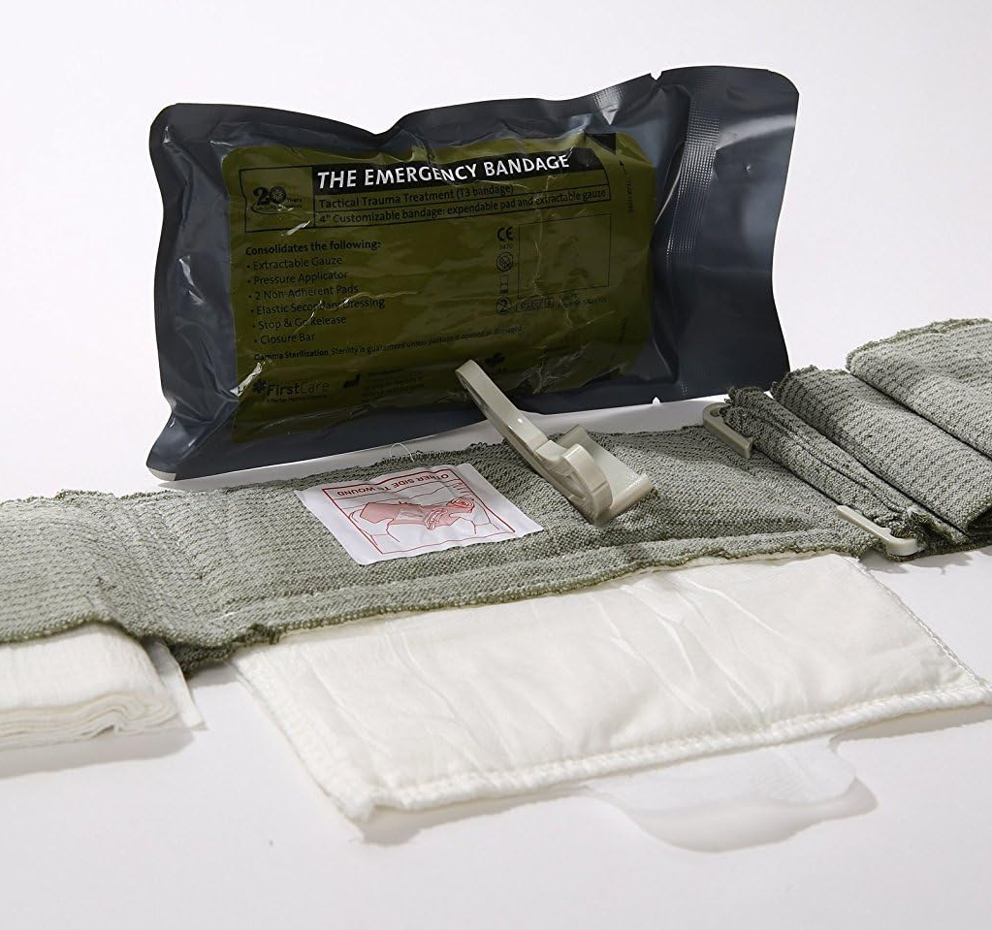
Israeli Pressure Bandage
Uses
Stab wounds
Junctional wounds (near shoulders and groin)
Deep venous bleeds (dark, oozing blood) that do not need a tourniquet
To hold pressure while attending to other injuries
*Not interchangeable with tourniquet *

Slide 69
How To Use an Israeli Pressure Bandage

Slide 70
QuikClot
Advantages
Accelerates clotting
Controls bleeding faster
Strengthens clot formation
Cautions
Not used in place of tourniquet
Not for internal use unless properly trained
How to use
Wipe off blood on surface of bleeding area
Place on bleed
Hold pressure for 5 mins or wrap it with roller gauze or Israeli Bandage
Call 911

Slide 71
Summary
Preparedness mindset…lifelong
Become your own first responder
Disasters: Natural & Non-Natural
Personal and family preparedness
Medical supplies for airway & bleeding control
Get Home Bag / Grab & Go Bag – Great Gifts!

Slide 72
DISASTER PREPAREDNESS
Presented by:
Greg C. Johnston, Commissioner/VP, CE-Bar Fire Dept
Travis County Emergency Services District No. 10

