Slide 1
DISASTER PREPAREDNESS
BECOMING YOUR OWN
FIRST RESPONDER
Presented by CE-Bar Fire Department
Travis County Emergency Services District #10
[This is an editable template for Texas ESDs]

Slide 2
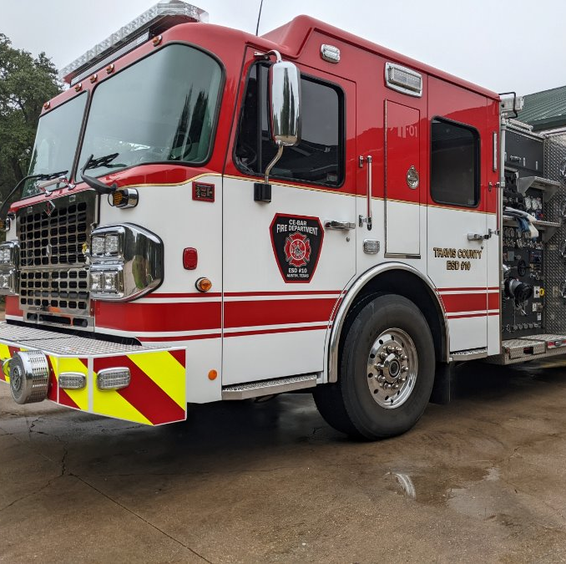
Who We Are
Travis County ESD #10
10 Square Miles
Service 8000 Residents
600 Calls / Year
Various Call Types
4.5 Minute
Response Time

Slide 3
Travis County
Divided into 13 ESDs surrounding the City of Austin
Neighboring departments – Westlake (ESD 9), Lake Travis (ESD 6), Oak Hill (ESD 3), AFD
Auto-aid partnership and response (4-5 agencies for high priority incidents)
Box Alarm – 4 Engines, 2 Trucks, 2 Bat Chiefs
Brush Alarm– 4 Brush Trucks, 2 Engines, 1 Tender, 2 Bat Chiefs
WUI Task Force – 4 Engines, 1 Aerial

Slide 4
ARBC Facility
Restrooms
Water
Breaks
Questions
Emergency Evacuation
Incident Action Plan

Slide 5
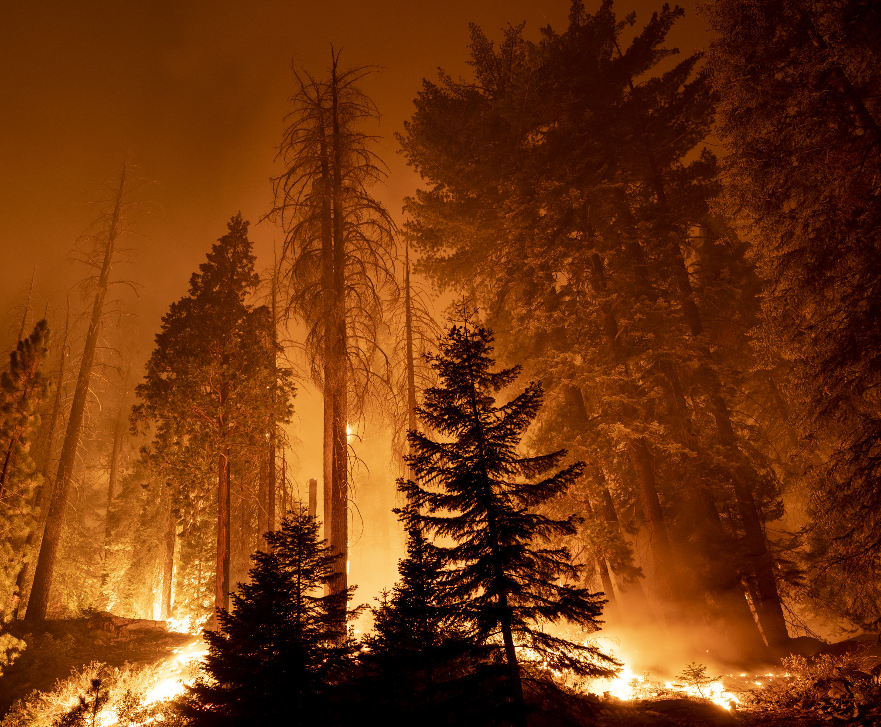
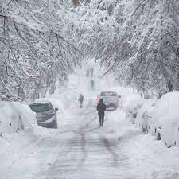
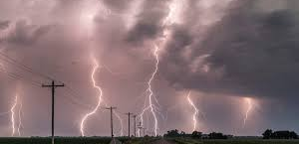
Why We’re Here
Urge YOU to be your own first responder.
Help you prepare for local disasters
Reduce physical, psychological & financial impact of a disaster on our community
Reduce reliance on emergency services when resources are diminished
Reduce the strain on the emergency response system
Better outcome for YOU.

Slide 6
Overview
Preparedness Mindset
Get Home Bags
Recent disasters and considerations specific to each
Individual & family preparedness
Medical supplies for airway & bleeding control
Q & A

Slide 7
Objectives
Understand local emergency service providers and the service they provide
Understand importance of disaster preparation at the individual level, and the need to promote preparedness throughout their communities
Understand how to effectively plan and prepare for various types of disasters & mitigating the negative impact on you, your family, your neighbors and the community

Slide 8
Preparedness Mindset

Slide 11
RECENT DISASTERS

Slide 12
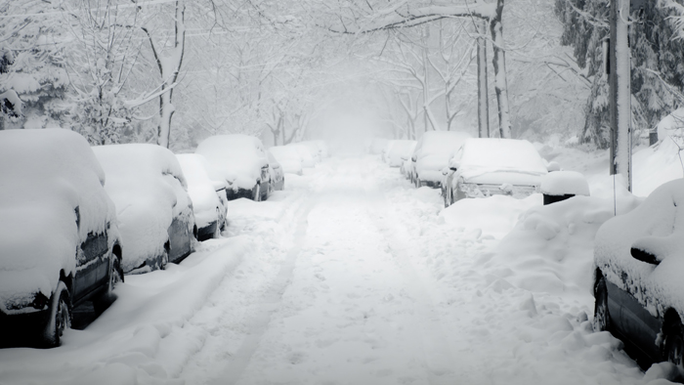
Winter Storms

Slide 13
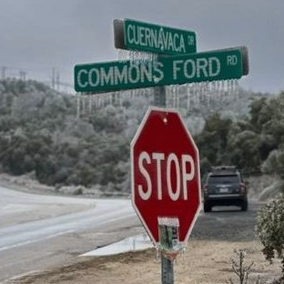
Winter Storms
Hazards
Icy roads
Loss of power
Broken water pipes
Frigid temps / hypothermia
Lack of emergency services / access
Lack of retail / food services
Carbon monoxide poisoning
Residential fires

Slide 14
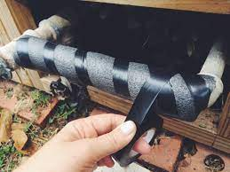
Winter Storms
Preparation
Wrap pipes, drip faucets, shut off water
Water shut off tool at the box!
Maintain generator – serviced, fuel, proper cords, output; Kill A Watt
Adequate blankets & clothing
Stockpile firewood
Emergency kits
Tire chains
Salt / sand entrances

Slide 15
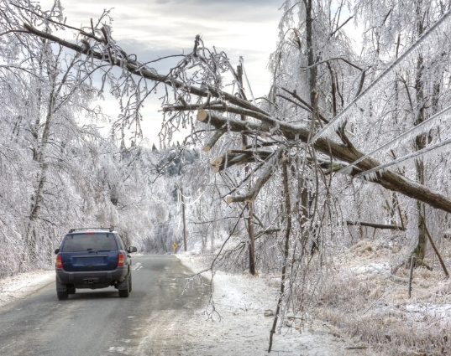
Winter Storms
During the Event
Avoid driving if possible
Travel during day. Have emergency kit in vehicle.
Notify emergency contacts before departing
Inventory emergency supplies
Prevent carbon monoxide poisoning!
Fire extinguishers

Slide 16
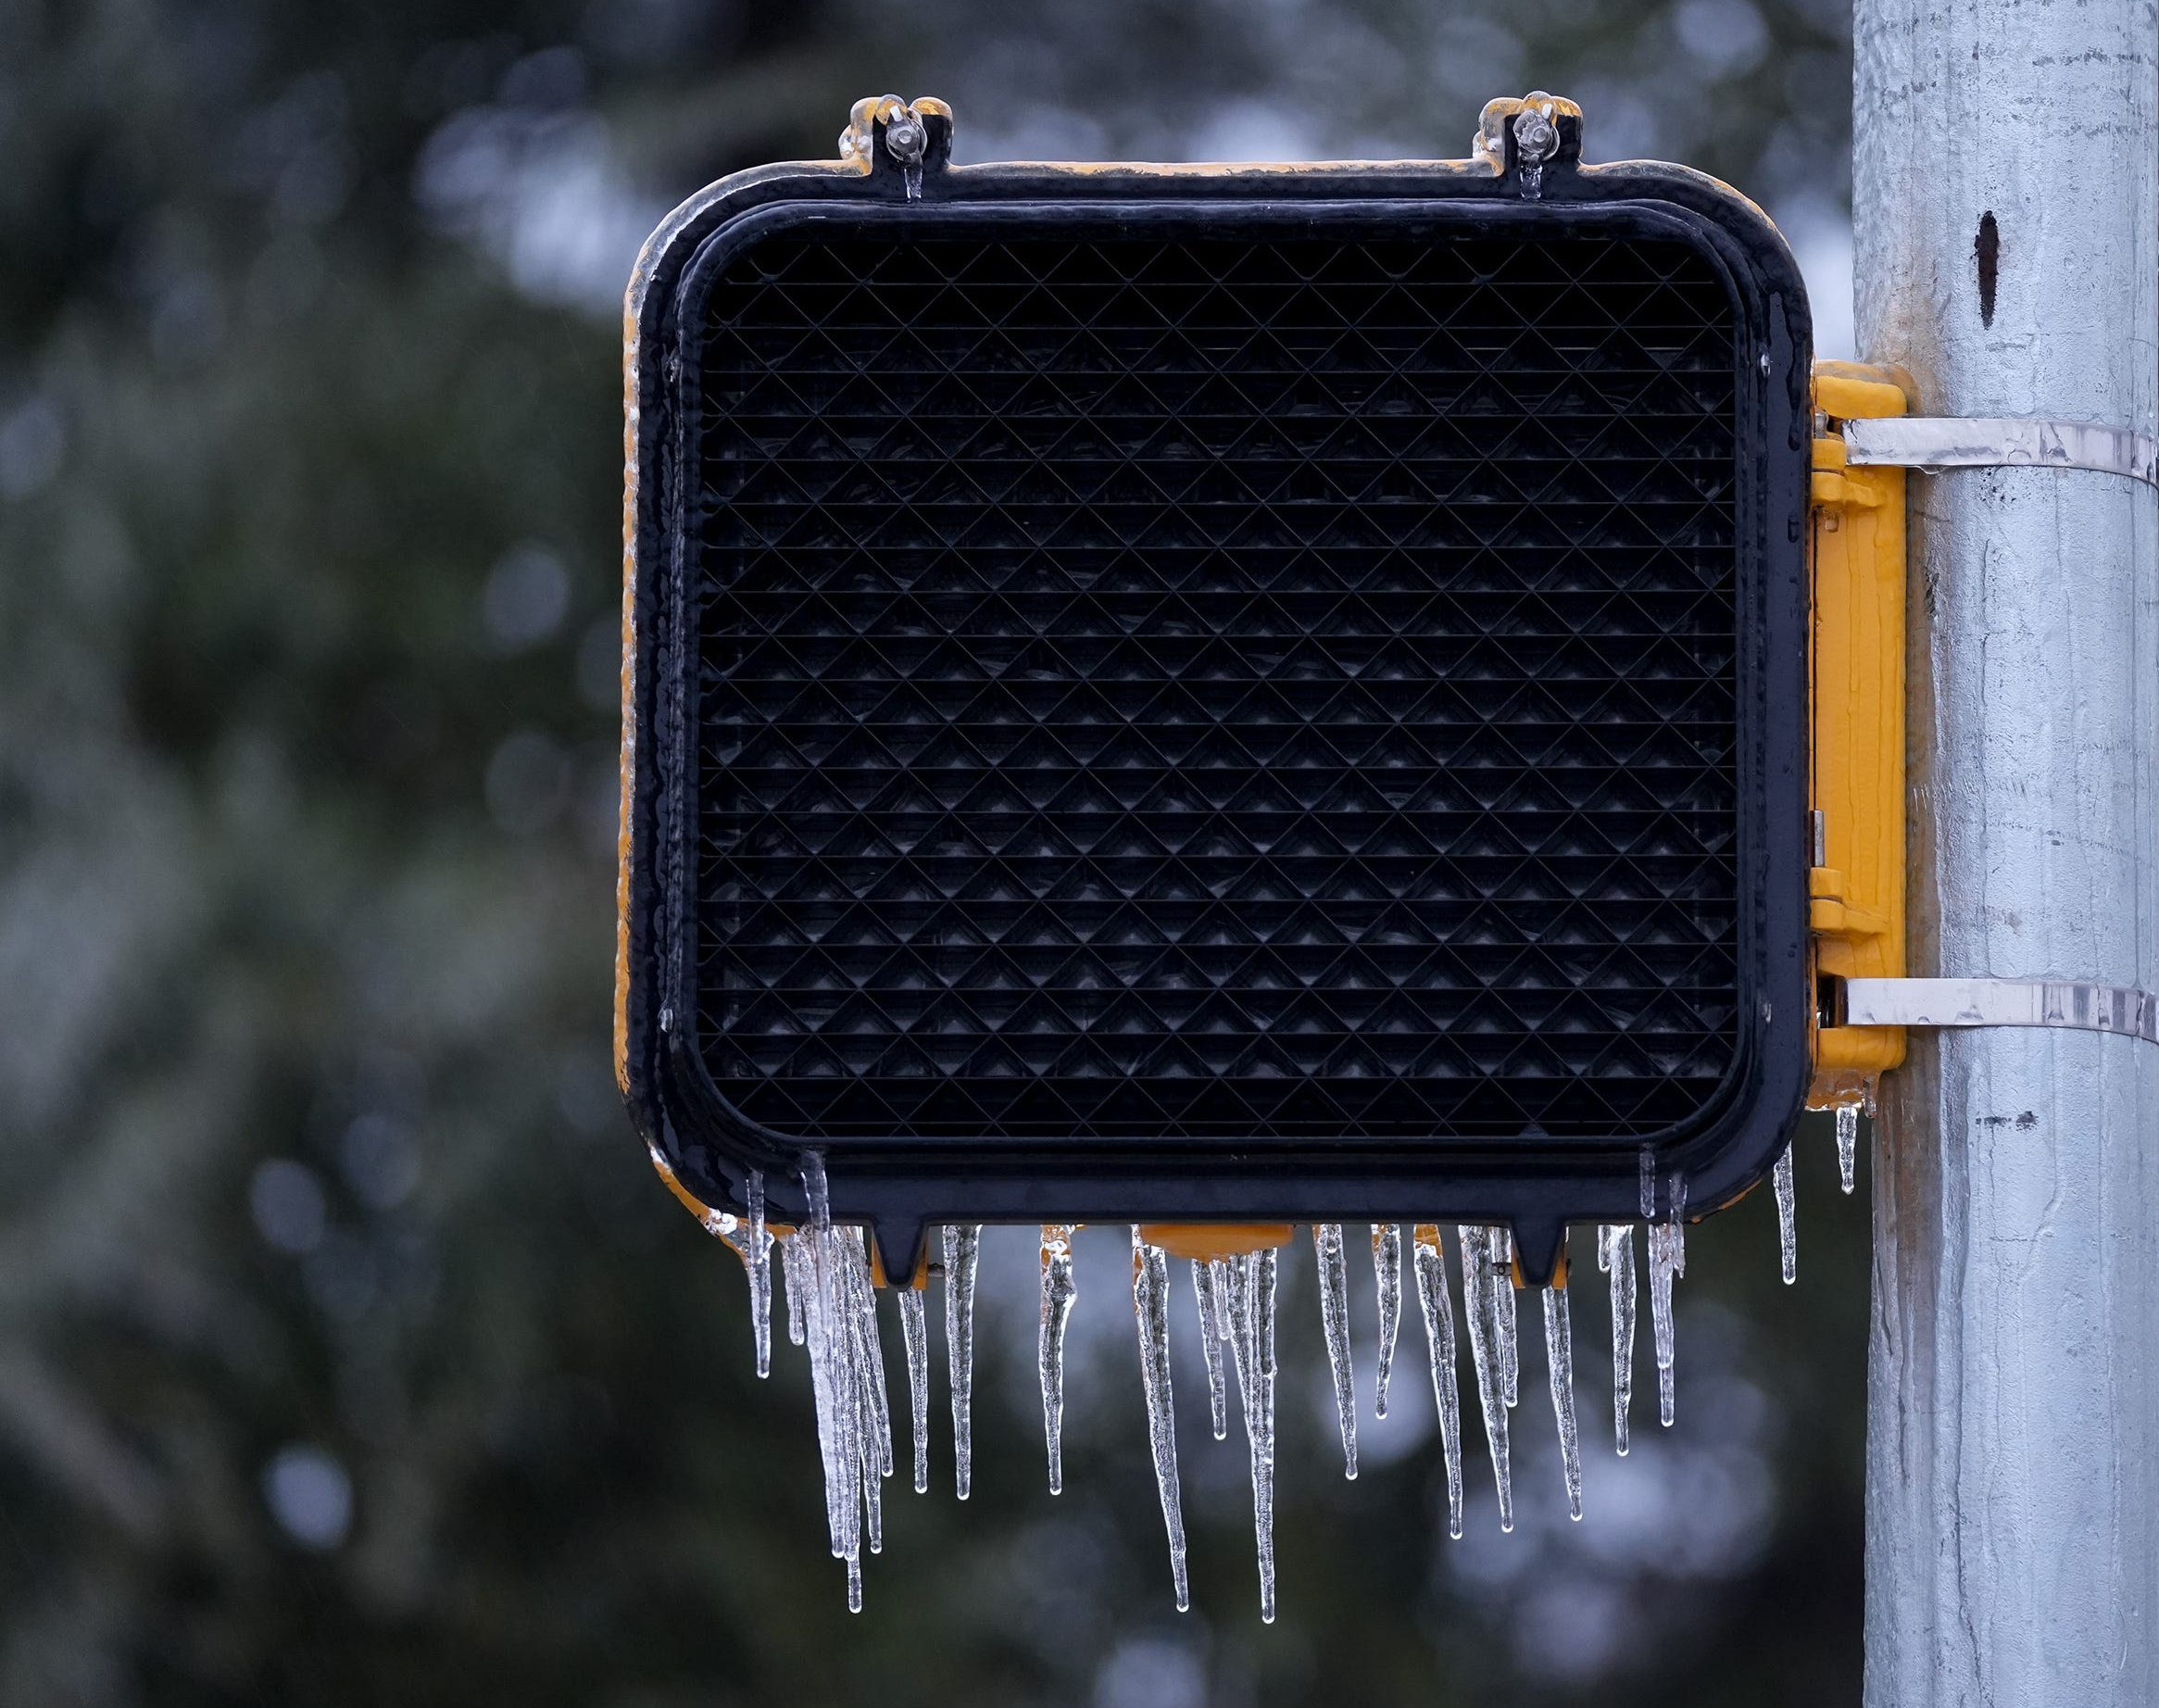
Power Outages

Slide 17
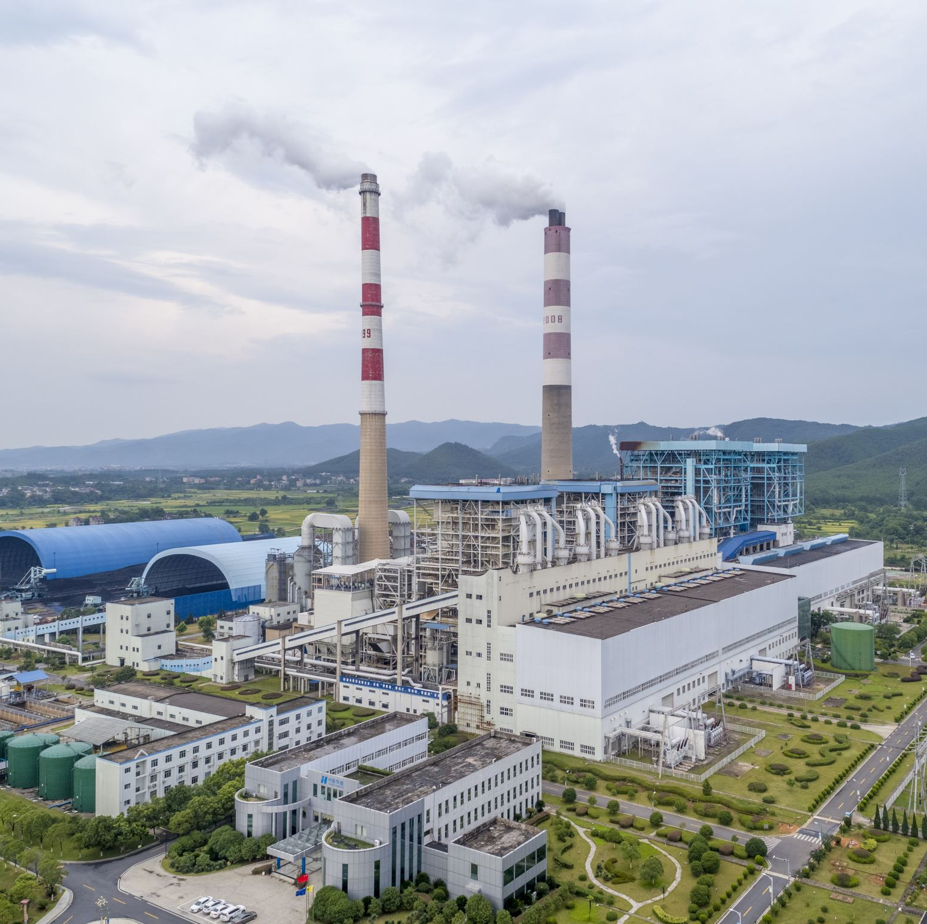
Power Outages
Hazards
Extreme temperatures
Lack of food, water, utilities, information
Carbon monoxide poisoning
Electrical fires when power turns back on
Traffic hazards
Chimney fires (winter)

Slide 18
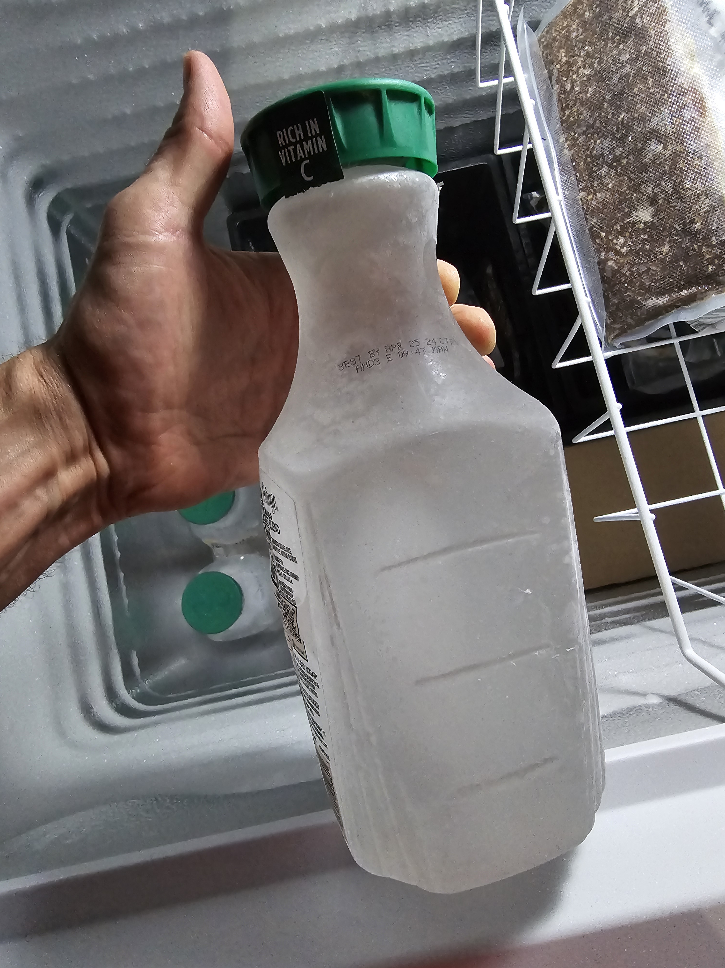
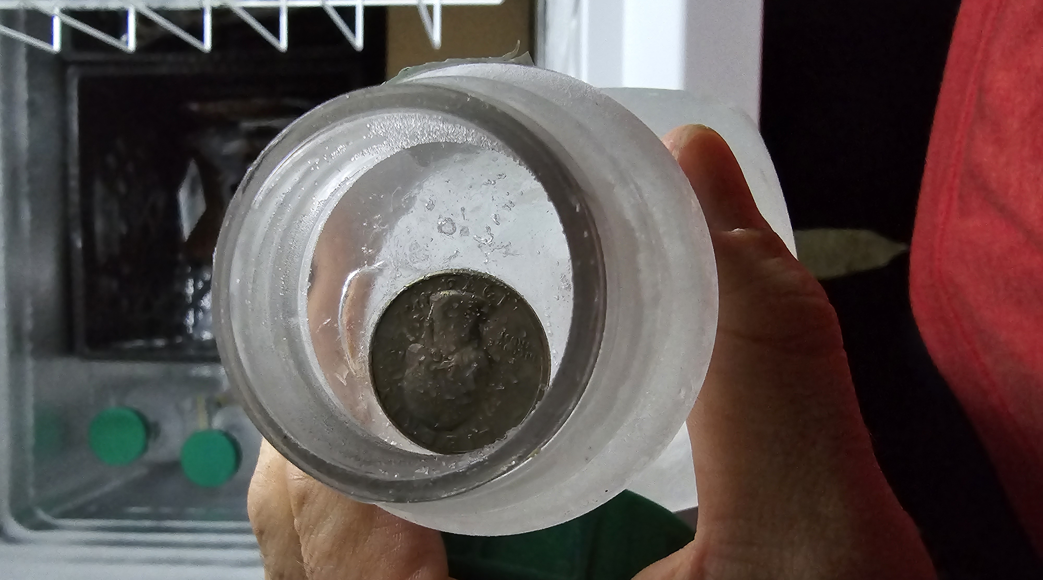
Power Outages
Preparation
Emergency supplies kit
Generator
Transfer switch vs. direct supply
Maintenance
Stabilized fuel
Makeshift ice blocks
Season appropriate equipment
Winter – blankets, firewood, indoor space heaters
Summer – fans, portable a/c units
Chimney serviced and cleaned
Battery powered carbon monoxide detector

Slide 19
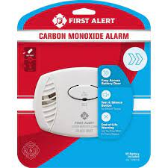
Power Outages
During the Event
Extend food supplies
Eat perishable food first
Closed fridge – 4 hours, full freezer – 48 hours, deep freezer – 72+
Rotating appliances (generator)
Prevent carbon monoxide poisoning
Use generators in well ventilated areas
Place CO detector in common area near where generator is
Decide when to stay and go based on safety, comfort, and health

Slide 20
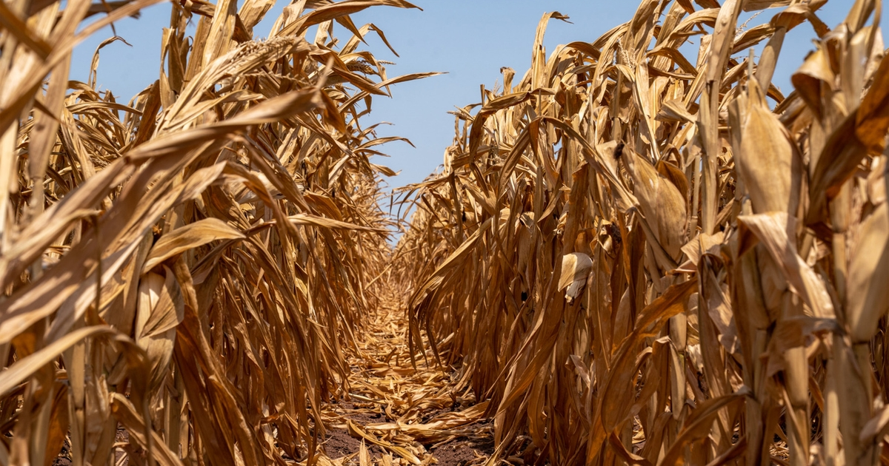
Extreme Heat

Slide 21
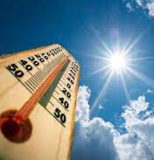
Extreme Heat
Hazards
Dehydration, heat exhaustion, heat stroke
Elderly and young populations at higher risk
Children or pets left in vehicles
Sunburn
Wildfire

Slide 22
Extreme Heat
Preparation
Individual
Drink extra fluids (H2O) w/ electrolytes
Wear moisture wicking garments
Plan strenuous outdoor activities to avoid peak temperatures
Take frequent breaks when working outside
Know the signs of heat emergencies:
Heat exhaustion – sweating, cramping, weakness, dizziness, nausea, vomiting, headache
Heat stroke – high body temp, hot dry skin, headache, confusion
Home
Have A/C serviced before summer; clean/vacuum drain lines
Box fans if you have a power source
Screen material for open doors & windows

Slide 23
Extreme Heat
During the Event
Heat emergencies
Call for emergency services
Move person inside or to shaded area
Remove clothes and cool as best as possible
Cold water immersion is most effective treatment
Home
Have a back-up plan if A/C malfunctions
Never leave people or pets in a closed vehicle
Cooling centers available

Slide 24
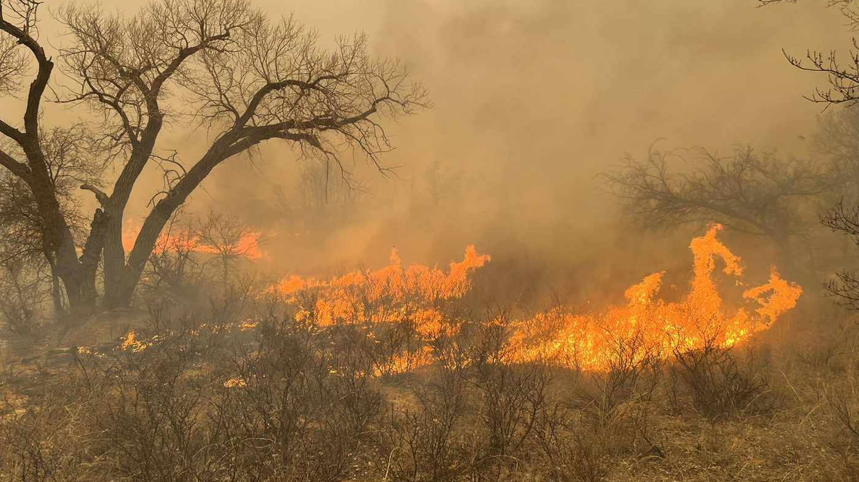
Wildfire

Slide 25
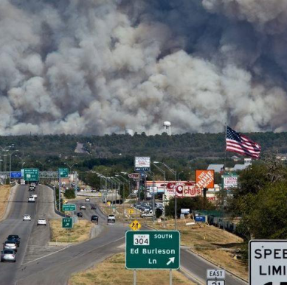
Wildfire
Texas 2022
12,411 Wildfires
650,712 Acres
Travis County 2022
6,725 Acres
202 Homes destroyed

Slide 26
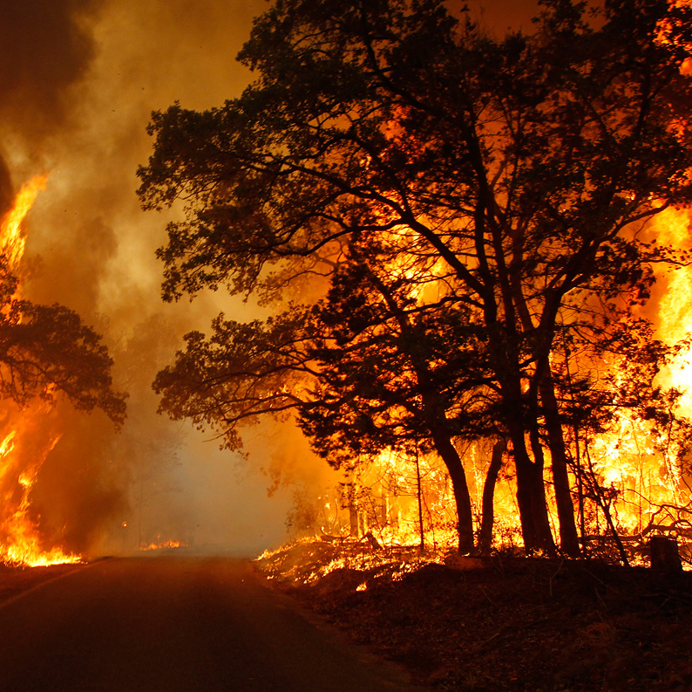
Wildfire
Preparation (individual)
Video all personal property
300+ photos; Cloud storage
List impt things to take
Prioritize it
Emergency kit for your vehicle
Create a family meet/comm plan
Register with alert systems
Know evacuation routes
Evacuate; don’t delay
Notify your emergency contact when leaving

Slide 27
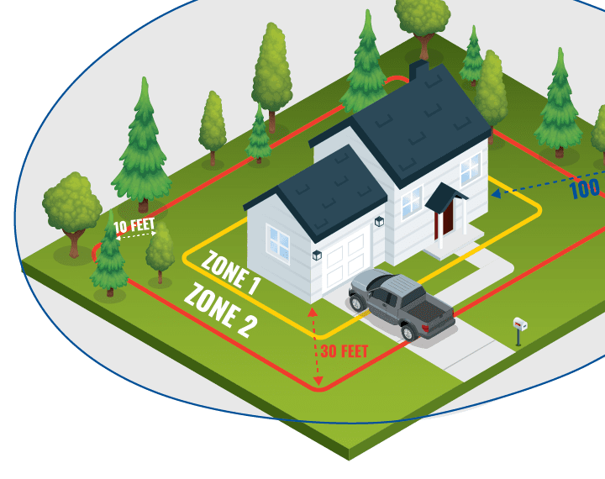
Wildfire
Preparation (home)
Mitigation programs – ReadySetGo, Firewise, TexasWildFireRisk.com
Watch Duty wildfire app
How you prepare impacts FD ability to defend your home
Defensible space, trees, roofs, gutters, building materials, propane tanks, access

Slide 28
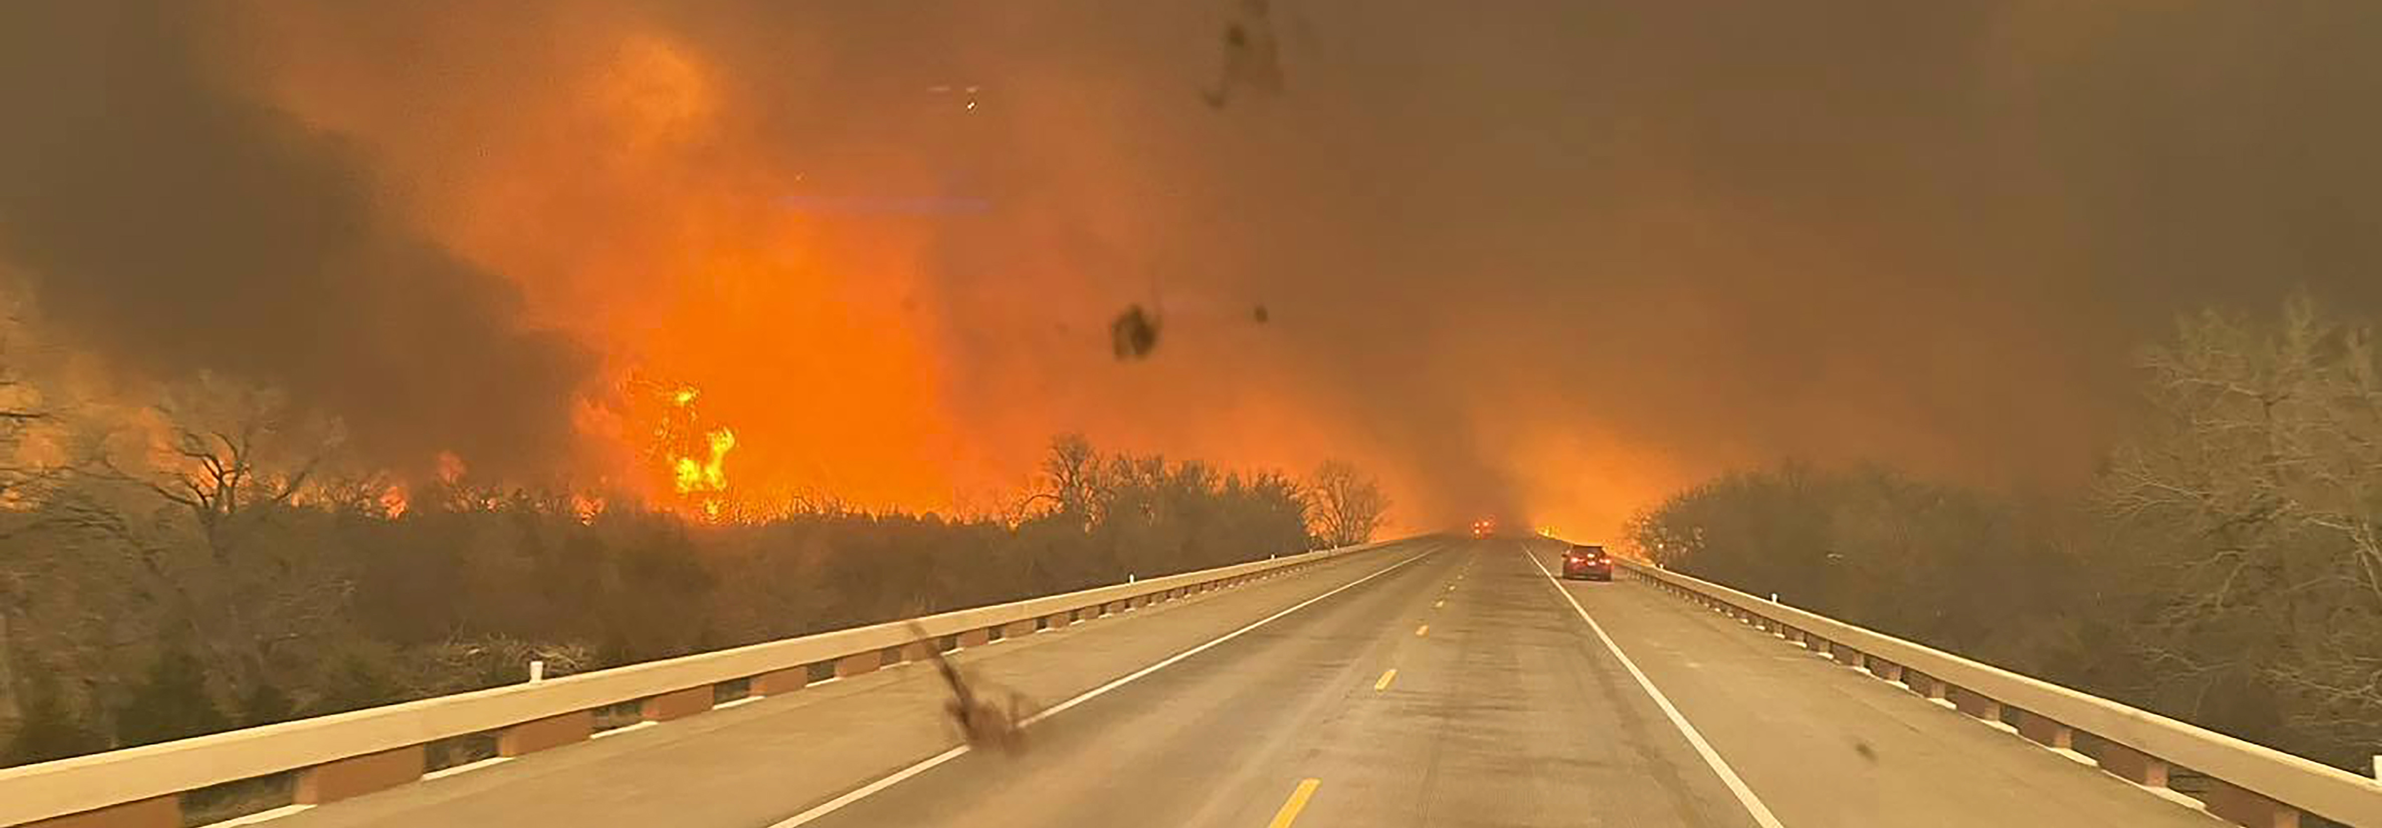
Wildfire
During the Event
Continuously monitor disaster updates
Evacuate when directed to by emergency personnel
Notify your emergency contact that you are leaving
Do not leave sprinkler systems running
Anticipate evacuation problems

Slide 29
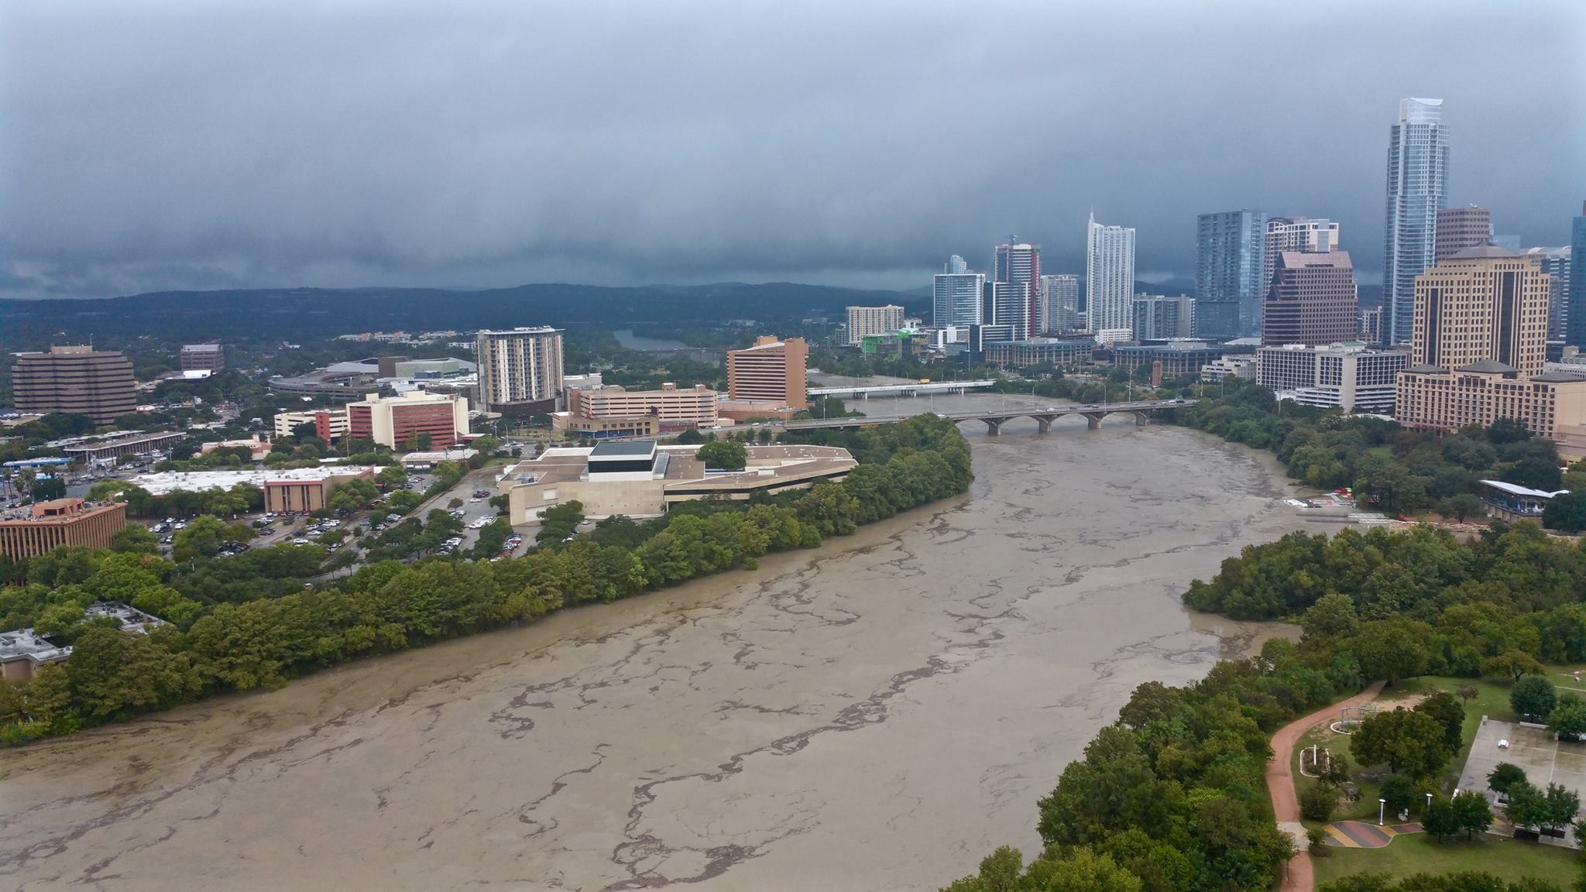
Severe Storms & Flooding

Slide 30
Severe Storms & Flooding
Hazards
Often underestimated
Flood water is fast & powerful!
High winds often lead to down trees
Blocked roadways
Lighting strikes and residential fires

Slide 31
Severe Storms & Flooding
Preparation
Maintain trees on property
Clean drains and gutters
Maintain your generator & top off fuel
Install / inspect smoke detectors,10-year lifespan
Have an emergency kit
Know your neighborhood flood areas
Monitor weather forecasts

Slide 32
Severe Storms & Flooding
During the Event
Stay indoors
Avoid driving if possible
Check ATXflood.com for flood map
Do not cross roads with water over it
Do not drive over or handle any down lines

Slide 33
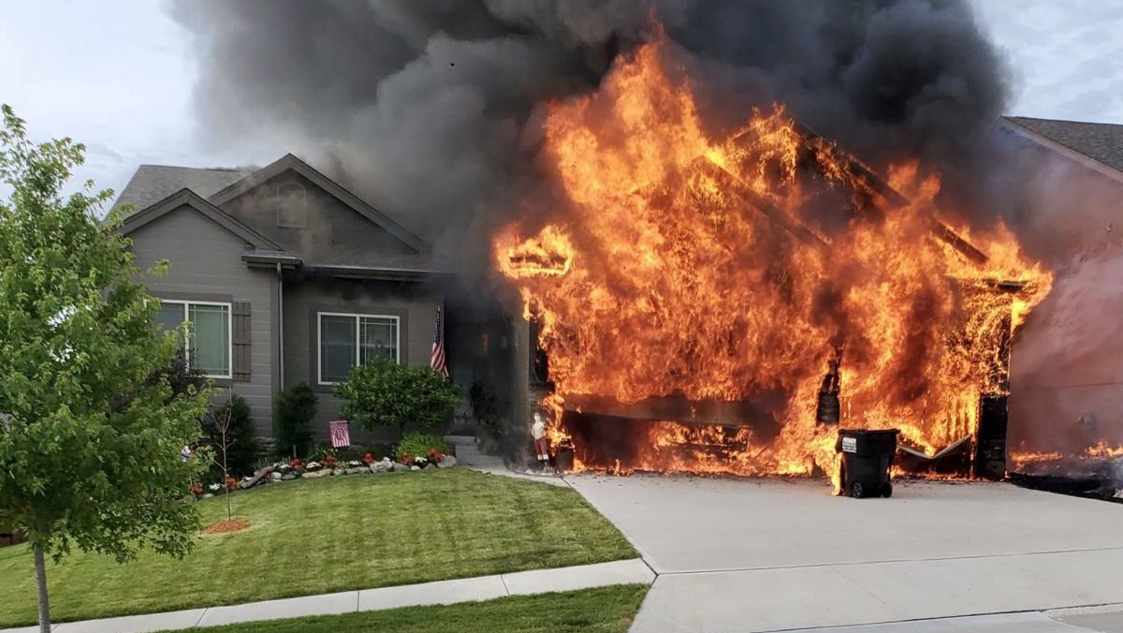
Residential Fires

Slide 34
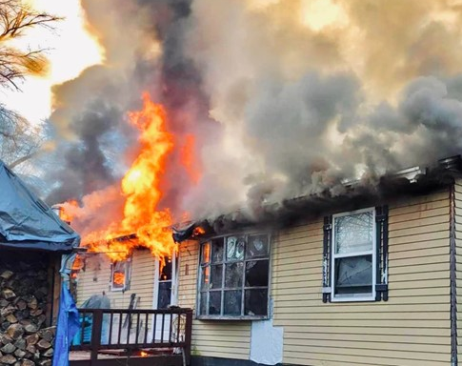
Residential Fires
2022 National Statistics
3,000 deaths
10,000 injuries
$10B in damage
375,000 house fires = 1/90 seconds
70% of deaths are in residential structures
Leading cause = 47% cooking

Slide 35
Ignition to Flashover Natural vs Synthetic Furnishings
https://youtu.be/87hAnxuh1g8

Slide 36
Residential Fires
Preparation
Install detectors outside every living space on every floor, in attic & garage
Change batteries in detectors every 6 months (time change)
Avoid using open flame candles
Ensure children do not have access to matches / lighters
Clean chimney at least every 10 years*
Have multiple fire extinguishers, mounted. Know how to use them.
Develop a family fire safety plan & meeting place (mailbox?)
Practice fire drills regularly

Slide 37
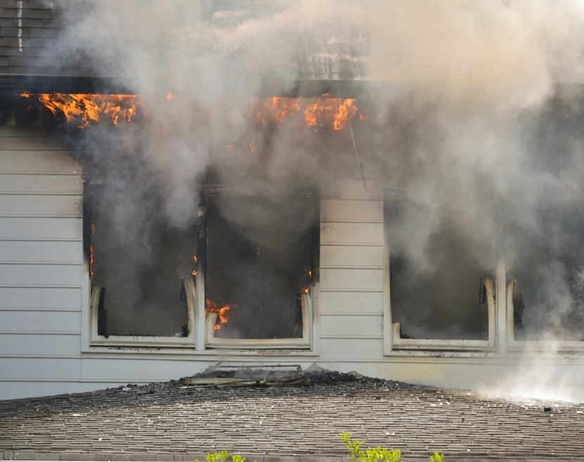
Residential Fires
During the event
Call 9-1-1 immediately
Use extinguishers for small fires only
Do not use water on kitchen / grease fires
When in doubt, get out
Stay low and go
If unable to get out, shut and seal door and move to the window
Flagger by road
Report accountability of occupants to FD immediately

Slide 38
PERSONAL & FAMILY PREPAREDNESS

Slide 39
Make a Plan
Family Communications
Family phone numbers, addresses, socials & medical info
Emergency contacts in case of separation or loss of phone – local & out-of-town
Important phone numbers – doctors, schools, employers, etc
Family code words: (a) I’m ok “daytime” or (b) I’m in distress “nighttime”
Meeting Place
Select a meeting place for at home, local & out-of-town
Establish meeting places in two directions
Save locations to map ahead of time

Slide 40
Make a Plan
Evacuation / Shelter In Place
Charge phones, fill fuel tank ahead of time, load gear
Plan what situations you’ll stay and for how long
Realistic expectations based on supplies and conditions – weather, utilities, comfort & health
Risk vs Benefit – 911 may be strained
Set triggers. Avoid indecision.
Plan 2 ways out
Leave early. Don’t delay.
Share your evacuation plan with emergency contacts
Follow instructions from emergency services

Slide 41
Build an Emergency Kit Get home bag, Go bag, Bug out bag, etc.
Build kits before the season
Build kits for both sheltering and evacuating
Ensure kits are season appropriate
Have a pre-made list for quick packing during evacuations
Tailor to your family’s needs
Inspect kits every 6 months and replace items as needed

Slide 42
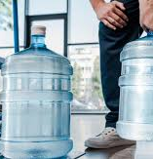
Build an Emergency Kit
Sheltering in Place (7 days supply)
Water – 1 gallon per person per day
Fill bathtub: WaterBob, Aquapod, Alexapure. Gifts!
Nonperishable, canned, freeze-dried food
Baby items – milk, formula, bottles, diapers, wipes, rash ointment
Pet supplies – food, medications, leash
First aid kit
Rx medications
Hearing or vision products
Flashlights w/ extra batteries
Battery powered or hand crank radio; AM/FM w earphones

Slide 43
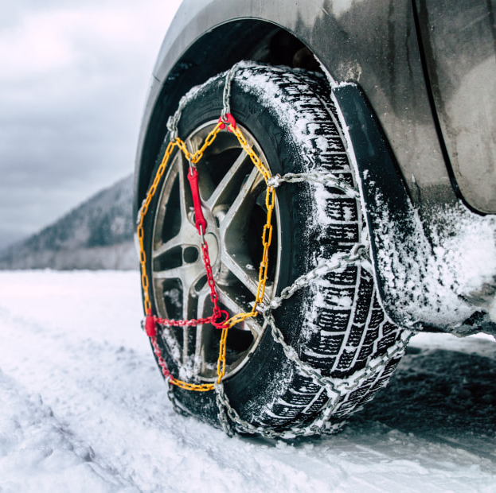
Build an Emergency Kit
Shelter in Place (continued)
Hand sanitizer
Plain bleach; check date
P&G Purifier of Water packets
Whistle
ABC extinguisher
Lighter or matches
Cash; it’s free!
Firewood & starters (winter)
Sleeping bags or warm blankets (winter)
Tire chains & cables (winter)

Slide 44
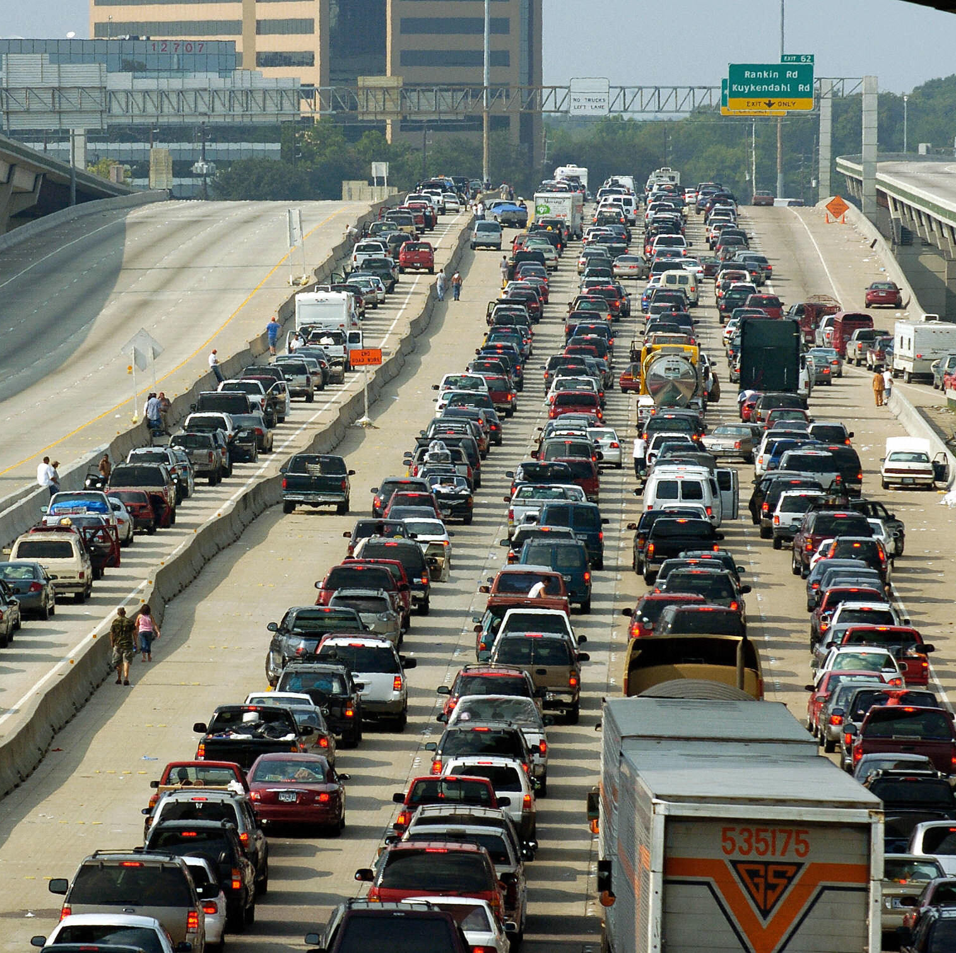
Build an Emergency Kit
Evacuating by Car
Fuel tank FULL
Water
Potty; Pullups?
Nonperishable food; can opener
Baby supplies
Pet supplies
First aid kit; Rx medications
Phones & chargers
Hearing or vision products
Flashlights w/ extra batteries

Slide 45
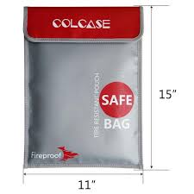
Build an Emergency Kit
Evacuating by Car (continued)
Cash
Whistle
Road maps
Spare clothes (season appropriate)
Essential toiletries
Documents – DL, passport, SSN, birth certificate, legal docs, family photos, insurance cards, prescriptions & dosages
Blankets (winter)
Roadside equipment – jumper cables, jack, spare tire

Slide 46
Know Your Neighbors
Identify at risk population that may go unnoticed
Encourage others to prepare and seek help when needed
Reduces strain on emergency services
Bystander aid is often faster than responders
You are the first responder until help arrives!
Community ties, build a network & improve mental health

Slide 47
Stay Informed
Public Alerting Systems
WarnCentralTexas.org – must register
Accessible Hazard Alert System (AHAS) – deaf, blind, hard of hearing
KLBJ 590 AM / 99.7 FM Broadcast EAS
FEMA - Integrated Public Alert & Warning System (IPAWS)
Mobile Apps
FEMA
City of Austin: ReadyCentralTexas
STEAR – State of Texas Emergency Assistance Registry – must register
National: Ready.gov

Slide 48
Stay Informed
Media
Facebook.com/TravisCoEmergencyServices
211texas.org – emergency updates & health and human services
ATXfloods.com – flood map
tfswildfires.com – wildfire map
Drivetexas.org – road closure map
Watch Duty - wildfire tracking app

Slide 49
Medical Supplies
For Airway and Bleeding Control

Slide 50
Airway Overview
Foreign Body Airway Obstructions
Opioid OD; NARCAN

Slide 51
Airway Obstructions
Things to Know For a Foreign Body Airway Obstruction
Usually little kids, people that don’t fully chew food, those with swallowing difficulties
Laughter while eating
What to do if the person is STILL MOVING AIR?
NO BLIND FINGER SWEEPS
4-6 mins of no O2 before brain injuries occur
Treatments
Abdominal thrust/ Back Blows
Life Vac
Call 911

Slide 52
Life Vac Home Kit: For Choking
Creates a Negative Pressure to “vacuum” a foreign object out of the air
Comes with an adult mask, adult practice mask, and pediatric mask
https://youtu.be/ENdY2j2xlbI

Slide 53
Directions
Connect Mask to device
Place on face with a good seal covering the mouth and nose
Push handle towards face
Pull handle towards the ceiling while maintaining a good mask seal

Slide 54
Opioid OD (Fentanyl, Heroin, Pain Meds)
The patient will be breathing slowly or not at all
If not breathing check for a pulse, if no pulse start CPR
Opioid Triad
Constricted pupils, unconscious, slow or absent breathing
Treatment
Narcan
Call 911

Slide 55
Bleeding Control Overview
Normal bleeding is stopped by 5 mins of direct pressure.
5 mins of pressure will not work when the bleeding is:
Arterial – Bright RED and squirting
Deep Venous Bleeds – requires more intense pressure or a hemostatic agent (QuikClot)

Slide 56
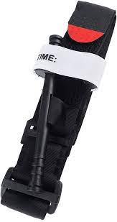
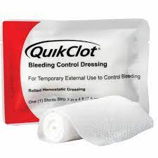
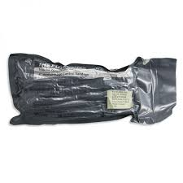
Bleeding Control Tools When More than Direct Pressure is needed
Tourniquet
Israeli Pressure Bandage
QuikClot

Slide 57
Tourniquet

Slide 58
Tourniquet
When to Use
Squirting blood – Don’t hesitate
Direct pressure is not working
An amputation
You are overwhelmed with the amount of blood
When NOT to use
When the bleeding is not on an extremity
When direct pressure is working

Slide 59
How To Apply
High and tight
Prior to tightening the windlass, only one finger should be allowed to fit between the tourniquet and the limb
Tighten the windlass until blood is no longer flowing, squirting, or limb is pulseless
Secure the windlass in the slot
Call 911
https://youtu.be/1izlp-v6WSk

Slide 60
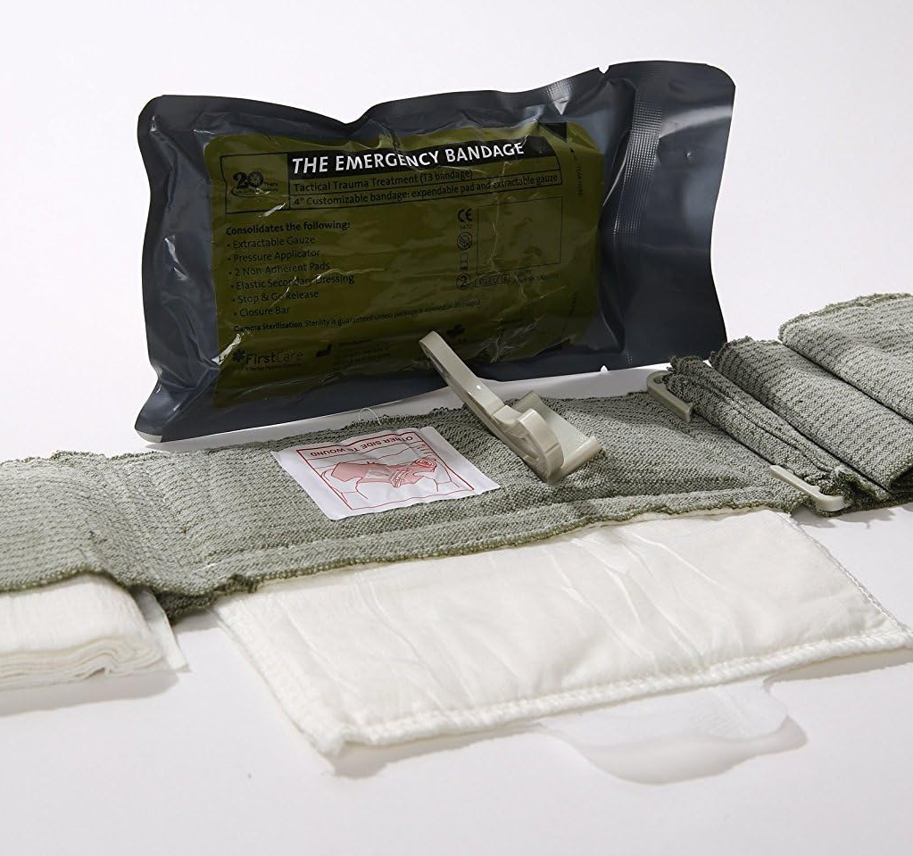
Israeli Pressure Bandage
Uses
Stab wounds
Junctional wounds (near shoulders and groin)
Deep venous bleeds (dark, oozing blood) that do not need a tourniquet
To hold pressure while attending to other injuries
*Not interchangeable with tourniquet *

Slide 61
How To Use an Israeli Pressure Bandage

Slide 62
QuikClot
Advantages
Accelerates clotting
Controls bleeding faster
Strengthens clot formation
Cautions
Not used in place of tourniquet
Not for internal use unless properly trained
How to use
Wipe off blood on surface of bleeding area
Place on bleed
Hold pressure for 5 mins or wrap it with roller gauze or Israeli Bandage
Call 911

Slide 64
Summary
Preparedness mindset
Get Home Bag
Disaster considerations; Discuss “What if…”
Personal and family preparedness
Medical supplies for airway & bleeding control

Slide 65
DISASTER PREPAREDNESS
Presented by CE-Bar Fire Department
Travis County Emergency Services District #10

